Slide 1
ADVANCED LEVEL
OPERATIONAL RISK MANAGEMENT
Notes:
You’ve all been through briefings on the theory behind risk management, and why it is an effective tool for preventing mishaps.
Most of those briefings were probably pretty technical, a little boring.
At the end, you probably understood the way it works, but you didn’t really know how to go out and use it in all your activities.
This very quick briefing is meant to tell you the most important parts of risk management,
With some easy tools you will be using during the next few days.

Slide 2
Review
Operational Risk Management (ORM) is a logic-based, common-sense approach to making calculated decisions on human, material and environmental factors associated with any type of activity. It’s a six-step process to manage inherent risk.
ORM does not replace regulations or allow for disregard of existing regulations. ORM fills the gap between real-world conditions and scenarios which are not already covered under regulation or law. Use of ORM does not guarantee mission success but provides a standard methodology for avoiding or reducing mishaps.
If your have forgotten certain aspects of ORM, go back over the two previous courses before proceeding. Otherwise here is a refresher of the main points of ORM.

Slide 3
Operational Risk Management Review
The 4 principles of ORM are: Accept no unnecessary risks Make risk decisions at the appropriate level Accept risk when benefits outweigh the cost Integrate ORM into CAP at all levels | The 5 steps of ORM are: Identify the Hazards Assess the Risks Analyze the Risk Control Measures Make Control Decisions and implement Supervise and Review
The 5M Model Man Media Machine Management Mission | The 3 levels of ORM Time-Critical Deliberate Strategic

Slide 4
What’s next?
This advanced course will enhance your success by increasing knowledge of the ORM process.
There are 7 hazard identification tools presented to help you uncover areas of potential hazards as you work through the ORM’s first step.
The ORM’s steps 2-6 will also be explored in greater detail.

Slide 5
Step 1 – Identify the Hazards
To identify the hazards, you: analyze the mission, list the hazards and list the causes.
Identify the hazards on all of CAP’s assets:
Aircraft
Vehicles
Personnel
Equipment
Identify the hazards to all operational levels:
National
Region
Wing
Group
Squadron & Flights

Slide 6
Step 1 – Identify the Hazards
These 7 primary tools are the backbone in identifying hazards in any CAP operation.
The 7 Primary Hazard ID Tools:
Operations Analysis
Preliminary Hazard Analysis
“What If” Tool
Scenario Process Tool
Logic Diagram
Change Analysis
Cause & Effect Tool

Slide 7
Step 1 – Identify the Hazards
Operations Analysis Tool
A big picture look at what is expected to happen. This helps overcome major weakness by focusing on a few intuitively risky areas. Evaluates all elements of operation for potential sources of risk.
Put steps of process on index cards or “sticky” notes so they can rearrange & easily add or eliminate areas or events
Project management software to create simple flow chart
Itemizes chronological a list of major events of an operation and then each event can be broken down into sub-events

Slide 8
Step 1 – Identify the Hazards
Preliminary Hazard Analysis Tool
Used to identify hazards requiring more in-depth identification
Easy to use and takes very little time
Provides initial overview of hazards present in overall operational flow
Briefly considers risk in every aspect
Can serve only as a hazard ID tool for low risk or routine
In higher risk operations, use to focus and prioritize risk
Used in virtually all ORM except time critical operations
Usually based on the operational analysis tool results
Activity or Event | Hazard
Step 1 | Hazard 1 Hazard 2
Step 2 | Hazard 1
Step 3 | Hazard 1 Hazard 2

Slide 9
Step 1 – Identify the Hazards
“What If” Tool
One of the most powerful hazards ID tools. Typically used after the operations analysis and preliminary hazard analysis. Designed to add structure to the intuitive and experiential expertise of operational personnel.
Especially effective in capturing hazard data about failure modes
Can be used on time critical applications
Captures input of operational personnel in brainstorming–like environment. Visualize expected operational flow in chronological order from beginning to end and then select a segment to focus on. Use “Murphy’s Law” to anticipate failures and worse-case scenarios.

Slide 10
Step 1 – Identify the Hazards
Scenario Process Tool
Identify hazards using imagination and visualization to reveal unusual hazards. Construct a mental movie to walk thru events immediately ahead of and of the actual hazard.
Visualize twice; once as they should be, then with worse credible scenarios
Ability to link two or more individual hazards makes it one of the best tools
Entertaining, dynamic and motivating for even the most junior personnel
Best to follow flow of events outlined in the operational analysis tool
Can be only tool needed in time critical events

Slide 11
Step 1 – Identify the Hazards
Logic Diagram Tool
The most comprehensive and detailed of the hazard identification tools. Most effective with complicated operations where hazards are interlinked in various ways. Tree-like structure establishes the connectivity and linkages that may exist between hazards. It’s graphics captures and correlates the hazards data produced by the other tools.
Three major types of logic diagrams
- Positive diagram. Highlights factors that must be in place if risk is to effectively controlled
- Event diagram. Focuses on one event, often a failure identified with “what if” tool, and examines possible outcomes
- Negative diagram. Selects a loss event and analyses various hazards that could combine to produce that loss
Excellent place to use the 5M Model – Interaction between Man, Machine, Media, and Management to produce Mission success.

Slide 12
Step 1 – Identify the Hazards
Logic Diagram Tool
s
EVENT
PRIMARY CAUSE
SUPORTING CAUSE
SUPORTING CAUSE
Example of Generic
Logic Diagram
ROOT CAUSE
PRIMARY CAUSE
SUPORTING CAUSE
SUPORTING CAUSE
PRIMARY CAUSE
SUPORTING CAUSE
SUPORTING CAUSE

Slide 13
Step 1 – Identify the Hazards
Logic Diagram Tool
s
Successful drive to SAREX
Man
Physically Ready
Mentally Ready
Emotionally Ready
Example of Positive
Logic Diagram
Legally Ready
Machine
Mechanically Ready
Safety Equipment Ready
Media
Weather Conditions
Road Conditions
Road Structure
Management
Traffic Rules
Enforcement

Slide 14
Step 1 – Identify the Hazards
Logic Diagram Tool
Speeding
Example of Negative
Logic Diagram
Road Rage
Weather
Automobile
Accident
Inattention
Road Conditions
Reckless Driving
Mechanical Failure
Falling Asleep

Slide 15
Step 1 – Identify the Hazards
Change Analysis Tool
Used to analyze the hazard implications of planned or unplanned changes.
Focuses only on the changed aspect of event
Compare the current situation with the previous one
Only tool needed if operation has been subjected to in-depth hazard analysis
Best accomplished using a simple worksheet

Slide 16
Step 1 – Identify the Hazards
Change Analysis Tool
Factors | Evaluated Situation | Comparable Situation | Difference | Significance
What Equipment Building Safety issues
Where In the process Location
When In time In sequence
Who Personnel Customer

Slide 17
Step 1 – Identify the Hazards
Change Analysis Tool
Factors | Evaluated Situation | Comparable Situation | Difference | Significance
Task Procedure Goal
Working Conditions Duty day Weather
Trigger Event
Managerial Controls Chain of Command Hazard Analysis Risk Monitoring
To use the worksheet: Start at the top of the left column and work across. Consider the current situation. Compare it to a previous situation in a similar operation. Identify differences and determine if changes will cause any significant hazards. Modify worksheet to operation specifics.

Slide 18
Step 1 – Identify the Hazards
Cause and Effect Tool
Brainstorming is used to identify causes, using the 5M Model, that may lead to a hazard.
Uses the “Fishbone” or Ishikawa Diagram. Named after the inventor, Professor Kaoru Ishikawa of Tokyo University, a highly regarded expert in quality management.
Illustrates hierarchical relationships between possible causes according to their level of importance
Can be drawn on flip chart or whiteboard
Variation of the Logic Diagram

Slide 19
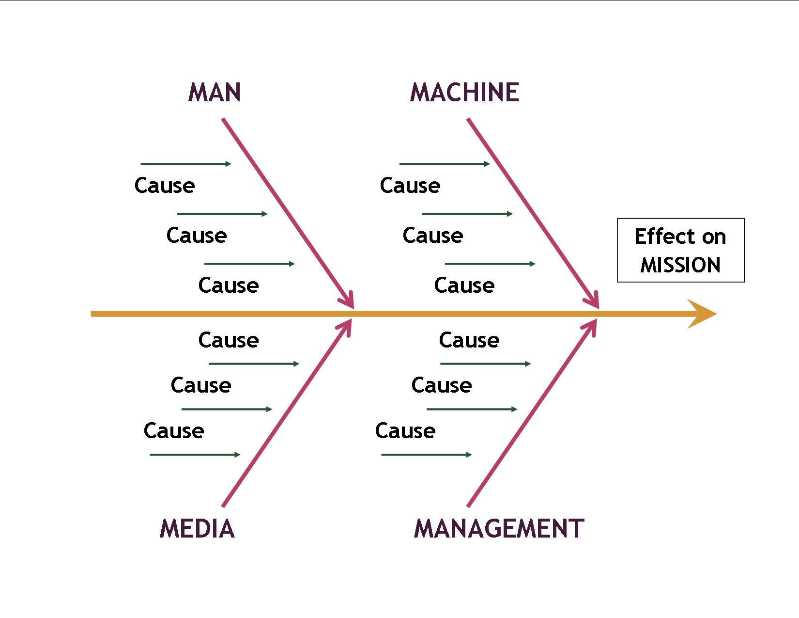
Step 1 – Identify the Hazards
Cause and Effect Tool
“Fishbone” Diagram

Slide 20
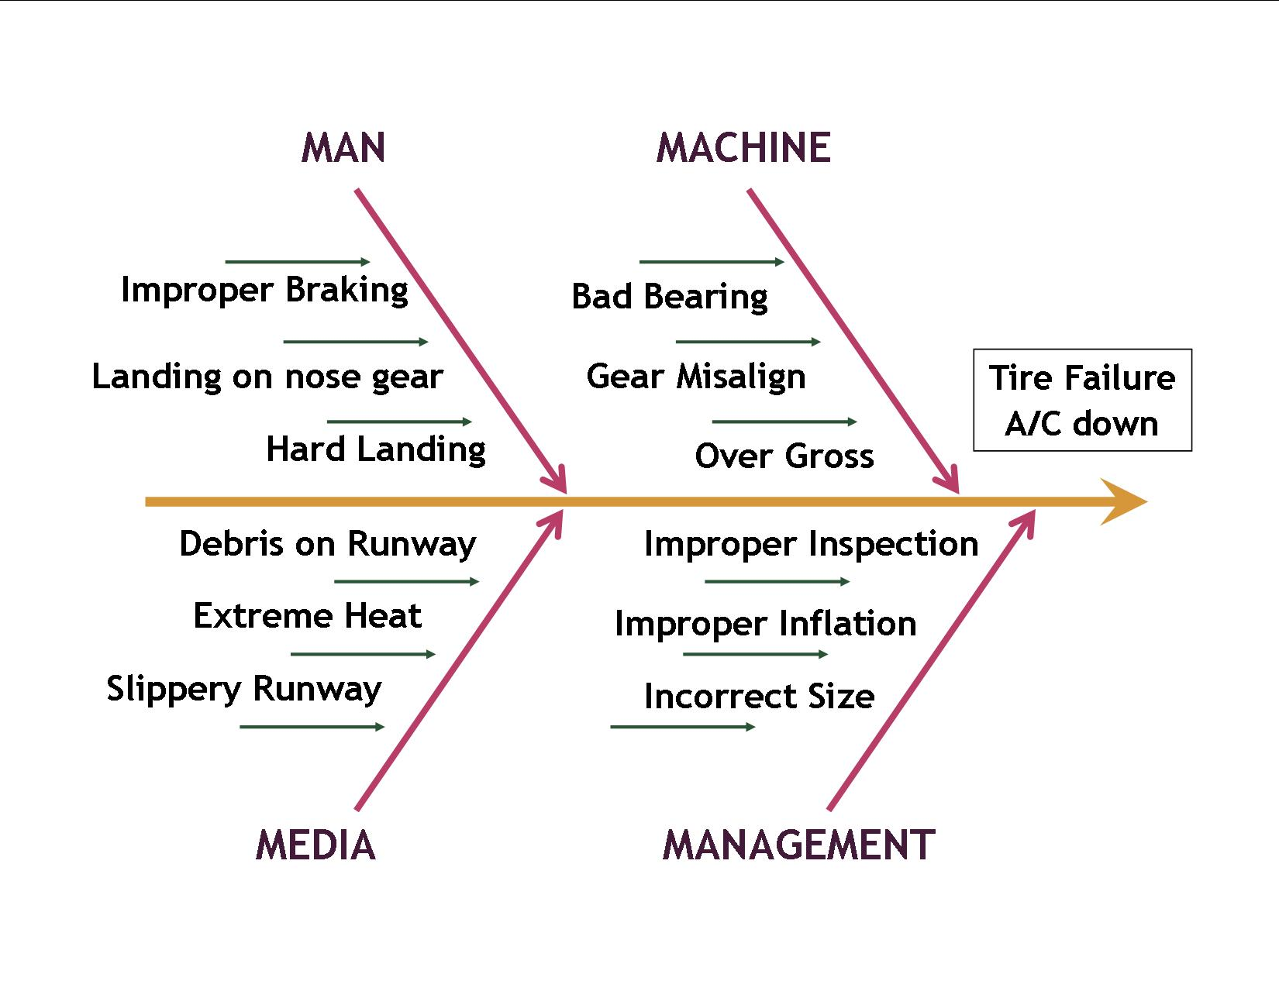
Step 1 – Identify the Hazards
Cause and Effect Tool
“Fishbone” Diagram

Slide 21
Step 1 – Identify the Hazards
Specialty Hazard ID Tool
USAF identifies 14 specialty hazard ID tools used to enhance the primary tools.
Three are covered here:
The Mapping Tool
The Interface Analysis Tool
Mission Protection Tool
Road maps, terrain maps, airport diagrams, facility blueprints and schematics are used to identify sources of hazards
Potential hazards are steep terrain, creeks and streams, winding mountainous roads, desert areas, flammables, and high voltage areas
Locate energy sources and other hazards on the map and note distance to operation and resources

Slide 22
Step 1 – Identify the Hazards
Specialty Hazard ID Tool
The Mapping Tool
Someone who has seen the map object is an invaluable resource to consult. An on-site inspection should occur before the operation begins.
Incorporate these hazards into other Primary Hazard ID Tools

Slide 23
Step 1 – Identify the Hazards
Specialty Hazard ID Tool
The Interface Analysis
Used to uncover potentially hazardous linkages or interfaces between unrelated activities.
A SAR/SAREX at a local airport may impose hazards to the local airport operations, facilities and pilots.
CAP operations at a airport not used before is a good cue to use the interface analysis and the Primary Hazard ID Change Analysis.

Slide 24
Step 1 – Identify the Hazards
Specialty Hazard ID Tool
The Interface Analysis
Example Matrix
Energy Interface | Generators for Communication Trailers
Personnel Interface | Mission Base Personnel Flight line Personnel Airport Personnel
Equipment Interface | Aircraft Trailers | Antenna Vehicles
Supply Interface | Food Catering
Product Interface | Mission Base Equipment
Information Interface | ATC FBO
Bio-Material Interface | None

Slide 25
Step 1 – Identify the Hazards
Specialty Hazard ID Tool
Mission Protection Tool
Designed to focus on protection of the mission rather than on protection of personnel or other assets. Has no specific method or worksheet and is characterized by its focus. Helps prevent stopping the mission by events that injure no one or cause no damage.
Identify key components of the “missions' continual success” and what could interrupt it
Examples to consider that may prevent missions from proceeding are:
Computers or Internet service
CAP Forms, reports, personnel contact information
Aircraft & vehicle tires, backup radios

Slide 26
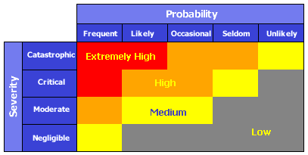
Step 2 – Assess the Risk
Standard Risk Matrix
Risk is assessed based on exposure, severity, and probability in the order of most likely to least likely to happen. You can use the standard risk assessment matrix below to find the risk.
3 Problems with standard matrix:
Subjected to individual interpretation of Severity and Probability
Problem arises if the two hazards are competing for same risk control resource
Only four ranges with most falling in the medium and high-risk level

Slide 27
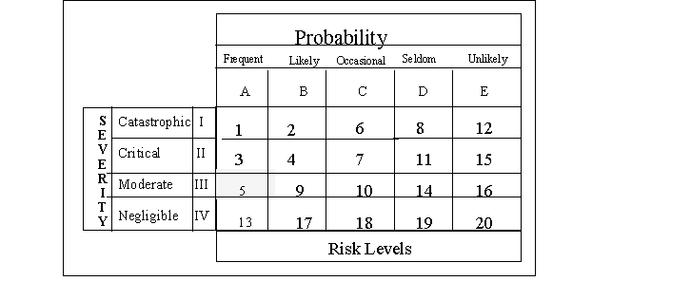
Step 2 – Assess the Risk
Modified Risk Matrix
Risk is assessed based on exposure, severity, and probability in the order of most likely to least likely to happen.
Modified Risk Matrix
20 levels of risk. Highest risk is 1, lowest risk is 20
Helps to prioritize risk control efforts
Can be used to group risks into clusters of related risks
Does not replace the standard matrix but augments it

Slide 28
Step 3 – Analyze Risk Control Measures
Analyzing Risk Control Measures involves 3 actions
Identify Control Options
Determine Control Effects
Prioritize Control Measures
Important to keep risk at the best acceptable level using control options, even if risk seems to be at an acceptable level.

Slide 29
Step 3 – Analyze Risk Control Measures
Identify Control Options
Eight major risk control options are designed to have the broadest application:
Reject the Risk
Avoid the Risk
Delay the Risk
Transfer the Risk
Spread the Risk
Compensate for the Risk
Accept the Risk
Reducing the Risk

Slide 30
Step 3 – Analyze Risk Control Measures
Identify Control Options
Reject the Risk if overall risks exceed benefits. It is the correct option if you do not have the authority to put proper controls in place.
Avoid the Risk by going around it or by performing the operation in another way.
Delay the Risk is the right answer if there is no urgency to perform the operation. The hazard could go away or the operation may not needed.
Transfer the Risk to another individual or operation. The hazard is not eliminated but may be better controlled with a different operator and/or equipment.

Slide 31
Step 3 – Analyze Risk Control Measures
Identify Control Options
Spread the Risk by increasing the exposure distance or increase the time between exposure events.
Compensate for the Risk by having redundant capabilities; extra resources or parts.
Accept the Risk if benefits exceed the cost in personnel and resources. Use risk controls to reduce the risk to it’s lowest possible level.
Reduce the Risk is the most widely used option. Brainstorm to come up with ideas or use the Risk Control Options Matrix.

Slide 32
Step 3 – Analyze Risk Control Measures
Risk Control Matrix
Risk Control Options Matrix uses 46 proven ways to reduce risk from most preferred to least preferred control area.
Options | Examples
ENGINEER/ENERGY MANAGEMENT Limit Energy Substitute Safer Form Prevent Buildup Prevent Release Provide Slow Release Re-channel/Separate in Time/Space Provide Special Maintenance of Controls | Reduce speeds, reduce heights Less hazardous chemicals Automatic cutoffs, limit momentum Containment, chock A/C & vehicles Use energy absorbing materials Barriers, launch A/C farther apart Special procedures, checklists
GUARD On Source Barrier Between On Human or Object Raise Threshold (Harden) | Fire suppression, energy absorption Walls, distance Personal protective equipment Reinforce, physical conditioning

Slide 33
Step 3 – Analyze Risk Control Measures
Risk Control Matrix
IMPROVE TASK DESIGN Sequence of Events/Flow Timing (within/between tasks) Man-Machine Interface/ Ergonomics Simplify Tasks Reduce Tasks Loads Physical, Mental, Emotional Backout Options | Toughest task first, only a few in a row Allow enough time, don’t rush Proper fitting equipment, good design Provide job aids, safely reduce steps Set weight limits, use automation Avoid excessive stress, provide breaks Stop process if new hazards observed
LIMIT EXPOSURE Number of People/Items Time Interactions | Only expose essential personnel & things Minimize time of exposure Limit repeat exposures
SELECTION OF PERSONNEL Mental Criteria Emotional Criteria Physical Criteria Experience | Essential skills, proficiency, common sense Essential stability and maturity Essential strength, endurance, motor skills Demonstrate performance abilities

Slide 34
Step 3 – Analyze Risk Control Measures
Risk Control Matrix
TRAIN AND EDUCATE Core Tasks (especially critical tasks) Leader Tasks Emergency Contingency Tasks Safety Tasks Rehearsals | Define min abilities: train, test, score Define leader standards: train,test,score Define, assign, train, verify ability Hazard ID, risk controls, standards Validate process, skills, verify interfaces
WARN Signs/Color Coding Audio/Visual Alarms Briefings | Warning, instruction and traffic signs Bells, flares, flashing lights, whistles Refresher training, demonstrate hazards
MOTIVATE Measurable Standards Essential Accountability Positive/Negative Incentives Competition Demonstrations of Effects | Define min acceptable risk controls Check performance at essential levels Meaningful awards or punishment Healthy competition on a fair basis Graphic, dynamic, tasteful demos of effects of unsafe acts

Slide 35
Step 3 – Analyze Risk Control Measures
Risk Control Matrix
REDUCE EFFECTS EMERGENCY Equipment Rescue Capabilities Emergency Medical Care Emergency Damage Control Procedures Backup/Redundant Capabilities | Fire Extinguishers, first aid materials Rescue squad, equipment, 911 Quality first aid personnel and facilities Emergency responses, co-agencies Alternate ways to perform mission
REHABILITATE Personnel Facilities/Equipment Mission Capabilities | Rehabilitate to restore confidence Return key elements back to service Focus on restoration of mission

Slide 36
Step 3 – Analyze Risk Control Measures
Determine Control Effects
From the control matrix, determine what effect each option will have on the associated hazard.
Prioritize Risk Controls
Controls must be chosen and prioritized that make the most effective and efficient use of mission available resources. Establish guidelines that will direct which control measure to recommend and implement.

Slide 37
Step 3 – Analyze Risk Control Measures
Guidelines for selecting risk control measures
Follow all published directives
Select combinations yielding the most mission-supportive risk level; not necessary the lowest risk as there is a risk of mission ineffectiveness with not taking risks
Avoid incompatible risk controls. Do not have only Gatorade available to combat dehydration if persons are allergic to food additives; have water available also
Choose risk controls that reinforce each other. Discipline safety rule violators and have a special awards program for following safety procedures and being accident free
Evaluate full costs versus full benefits, not isolated areas. Apply controls to activities and personnel at risk
Choose redundant risk controls when it is mission supportive, practical and cost effective, but do not waste resources. The goal is optimum risk control

Slide 38
Step 4 – Make Control Decisions
Develop a decision-making system that establishes who will select and implement the risk controls and who determines the final go/no-go decision.
EXAMPLE of Risk Decision Making Personnel for SAREX
Risk Level | Decision Level
01-03, Extremely High 04-08, High 09-13, Medium 14-20, Low | Wing Commander Incident Commander Mission Safety Officer Operations/Planning Section Chief

Slide 39
Step 4 – Make Control Decisions
The Person Making Decisions
Must pick the controls and oversee their implementation
Decide how much to spend
Be responsible for the outcome of the operation
Be able to obtain resources needed
Be in control of the resources
Have authority in the chain of command

Slide 40
Step 4 – Make Control Decisions
Implement good decision making by using a decision matrix:
Example of Decision Matrix
Characteristics | Control Option: 1 | 2 | 3 | 4 | 5 | 6 | 7
Low Cost | 5 | 8 | 6 | 10 | 4 | 9 | 9
Easy to Implement | 8 | 8 | 5 | 9 | 9 | 5 | 7
Positive Operator Involvement | 7 | 4 | 7 | 10 | 6 | 4 | 8
Consistent with Culture | 5 | 7 | 6 | 7 | 6 | 3 | 6
Easy to Integrate | 1 | 6 | 2 | 10 | 5 | 9 | 7
Easy to Measure | 8 | 4 | 9 | 5 | 8 | 7 | 9
Low Risk/Sure to Succeed | 8 | 10 | 7 | 9 | 10 | 8 | 9
TOTALS | 42 | 47 | 42 | 60 | 48 | 45 | 55
Rank each risk control option considering on a scale of 1 to 10, 1 being the lowest and 10 the highest, on a list of chosen desirable characteristics. Add up each risk’s score. The option with the highest score is chosen.

Slide 41
Step 5 – Implement Risk Controls
Once the risk control decision is made, assets must be made available to implement specific controls.
To implement risk controls:
Develop a complete action plan
Establish accountability
Provide a means of resource support

Slide 42
Step 5 – Implement Risk Controls
Develop an Action Plan
Develop an action plan to manage the control options:
Determine all manpower and resources needed
Estimate cost to implement each control
Set a timeline that clearly sets milestones and goals
Assign tasks and due-dates to specific personnel
Enlist user input to establishment ownership
Provide job aids, tools and examples to make implementation clear to everyone
Measure performance
Document any outside support given

Slide 43
Step 5 – Implement Risk Controls
Establish Accountability
Levels of accountability:
Identify person responsible for successful implementation of each control measure.
Identify unit or operations level person responsible for the implementation.
Combine the power of command with leadership to maintain accountability.
Establish motivation and create meaningful and positive incentives for success.
Involve persons affected by the controls during implementation.

Slide 44
Step 5 – Implement Risk Controls
Resource Support
Resource support includes 6 components:
Policy support with operating instructions, technical orders, and any standard operating procedures
Command support showing the absolute backing of the leadership
Training support for personnel implementing controls
Tools support including job aids, checklists, decision guides and instructions
Measurement support to determine if timelines, schedules and standards are being met
Motivation support providing the positive and negative incentives for a successful risk control

Slide 45
Step 6 – Supervise & Review
Resource Support
Determining the effectiveness of risk control involves setting a goal, knowing where you are in relation to the goal, and a plan in place to reach the goal.
This last step of ORM involves
Supervise
Review
Feedback

Slide 46
Step 6 – Supervise & Review
Supervise
Supervise the implementation plan, insure all are in place, monitor all controls and make certain they are effective.
Controls are effective if they bring about favorable changes to the physical condition or personal behavior.
If a control is ineffective, correct or discontinue.
Use the Change Analysis Tool from Step 1 to reevaluate any changes that require further risk management.

Slide 47
Step 6 – Supervise & Review
Review
Review the total cost verses total benefits the controls provide; for each control consider both physical and behavioral changes.
Costs should be in line with expectations. The benefits in risk reduction should be greater than the cost of the control measure
Benefits or effectiveness of controls should be compared to forecasted goals
A simple cost vs. benefit matrix is recommended

Slide 48
Step 6 – Supervise & Review
Feedback
Feedback is the essential element in Step 6. It provides the ability to share success and failure. One of the basic rules of ORM is to stop reinventing the wheel and learn from past practices and from the mistakes of others.
Feedback should go to all personnel; from new cadets to commanders. Effective risk controls that increase the overall mission success should be a part of every CAP member’s lessons learned file.

Slide 49
Conclusion
To fully realize all the benefits from Operational Risk Management, it must be integrated into every aspect of CAP’s organization and it’s missions.
All levels of CAP should proactively promote and use Operational Risk Management.
Its use will benefit everyone by improving mission capability, enhancing better decision making, reducing accidents and injuries, and preserving our assets.

Slide 50
References
Air Force Policy Directive 90-9, Operational Risk Management
Air Force Instruction 90-901, Operational Risk Management
Air Force Pamphlet 90-902, Operational Risk Management (ORM) Guidelines and Tools

Slide 51
Thank You!
Civil Air Patrol wishes to thank the USAF Safety Center for the use of their information in the creation of this presentation.

Slide 52
Quiz Time!
Close the presentation.
Verify that you have read the required material then click the “Start Quiz” button.
Thank your for your support of CAP’s safety program.
52
Notes:
52

