Slide 1


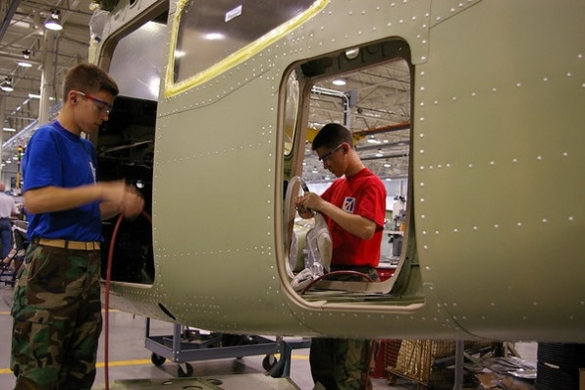
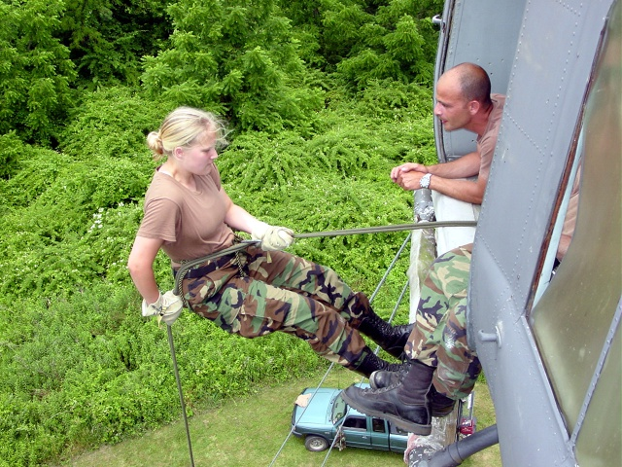
Aerospace/STEM
Education
Presentation for Formal and Informal
K-12 STEM Educators and Organizations
CITIZENS SERVING COMMUNITIES
www.gocivilairpatrol.coM

Slide 2

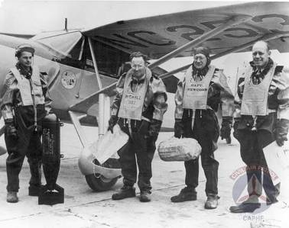
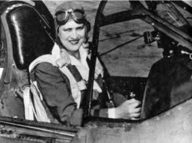
Civil Air Patrol History
Formed December 1, 1941, for civilian aviation purposes, Civil Air Patrol is a nonprofit, humanitarian organization chartered by Congress and is the official Auxiliary of the United States Air Force.
1942- Started the Cadet Program
1946- Incorporated by Congress
1948- Became USAF Auxiliary
1953- Aerospace Ed in school systems
Today- Outreach to the nation
* Leading K-12 youth and STEM
organization in the nation
***Has always had women at the forefront. CAP Continues to provide myriad aviation/STEM opportunities for diverse populations of male and and female youth across our country!

Slide 3

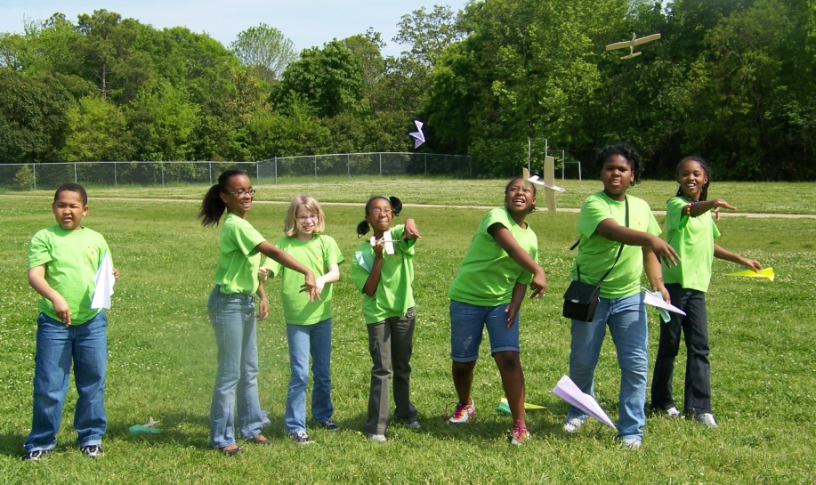


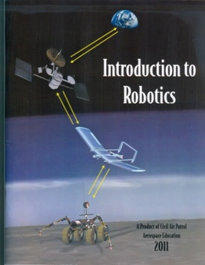
Aerospace/STEM Education
How can YOU and/or YOUR school, home school, youth
organization, museum, library, or any other STEM-based
organization become involved?
How can you benefit from the amazing FREE STEM products and programs & inspire youth to SOAR?
Become a CAP Aerospace Education Member!

Slide 4
Aerospace/STEM Education
~ Aerospace Education Membership (AEM)
$35 one-time membership fee; free annual renewal
Not a member of a CAP squadron; no uniform to wear; no meetings to attend; just inspire youth with STEM Ed
K-12 formal/informal educators eligible (schools, libraries, museums, youth organizations, etc.)
Enjoy all of the FREE AEM benefits (to follow)
Why? Help inspire youth toward STEM careers

Slide 5
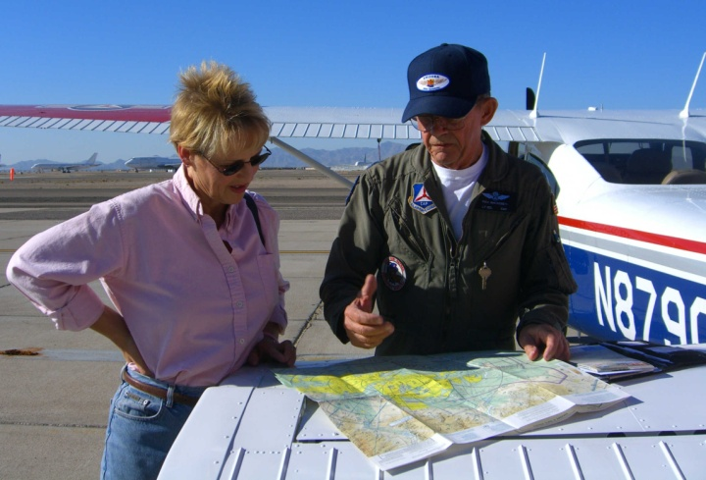
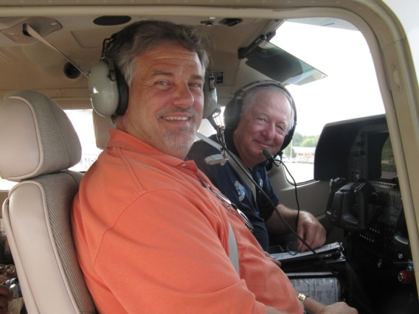
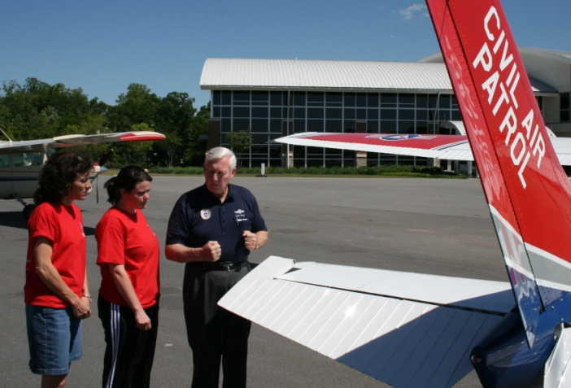
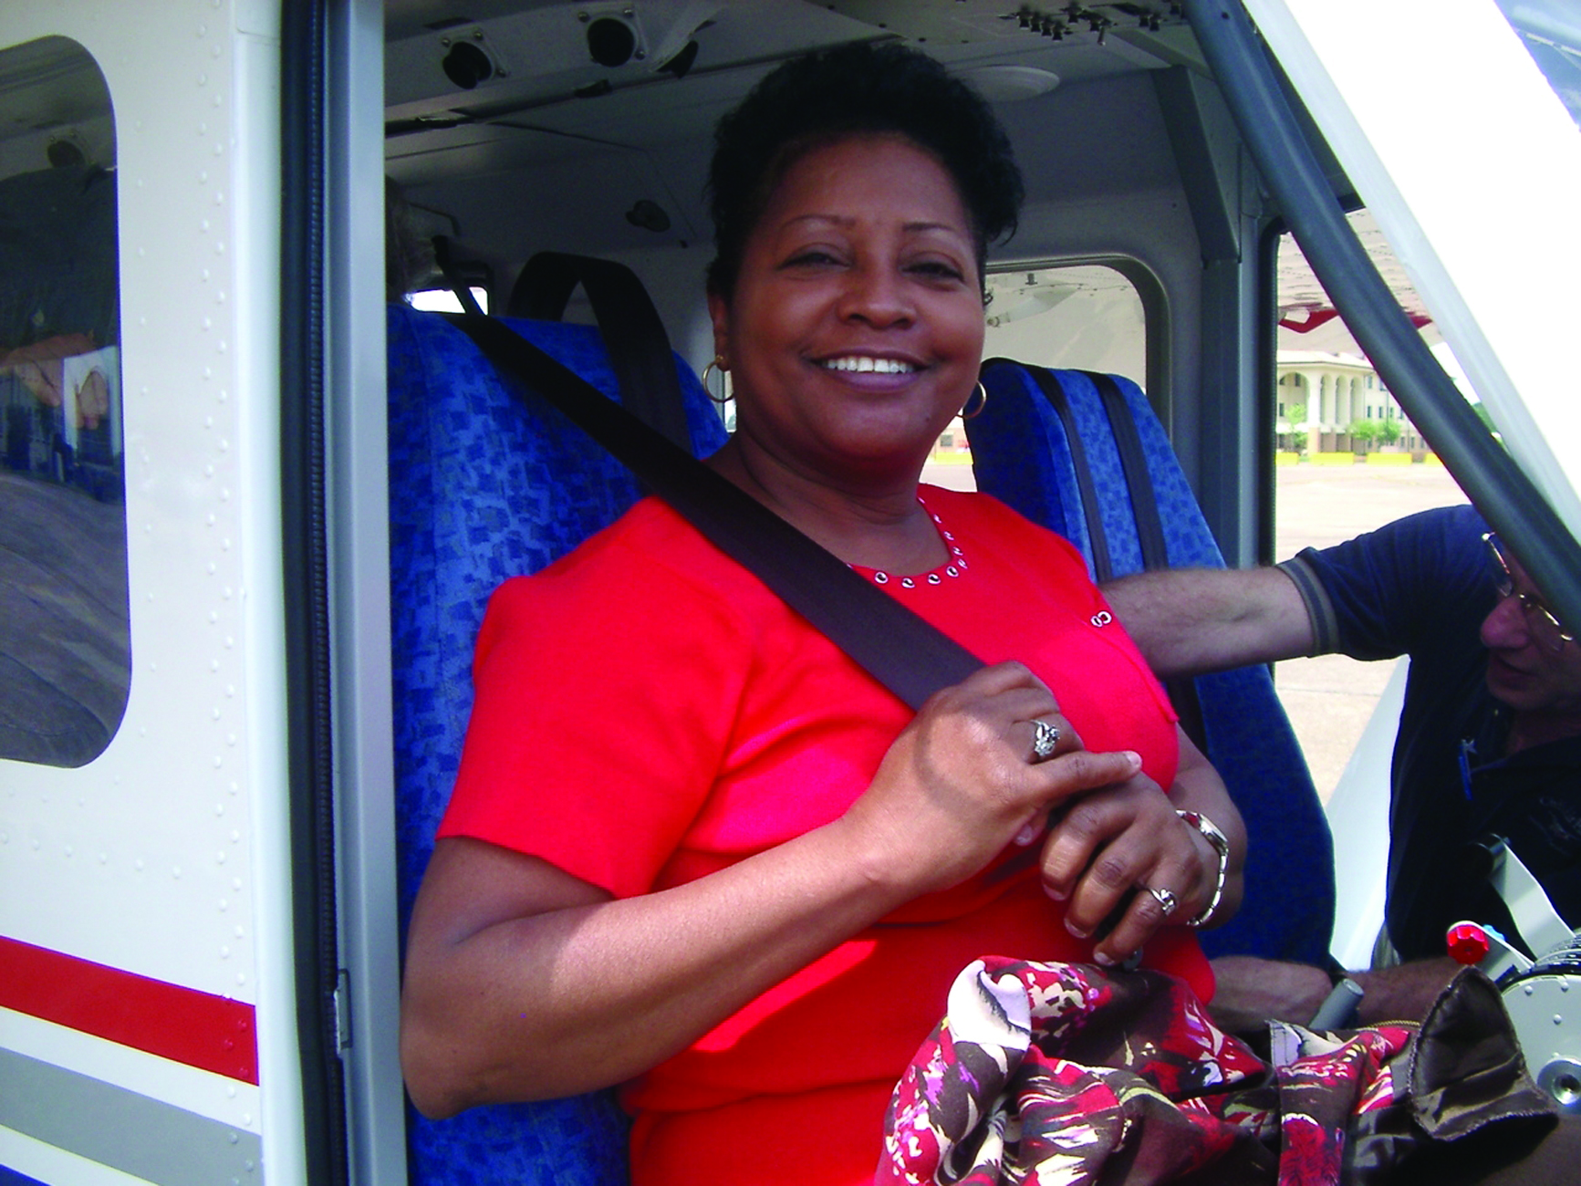
Aerospace/STEM Education
~ Teacher Orientation Program (TOP) Flights
Fly in a CAP Cessna airplane
Pre-flight briefing
Fly over local area or school
Handle the controls to fly the plane
Bring experience back to students

Slide 6

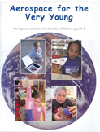

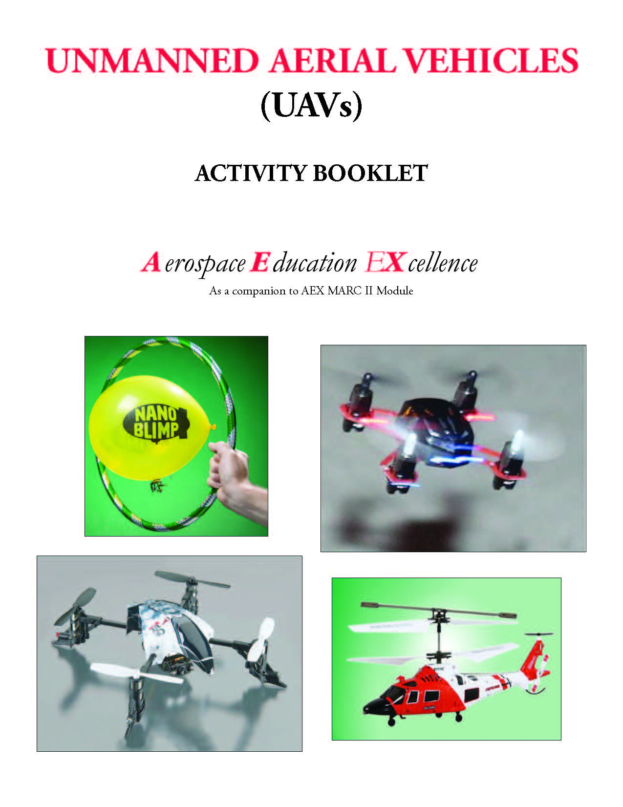

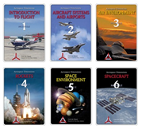

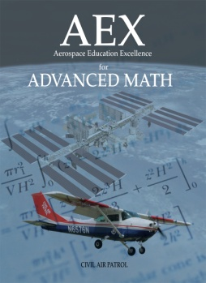
Aerospace/STEM Education
~ Free Educational Products
Over 40 products- order in print and/or download online from member portal, eServices
Aligned w/ Next Gen Science Standards and other National Academic Standards
Pre K- grade12

Slide 7
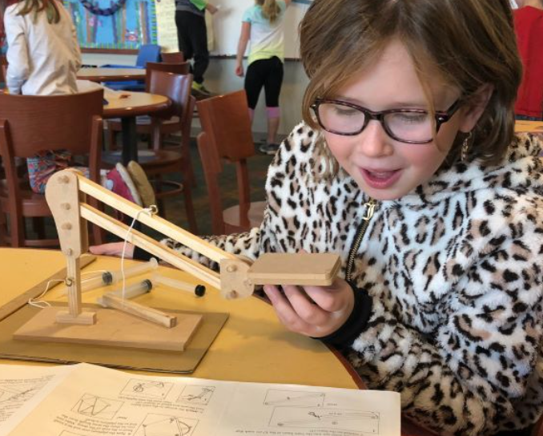
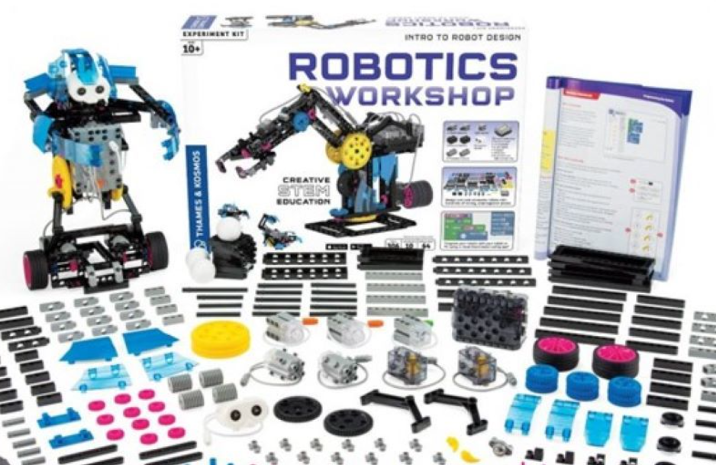
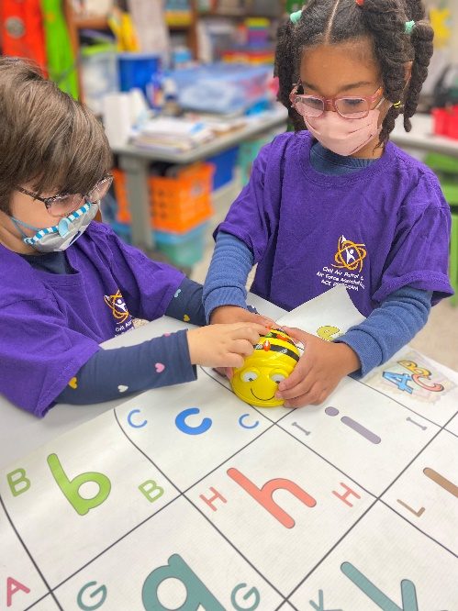
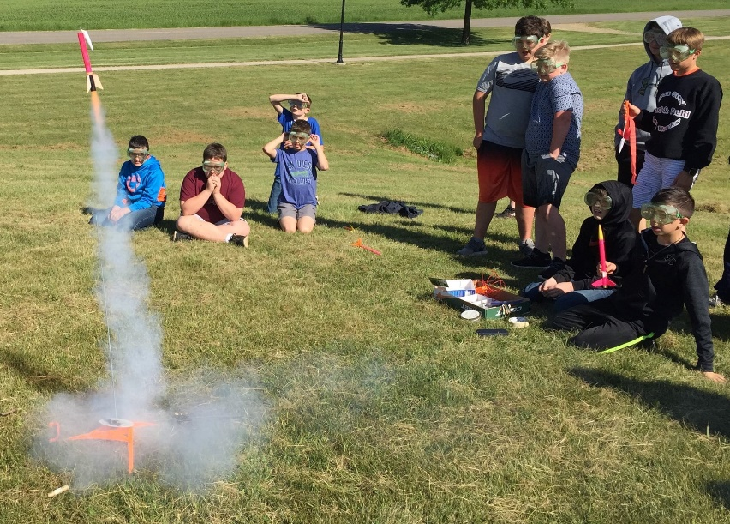
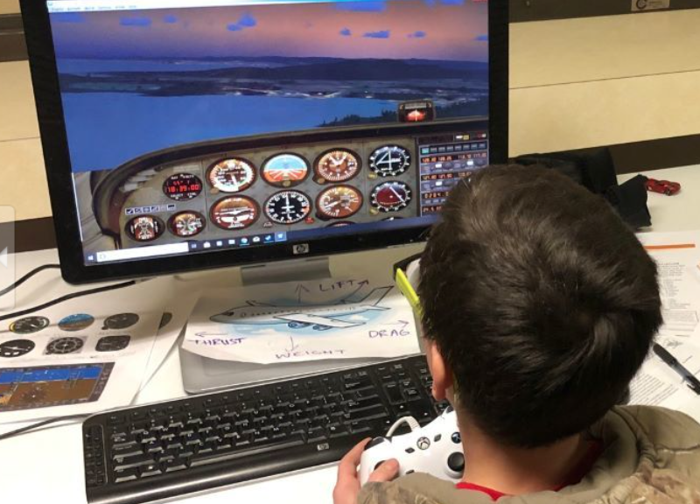
Aerospace/STEM Education
~ K-12 STEM Kit Program
20+ FREE kits from
which to select
one-at-a-time to use, evaluate, and keep!
87% Increased STEM Career Interest

Slide 8
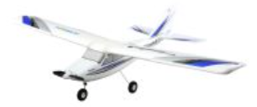
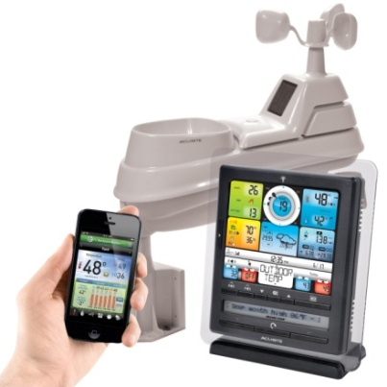
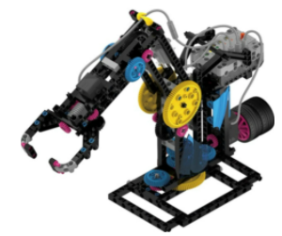
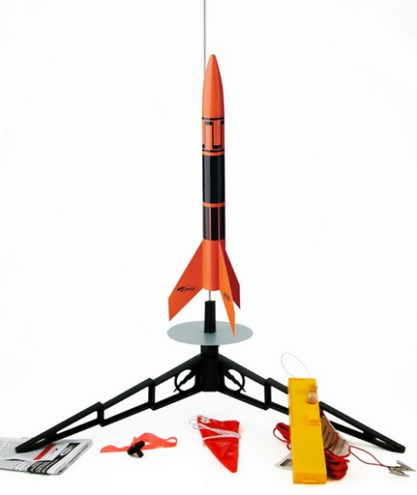
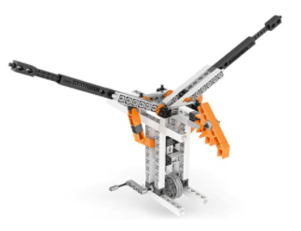
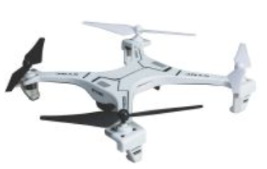
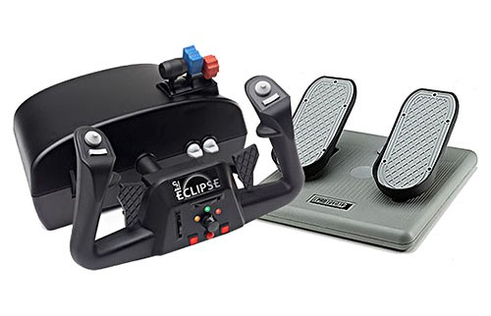
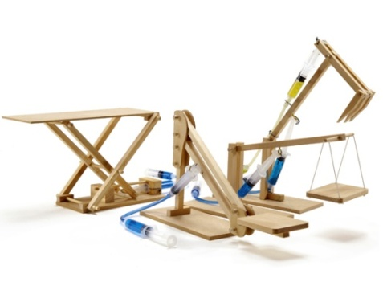
Free STEM Kit Program
Weather Station
Model & Remote
Control Aircraft
Robotics Workshop
Indoor Quadcopter
Rocketry
Mechanics
Outdoor Quadcopter
Hydraulic
Engineering
Flight Simulator

Slide 9
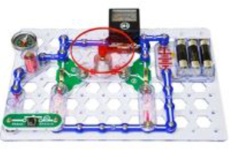

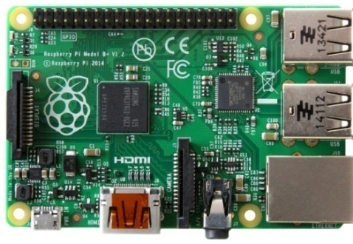
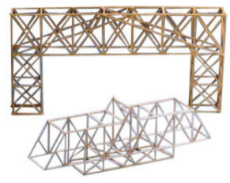
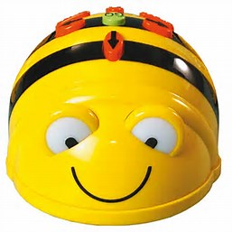
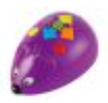
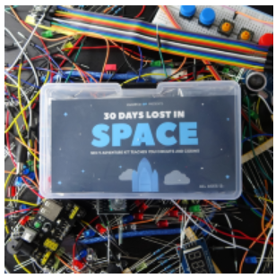
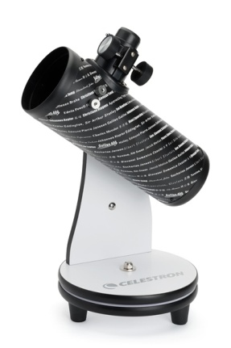
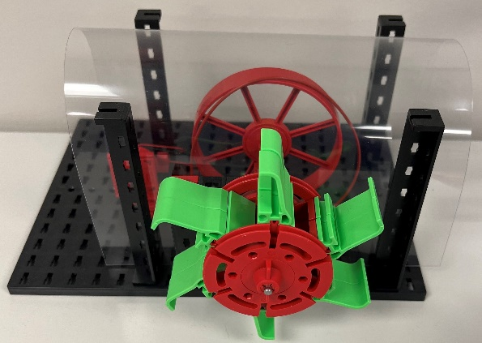
More Examples of Free STEM Kits
Raspberry Pi Computer Coding
Snap Circuits Snaptricity
Sphero Bolt and Code Map
Bridge Building
BeeBot/ Code &Go Mouse
Renewable Energy
30 Days
Lost in Space
Astronomy

Slide 10

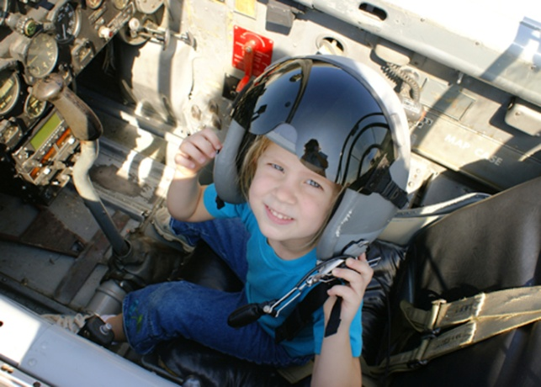
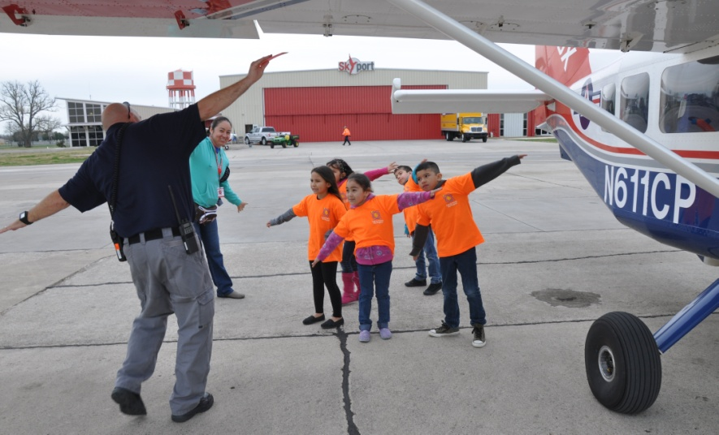
Aerospace/STEM Education
~ Free K-6th Grade ACE Program
Aerospace Connections in Education
Use of aerospace theme to promote:
~ academics (STEM-centric)
~ character development
~ physical fitness
22 lessons per grade level in standards-curriculum guides aligned w/ NGSS / other academic standards
Class set of grade level educational manipulatives

Slide 11

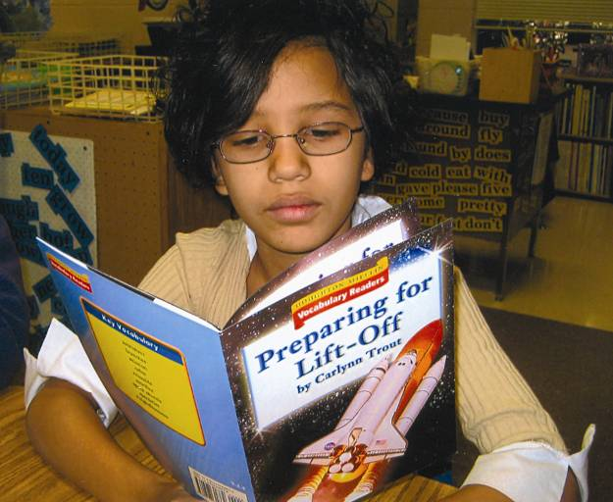
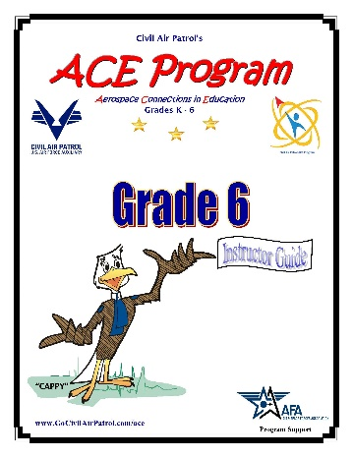
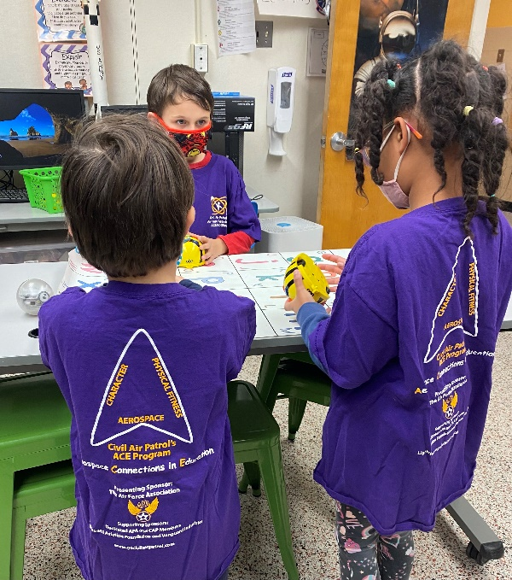
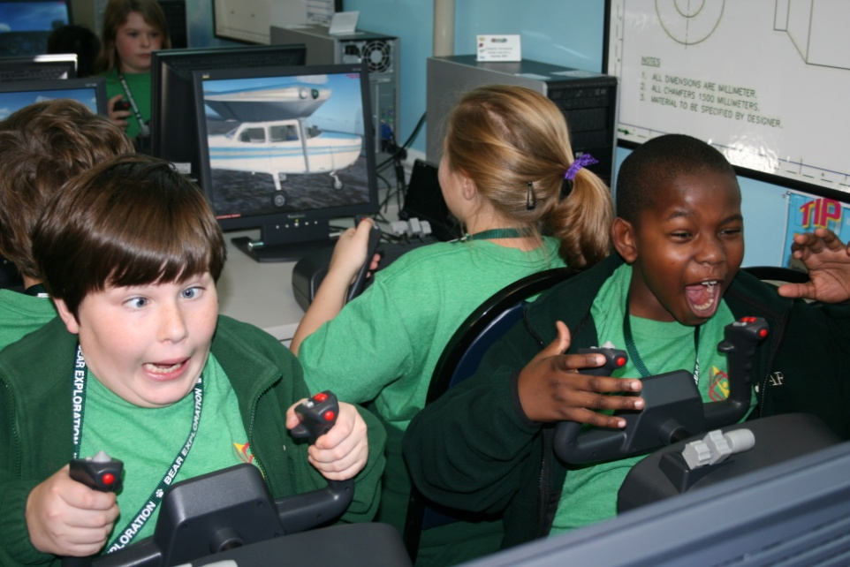
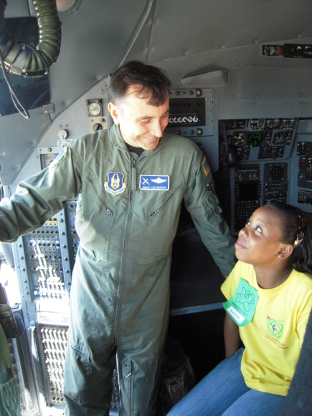
Aerospace/STEM Education
Aerospace Connections in Education: K-6 STEM
Over 600,000 students across the nation inspired to pursue STEM careers. Can be expanded to K-8!

Slide 12
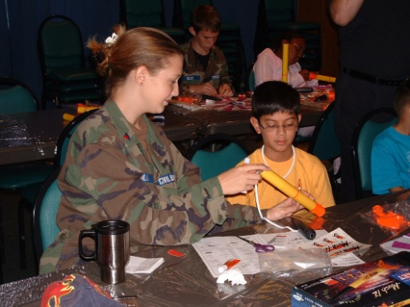
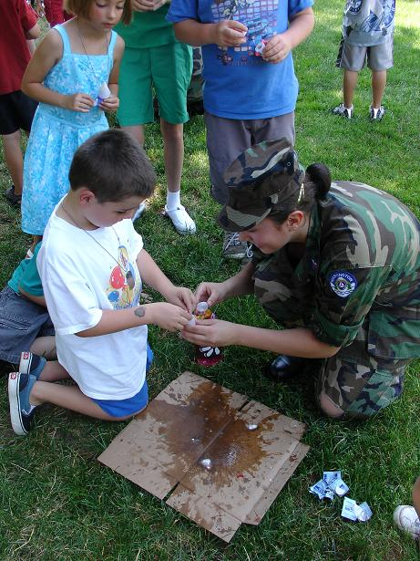
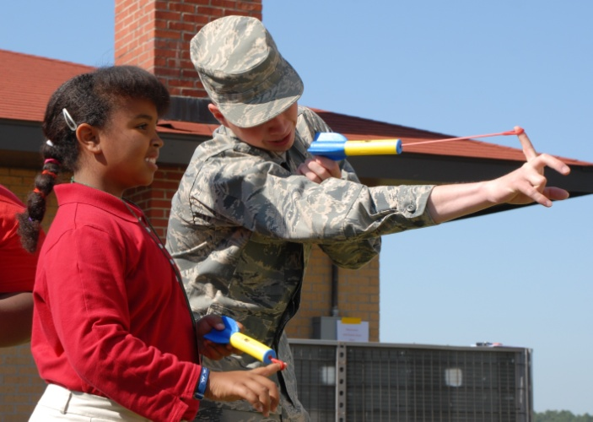
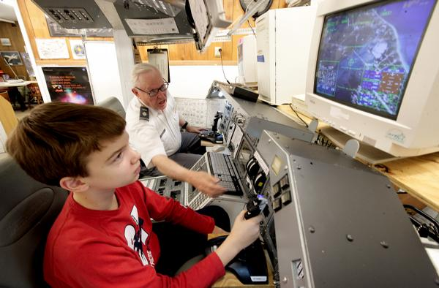
Aerospace/STEM Education
~CAP Squadron Support to AEMs
Assist with program implementation
Provide teacher flights
Share cadets and cadet program
Classroom aerospace speakers
Arrange field trips to airports/museums

Slide 13
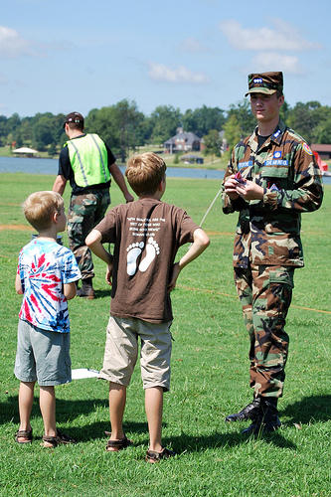
Aerospace/STEM Education
~ Sharing CAP Cadet Program
Available to any youth, ages 12-18, who are interested in learning to fly, becoming a part of a CAP squadron, earning scholarships, learning about aerospace/STEM careers, being mentored by aviation specialists, or mentoring other youth!
Want to know more about the program?
Read on….

Slide 14
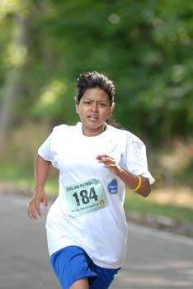

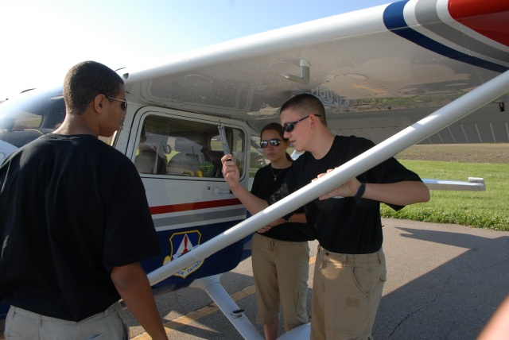
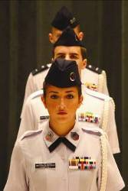
Aerospace/STEM Education
~ CAP Cadet Program www.GoCivilAirPatrol.com/cadets
For youth, ages 12-18, wanting MORE experience in aviation and STEM
Military-style program involving:
~ character/leadership development
~ aerospace/STEM career exploration
~ aviation/private pilot scholarships
~ physical fitness/drill & ceremony
~ community service/mentoring
CAP Cadet squadrons are located across the nation
~ Locate a local squadron at www.GoCivilAirPatrol.com
***Enter ZIP code at “Find Your Local Squadron”

Slide 15






Aerospace/STEM Education
~ CAP Cadet Program Career Exploration
Aircraft Maintenance & Manufacturing
Engineering Technology
Advanced Technology
Space Command
Meteorology
Pararescue
Flight Training
Cyber Security
STEM Educator

Slide 16


Aerospace/STEM Education
~ Benefits of CAP’s Aerospace & Cadet Programs
Offers positive STEM role models
Encourages respect for self and others
Reinforces academic relevance and purpose
Promotes a physically fit and drug-free lifestyle
Empowers youth with the desire to seek STEM careers
Provides career development options & opportunities
Helps develop technologically-prepared STEM workforce
Inspiring the Next Generation!

Slide 17

Aerospace/STEM Education
What to become involved with CAP?
Join online as AEM for $35 fee
www.GoCivilAirPatrol.com/joinaem
* Inspire the youth within your reach
* Introduce the CAP Cadet program
Reach out and touch:
~ other youth ~ other educators ~ the future…

Slide 18


Aerospace/STEM Education
CAP: Investing in our future…
Contact ae@capnhq.gov for more information

