Slide 1
CAPS 72-series Aircrew Evaluation

Slide 2
Sources of Change
Aircrew Professionalism Cross-Functional Team
Glider Program Cross-Functional Team
Youth Aviation Initiative Cross-Functional Team
CAP-USAF AFAM Status Requirements
CAP Publications Proof-of-Concept
Comments and recommendations from the field

Slide 3
Publications Architecture
CAPR 70-1
CAPS 71-series Training
CAPS 72-series Standards
CAPS 73-series Procedures
CAPS 72-series
72-2 Mission Symbols
72-3 Aircraft Checklists
72-4 Aircraft Information File
72-5 Aircrew Evaluation
72-6 Aircrew Evaluation Criteria
CAP Publications Proof-of-Concept

Slide 4
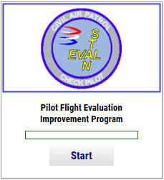
CAPS 72-5 Aircrew Evaluation CAPS 72-6 Evaluation Criteria
Check Pilots must complete training prior to 31 Mar 20
Qualifications of those not completing the required training will be suspended on 31 Mar. Reinstatement will require NCPSC.

Slide 5
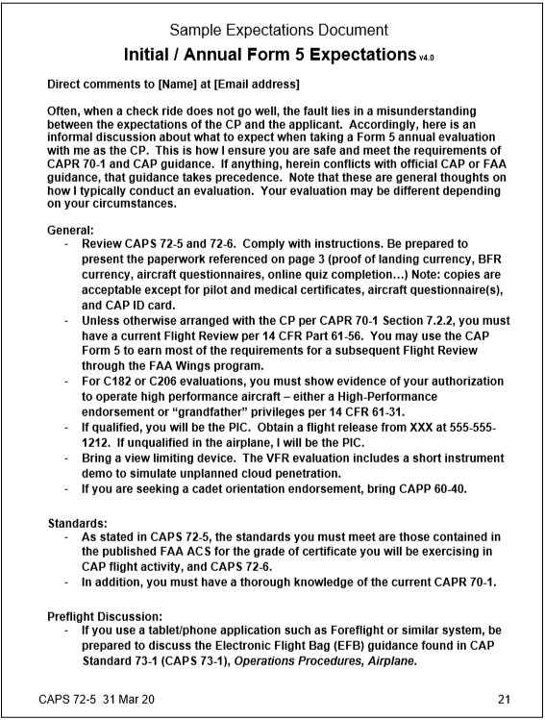
CAPS 72-5 Aircrew Evaluation
Why improvement?
Terminology changes
Process changes
CP authority & responsibility
Plan of action
Expectations document
Grading criteria (next)
Mandatory items for annuals
30-days to complete
CP/IP evaluations

Slide 6
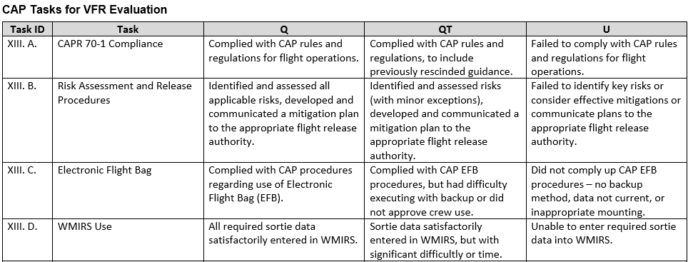
CAPS 72-6 Evaluation Criteria
Certificate exercised
ACS/PTS
CAP-unique
Operations
Endorsement
Qualified with Training (QT)

Slide 7
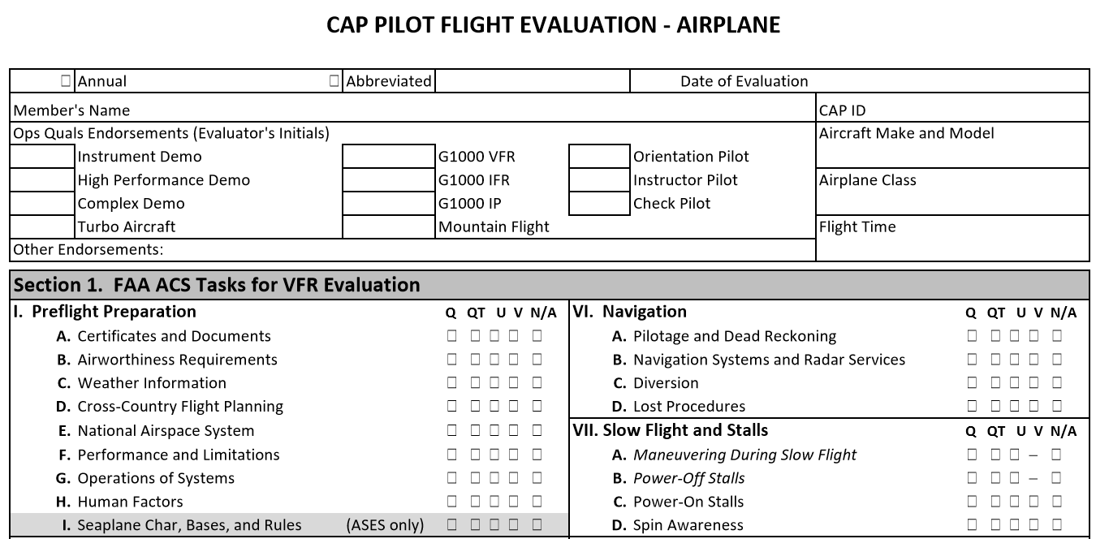
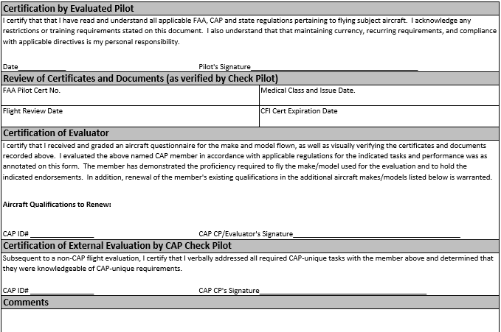
CAPF 70-5A/B/G
SEE OPSQUALS LESSON FOR UPLOAD INFO

Slide 8
Questions & Answers
Please go to –
gocivilairpatrol.com > Programs > Emergency Services > Aircraft Operations > Change Communications

