Slide 1
Basic Risk Management
Notes:
You’ve all been through briefings on the theory behind risk management, and why it is an effective tool for preventing mishaps.
Most of those briefings were probably pretty technical, a little boring.
At the end, you probably understood the way it works, but you didn’t really know how to go out and use it in all your activities.
This very quick briefing is meant to tell you the most important parts of risk management,
With some easy tools you will be using during the next few days.

Slide 2
Basic Risk Management
Training Objectives
Be Able to Explain Risk Management
Understand Risk Management in CAP
Apply Risk Management in Everything You Do
Be able to locate RM tools and training on gocivilairpatrol.com
Notes:
Who is this geared for --- objectives ---- what you should be able to do and where to locate things
CAP’s safety vision - everyone use risk management…. Part of cadet program … what does “core competency” mean
SMS slide - where risk management fits?
Review steps w/ layman’s definitions --- without going into a lot of technicalities, this briefing gives the basics of what you need to know to personally use risk management in everything you do in CAP and in your daily lives, as well as being a supportive part of the RM process in CAP missions and activities.
Examples
Things you’ll need to know about
Regulation
Risk Assessment Form 160
Knock it off
pre-activity risk assessments and briefings

Slide 3
Basic Risk Management
“The goal of the CAP Safety Program
is for each and every member of Civil Air Patrol,
as well as the organization itself,
to embrace and practice RM
as a core competency of Civil Air Patrol.”
CAPR 160-1 § 2.2.4., CAP Safety Program

Slide 4
Basic Risk Management
Risk Management is the core of our CAP Safety Management System

Slide 5
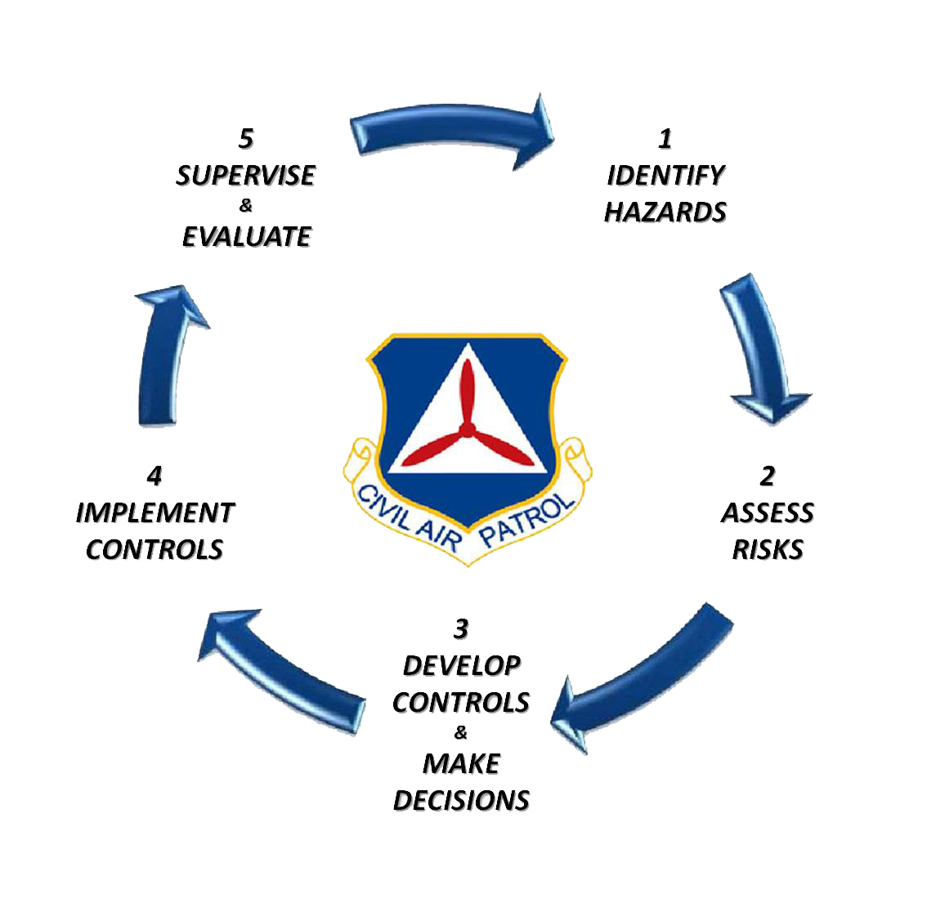
Basic Risk Management
Risk Management Is a 5 Step
Continuous Process
This training will explain those steps in
easy-to-understand terms so everyone can understand how RM works in CAP and
in their daily lives

Slide 6
Step 1 - Identify Hazards
Look around
What can cause harm?
What can hurt you?
Possible Hazards
Rugged Terrain? Hot Weather?
Slippery Floors? Sharp objects?
Anything that “worries” you might be a hazard … take the time to look around
What can go wrong with the plan?
A “bad plan” can be a hazard

Slide 7
Step 2 - Assess Risk
How likely is it that hazard will hurt you?
The “probability”
A good chance, or a very remote chance?
How badly could that hazard hurt you?
The “severity”
How bad could the damage be?
How serious of an injury could it cause?
The Risk is High if…
The risk is likely to happen
or
Serious injury or damage could occur

Slide 8
Step 3 - Risk Controls
What’s a risk control?
It’s anything that you can do, or change, that will reduce the risk
Reduce the probability, or
Reduce the severity
Remove the Hazard?
Train people to do the task properly
Provide protective equipment
Work slower or use a spotter
Figure out which controls work the best and make them part of your plan

Slide 9
Step 4 - Implement Controls
Make risk controls part of your plan
Perform your task or mission using risk controls
Original plan?
Cross the street
Better plan with Risk Controls
Cross the street,
At the crosswalk,
When the light is green,
After looking both ways for traffic
Make risk controls part of your plan!

Slide 10
Step 5 - Supervise & Evaluate
Are your risk controls working?
Plans can change. New hazards can appear.
Is it going according to plan?
It is common to need new risk controls
Decide on new risk controls, or…
Adjust the risk controls you planned
Risk Management continues
through the entire activity!

Slide 11
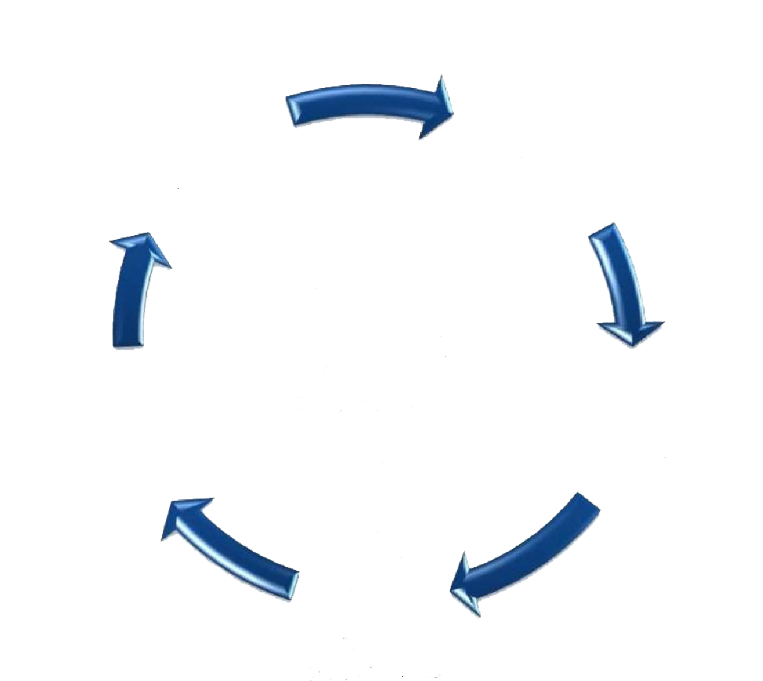
Risk Management - The “Loop”
RM is a continuous process!
You must continuously …
Look for new or changing hazards
Assess the changing risks
Decide on new or improved controls
Change the plan to include new controls
Keep evaluating how they’re working
Continuously!

Slide 12
Risk Management - The Lingo
It’s important that ALL CAP members understand the same language of risk management
So…
Let’s do quick review of the terms and the definitions…

Slide 13
RM Review
Hazards
Things that can hurt you
Things that can damage property
Risks
How likely is damage or injury to occur?
How serious could it be?
Controls
Things you can do to reduce the risk

Slide 14
RM Review
Risk controls
What can you do to reduce the risk?
Make those controls part of the plan
Supervise
Are members following the plan?
Are we using the controls we chose?
Evaluate
Are the controls working like we planned?
Do we need to adjust or improve the controls?

Slide 15
The “Risk Assessment”
Starting the risk management
Performed before any task, activity, event, mission, etc.
The first 3 steps of the risk management loop
Identify Hazards
Assess Risks
Develop Controls and Make Decisions
Needs to be done for all activities in CAP!
Everyone needs to know the hazards, the risks, and the plan

Slide 16
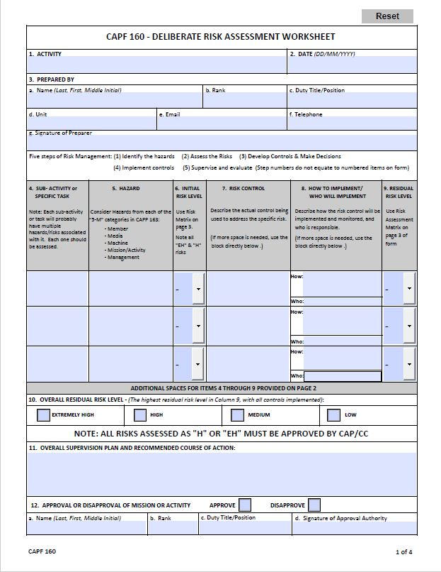
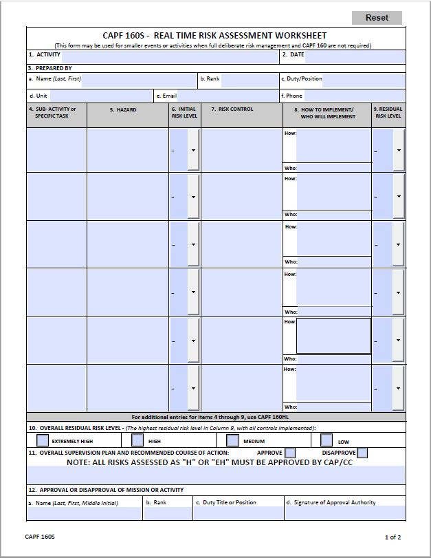
CAPR 160-1 and CAPF 160
CAPR 160-1 § 3.3, CAP Safety Program
Explains when a formal risk assessment is required
Explains when a CAPF 160 is needed
CAPF 160 used for major activities
like encampments, NCSAs, etc.
CAPF 160S is for smaller activities
and as a guide for everyday RM
Go to Safety page of gocivilairpatrol.com, or look at “Intermediate Risk Management” for more information on Risk Assessments

Slide 17
Real Time Risk Management CAPF 160S
Before EVERY Activity!
Unit meeting?
PT? Drill Practice?? Moving the… ???
YES!!!!
It’s EASY!
Gather together
Talk about the hazards and risks
How do we reduce the risk?
Team effort; everyone on the same page?
Get started and follow the plan!

Slide 18
“Knock it off!”
See something unsafe?
See a risk you didn’t anticipate?
Need to warn someone!?
Yell … “KNOCK IT OFF!!”
Anyone can scream it. Everyone repeat it.
EVERYONE stops what they’re doing.
Warn others about the hazard!
The “knock it off” call is a time-honored tradition in the
Air Force, used in combat and
day-to-day missions. Everyone respects it, and everyone knows what it means!

Slide 19
The “Huddle”
The “get together” after the “knock it off”
Gather everyone together
Talk about what went wrong?
Is there a new risk we didn’t see?
Is the original risk worse than we thought?
Decide on new controls?
What’s the new plan?
IMPORTANT NOTE: You may find that the risk is just too great. Maybe the weather got worse, the task got harder, or your members got hot and tired. If the risk is too great, then cancelling is the “ultimate” risk control.

Slide 20
Everyday Risk Management
CAP is committed to using risk management in the planning and execution of every mission and activity
Members are CAP’s greatest resource
Every CAP member should actively use risk management
in their CAP activities and in their daily lives
Every Member. Every Day. Every Activity. Every Mission.

Slide 21
Everyday Risk Management
It’s Easy!
Take the time to use a couple quick memory aids before every task, and YOU will be practicing
risk management!
“What’s the worst that can happen?”
“What am I doing to prevent that?”
“My goal is to finish this mission…
“to run this obstacle course …
“to move this airplane …
“to park this vehicle …”
“… WITHOUT GETTING HURT”

Slide 22
Risk Management
By now you should be able to:
List and explain the 5 steps of risk management
Practice risk management as a member of a CAP team
Practice everyday risk management in your day-to-day life
For more information on risk management, refer to the following
CAPR 160-1, CAP Safety Program
Safety pages of gocivilairpatrol.com website
Intermediate Risk Management training module
CAPF 160 and CAPF 160S

Slide 23
Questions?
We need your help!
If you have any questions or
suggestions about any CAP
Safety Education, please contact us at safety@capnhq.gov
Thanks!

