Slide 1
Civil Air Patrol Safety CAPSafety Information System (CAPSIS) Safety Reporting
Notes:
Welcome to the CAPSafety Information System (or CAPSIS) Safety Reporting overview. This presentation will take you through the basics of reporting a safety significant occurrence (or SSO) within CAPSIS. This presentation follows the CAPSIS Safety Reporting Guide which can be found on the CAPSafety website in the CAPSIS section at www.gocivilairpatrol.com. An accompanying change to CAP regulation 160-1 and 160-2 will follow at a later time.

Slide 2
Objectives
Introduce the terms associated with safety reporting
Review the information that reporting members can provide
Notes:
The objectives for this learning segment include:
Introducing the terms associated with safety reporting
And, reviewing the information that reporting members can provide
Let’s start with the terms and definitions.

Slide 3
Terms
Safety Significant Occurrence (SSO)
Notes:
Safety Significant Occurrence. Any observed outcome that resulted in or could have resulted in damage to equipment or a facility, injury to a member, and/or a member illness.

Slide 4
Terms
Safety Significant Occurrence (SSO)
Damage
Notes:
Damage. Any physical harm, breakage, marring, or any unintended change to a vehicle, aircraft, facility, or any other piece of real or personal property. This includes any damage to CAP property, regardless of the cause, or damage to private property that may occur during a CAP activity or mission.

Slide 5
Terms
Safety Significant Occurrence (SSO)
Damage
Injury
Notes:
Injury. Evidence of internal or external physical trauma or damage to the body and/or evidence of an aggravated pre-existing injury in the context of a CAP activity or mission.

Slide 6
Terms
Safety Significant Occurrence (SSO)
Damage
Injury
Illness
Notes:
Illness. Evidence of disease or sickness affecting the body or mind and/or evidence of an aggravated pre-existing illness occurring in the context of a CAP activity or mission.

Slide 7
Terms
Safety Significant Occurrence (SSO)
Damage
Injury
Illness
Near Miss
Notes:
Near Miss. An SSO that did not, but could have resulted in damage to equipment, injury to a member, and/or a member illness.

Slide 8
Terms
NTSB Reportable Accident or Incident
Notes:
And lastly, NTSB Reportable Accident or Incident. 49 CFR Part 830 defines requirements for immediate and later reporting of aircraft accidents and incidents. Refer to this regulation for the most current and up to date requirements. All NTSB reportable accidents or incidents must be reported the National Operations Center per CAPR 160-2.
Next, let’s cover the basic steps of the safety reporting process and then go into detail about the reporting tabs and fields.

Slide 9
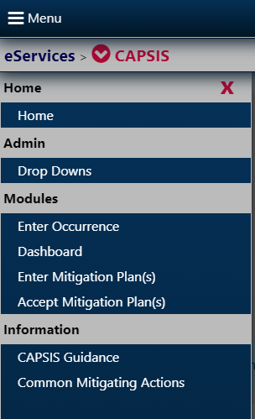
Safety Reporting Steps
Notes:
The enter an occurrence, you will need to click on the CAPSIS down-arrow at the upper left of your screen and select “Enter Occurrence” in the Modules section. From here, we will look at the data entry fields in each reporting tab.

Slide 10
Safety Reporting Steps
Step 1. Follow your region supplement
1
Approved Supplements and OIs by Region | Civil Air Patrol National Headquarters (gocivilairpatrol.com)
Your region supplement outlines your internal requirements for safety reporting.
Notes:
Step 1 is…Follow your region supplement. In accordance with CAP regulation 160-2, each region must have a regulatory supplement that outlines procedures for safety reporting. These supplements can be found on the gocivilairpatrol.com website under the Members tab in the Publication Library menu option.

Slide 11
Safety Reporting Steps
Step 1. Follow your region supplement
1
Step 2. Talk with your Safety Officer
2
Your safety officer can help you report relevant information
Approved Supplements and OIs by Region | Civil Air Patrol National Headquarters (gocivilairpatrol.com)
Your region supplement outlines your internal requirements for safety reporting.
Relevant reporting reduces workload
Notes:
Step 2 is…talk with your safety officer. Your safety officer is a good resource to help you determine whether a safety report should be entered and what information is most relevant. Reporting done right reduces workload and ensures review officers have what they need to begin the safety review process.

Slide 12
Safety Reporting Steps
Step 1. Follow your region supplement
1
Step 2. Talk with your Safety Officer
2
Input information in CAPSIS
3
Follow the guidance in the Safety Reporting Guide and the reporting prompts
Your safety officer can help you report relevant information
Relevant reporting reduces workload
Fill in as much information as known within 48 hours
Your region supplement outlines your internal requirements for safety reporting.
Approved Supplements and OIs by Region | Civil Air Patrol National Headquarters (gocivilairpatrol.com)
Notes:
Step 3 is…input information in the CAPSafety Information System. CAPSIS will guide you through the process of entering the information needed to complete the initial safety report. Filling in as much information as possible within 48 hours of the SSO will provide important information to the review officer.
Now, let’s go through each of the fields associated with safety reporting in CAPSIS.

Slide 13
What should members report?
Notes:
What should members report?
Any observed or potential safety hazard should be reported. The Safety Reporting Process in CAPSIS will lead you through the following steps for what information to provide for initial reporting. Only the “General” section contains mandatory fields, but you should collect and enter as much information as you can during initial reporting. The assigned review officer is responsible for finalizing the initial report.
The General tab contains the SSO account, date/time, and location fields. This section also asks the question, “Was this a near miss?” if there was no actual damage, injury, or illness involved but where something was observed that could have resulted in a negative safety outcome.

Slide 14
Notes:
If you are using this report to meet Specialty Track requirements or for training purposes, select the “This entry is used for Specialty track or for Training” button. You no longer need to label these as “TEST” entries. By selecting the referenced button, the system will not count this as an official report and can be deleted by the safety officer once completed.

Slide 15
Notes:
The Account field is a free-text field that briefly describes What happened? Keep this brief and do not include proper names or other identifying information about an individual.

Slide 16
Notes:
Next, select the Date and local time of the SSO. In some cases, a reporting member may observe an outcome such as damage to a vehicle or an aircraft but not be able to determine the date it occurred. In this instance, select the UNKNOWN box.

Slide 17
Notes:
The Location field is where you can input the state, city, and/or airport. Once a state is selected, you may begin typing the city or three-letter airport code and a list of options will be available for selection. For similar reasons as previously noted in the date/time field, if the location is not known, UNKNOWN may be selected.

Slide 18
Notes:
Next, let’s cover the fields in the Activity tab.
These fields include the Activity type – which may also lead to additional drop-down or text entry fields – and the responsible wing and unit. Note that the region information is also included in all wing/unit selections.

Slide 19
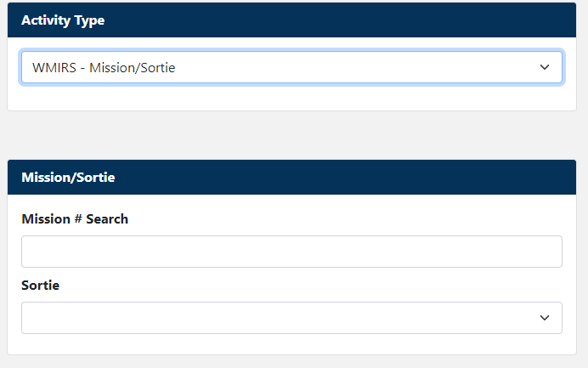
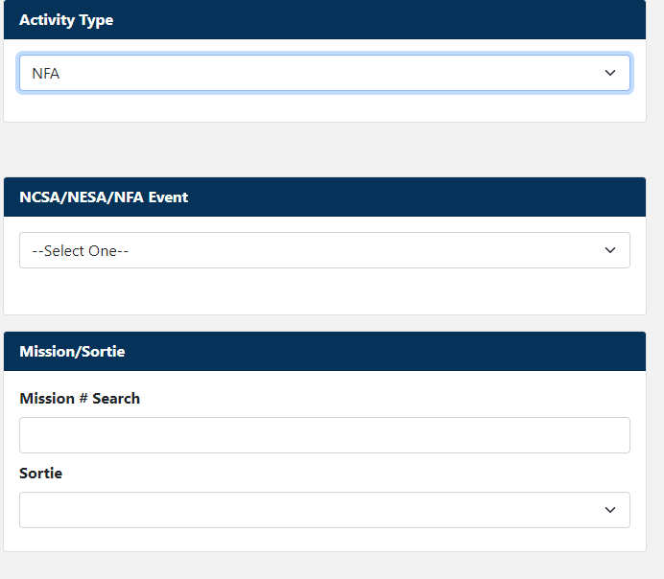
Notes:
When selecting an activity in which the SSO occurred, the system may ask for additional information in the form of selectable options or text entries. Depending on which activity is selected, you may also select an associated sub-activity – such as sports or physical fitness. Only use the OTHER option if the activity of sub-activity is not listed. Other fields may auto fill based on selections from this list.

Slide 20
Notes:
The responsible wing/unit may auto-fill based on previous selections. If this field is auto filled, verify it is accurate. If not, select the wing/unit that had responsibility for the activity. Note that NHQ and REGION options will also be available in this field.

Slide 21
Notes:
Let’s now cover the fields under the Individuals tab. This is where you enter the CAP IDs or names of individuals involved in an SSO or of those who can provide relevant witness information about it.

Slide 22
Notes:
In the Individual field, enter the CAP ID of the individuals involved in or witnessing the SSO, add them to the report, and answer the injury and illness questions for each. If the individual was a non-member, select “No” to the CAP member question and enter the individual’s name. Contact information for non-members should be placed in the attachments tab which we will describe later.

Slide 23
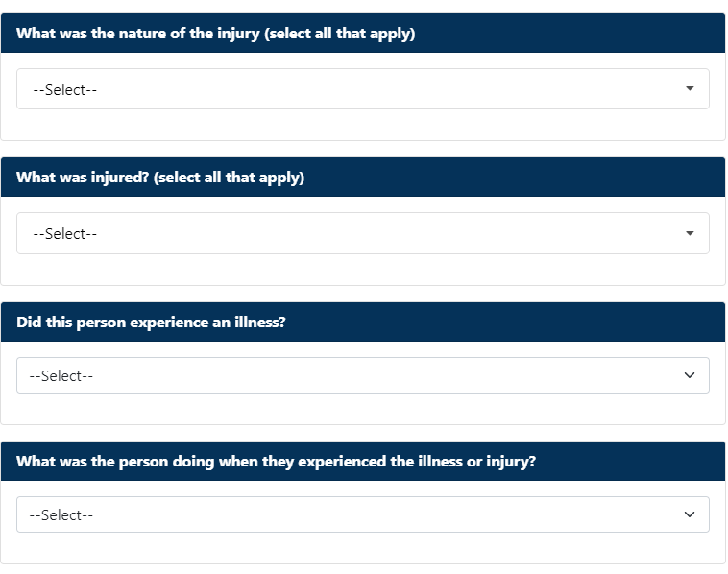
Notes:
Once you have added an individual, the system will ask you a series of questions.
For Injury or Illnesses. If the individual was injured or became ill, select “Yes”, and select additional information about the injury or illness, if known.
If you select “Yes”, you will be asked to select a severity and then answer the questions regarding the nature of the injury or illness. If the severity or nature is not known at the time, you may leave this field unselected. The option labeled “No medical treatment” may be selected if the individual only received first aid.
Before going on, select an answer to the question, “What was the person doing when they experienced the illness or injury?”

Slide 24
Notes:
Answering “Yes” to the injury or illness questions about an individual will automatically trigger an email notification to CAP members for entering a statement about the SSO. If the individual was neither injured nor became ill and was not directly involved in the SSO (such as a driver, pilot, instructor pilot, etc.), you can select “Yes” to the witness question. If the individual is a CAP member, they will receive an email notification for entering a witness statement. Remember, if a non-CAP member is involved in or witnessed an SSO, their contact information should be included in the attachments tab covered later.
The Follow Up field can be used to select any known updates about an individual who was injured or became ill. For example, if an individual was transported to a medical facility and later either received medical treatment or if the final result was first aid only in accordance with CAP regulation 160-2.
If “First Aid” is selected, the region commander or the region director of safety have the option to close the occurrence or to require a review.

Slide 25
Notes:
Once you have answered the relevant questions about an individual, they will be listed in the “Individuals involved in an SSO” field which will also depict some additional symbols that pertain to them. In this case, John Doe is depicted as having been injured. You can add as many individuals as you need to using the same process just described.

Slide 26
Notes:
The Resources tab contains information about damaged aircraft, vehicles, equipment, or facilities, as applicable. If nothing was damaged, you may leave this information blank. You may list as many resources as you need to in this tab.

Slide 27
Notes:
In the resource field, you can select aircraft, vehicle, equipment, or facility. You will be asked a series of questions about the resource and individuals involved. The questions will vary depending on the resource selected. We cover the list of possible questions in the slides that follow.

Slide 28
Notes:
Note that not all of the following questions will be associated with each resource and the specific wording of the question may vary.
Who owns the resource? Is the resource CAP-owned, member-owned, or other-owned
Who was onboard? In this field, you will be able to select from the individuals listed previously and select the role they were serving in at the time. If you need to go back and add an individual, you may do so and then return to this tab to associated them with the resource.
What specific resource was involved? Based on the selected resource type, you can select from a list of information about the resource. If this field is auto filled, verify it is accurate.
When did the damage occur? This question may include the phase of flight or the driving situation during which the damage occurred.
What was damaged? You can select from a list of components that were damaged in the SSO.
Registration. Select or enter the registration, if known. If this field is auto filled, verify it is accurate.
Type. This field is specific to aircraft and should be auto filled based on previously entered information. Verify it is accurate.

Slide 29
Notes:
Lastly, we briefly cover the Attachments tab. Here, you can upload any records, documents, or pictures associated with the SSO. Don’t forget to include any non-member contact information in this tab.

Slide 30
Thank you!
Notes:
This concludes the Safety Reporting segment of the CAPSIS module. You may now close this presentation and take the knowledge check quiz.

