Slide 1
Mission Briefing
John Desmarais
Director of Operations
Civil Air Patrol National Headquarters
11 August 2022

Slide 2
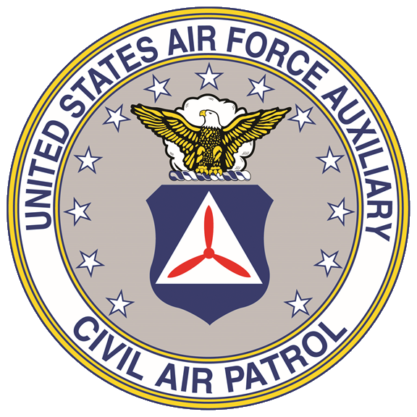
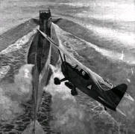
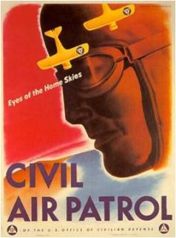
            Performing Missions for America since December 1st, 1941
  World War II Missions
    Coastal Patrol including anti-submarine combat
    Homeland Security
    Search and rescue and natural disaster support
    Emergency transport of personnel and cargo
    Border patrol
    Air defense (targets for AA, aircraft, search light)
    Observation training support for Army units
    Forest fire spotting
    Flight training
    Cadet programs and aerospace education
  1946: Incorporated Non-Profit (Public Law 476)
  1948: Became Auxiliary of the USAF (Public Law 557)
Most core WWII missions are still CAP’s core missions today!
2

Slide 3
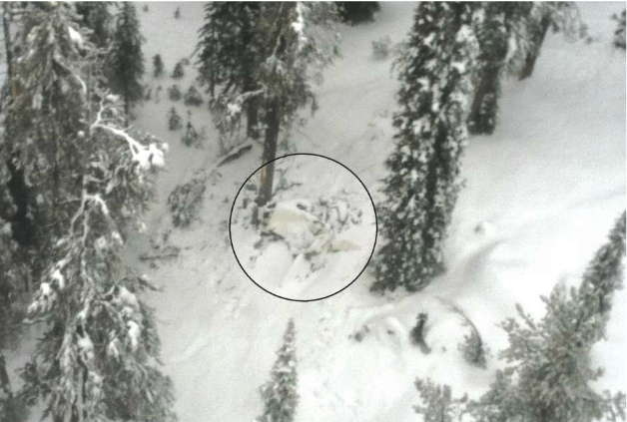
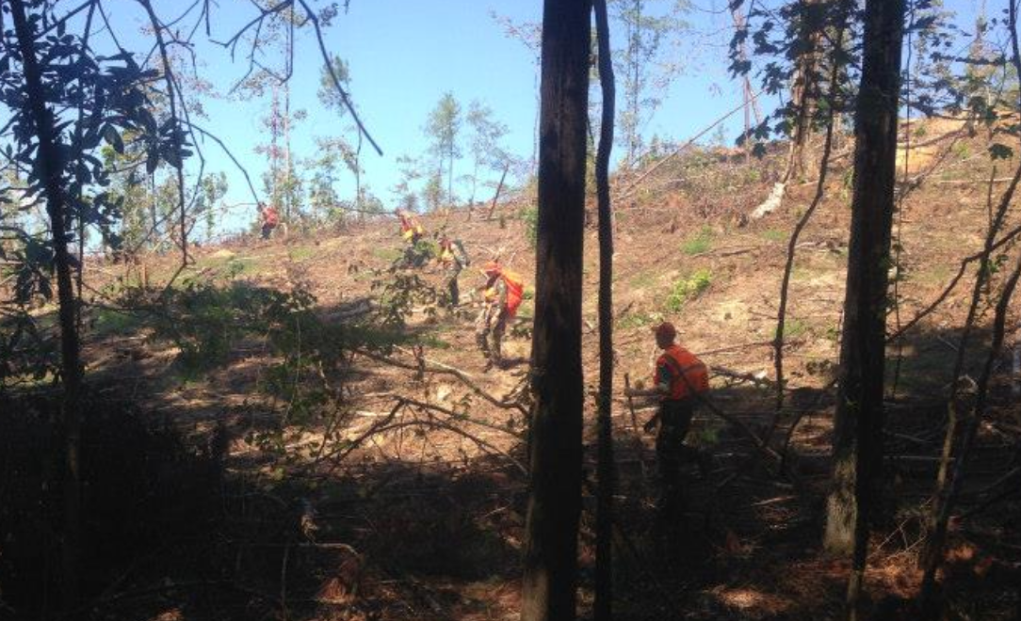
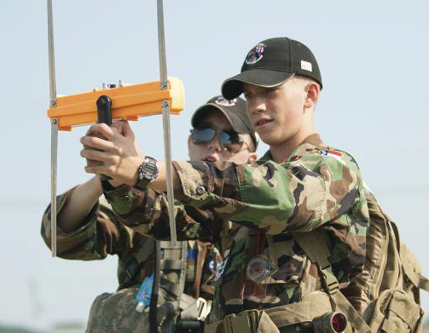
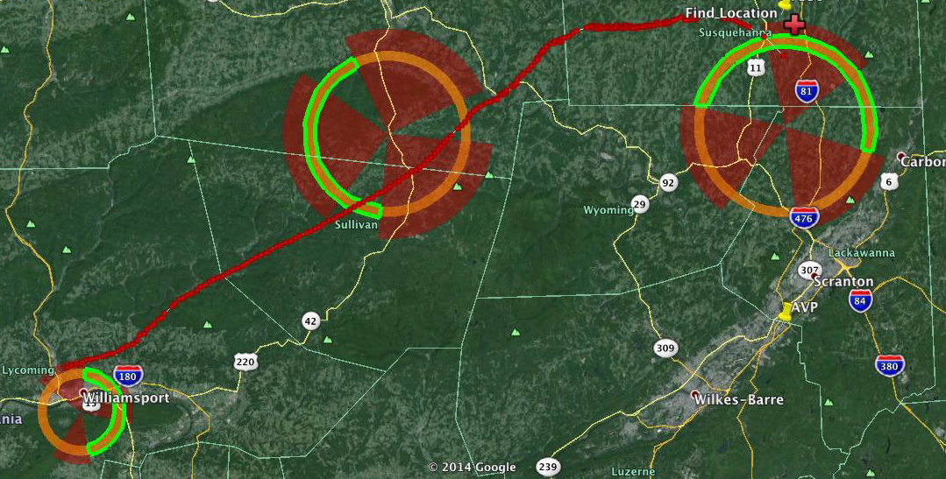
Search & Rescue Operations
CAP was credited with 108 lives saved in FY21 and 138 so far in FY22
3
Notes:
12 April 2022

Slide 4
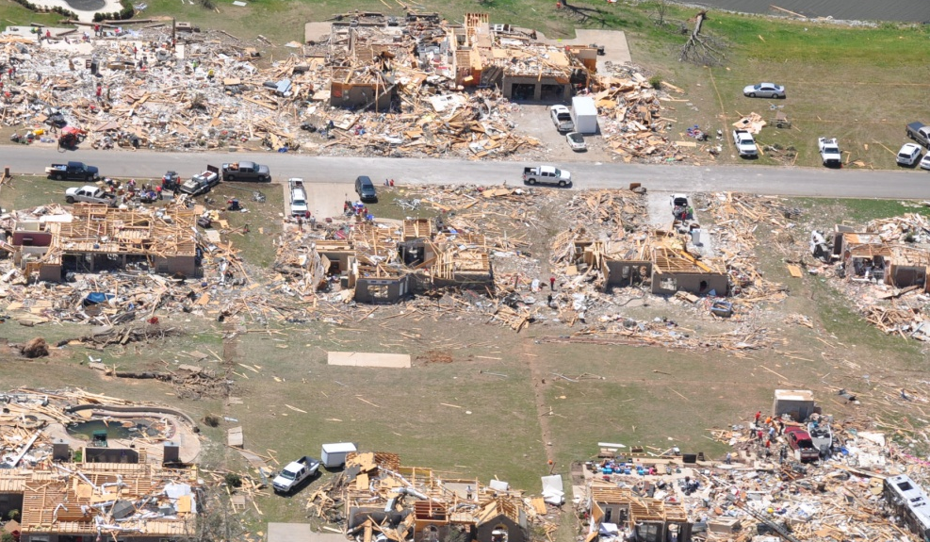
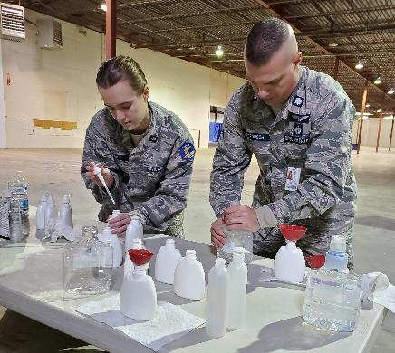
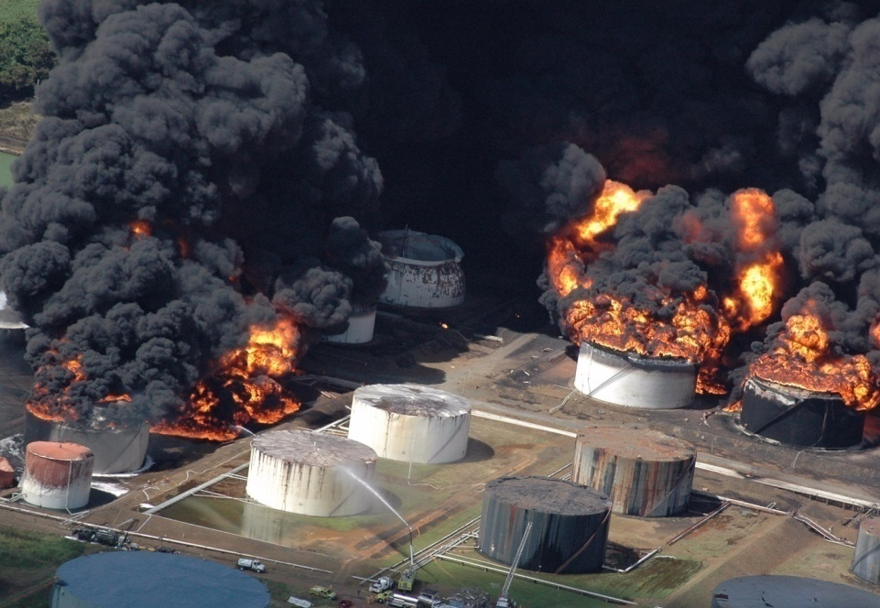
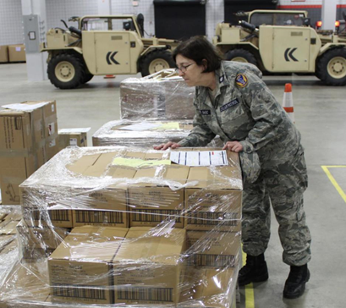
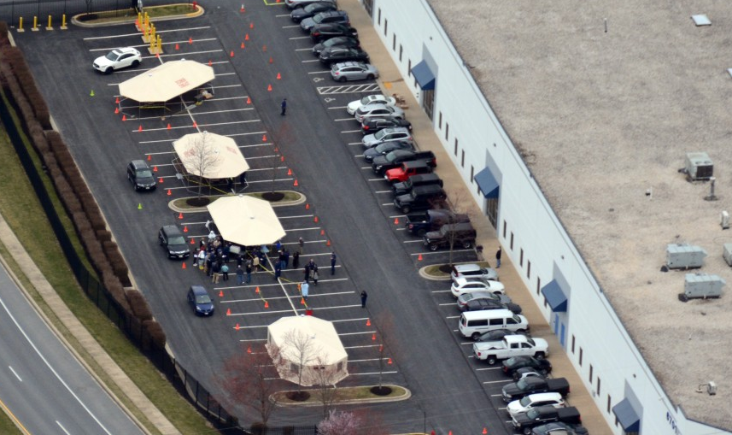
Disaster Relief Operations
Notes:
CAP provides support a variety of disaster both with airborne as well as ground responders.

Slide 5
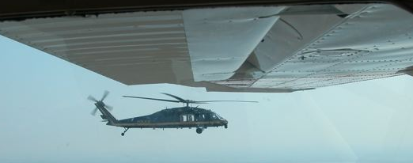
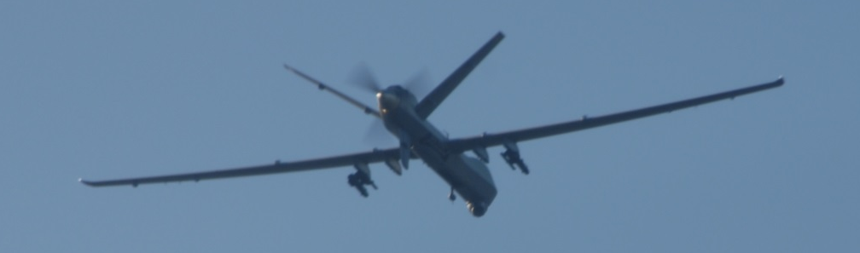
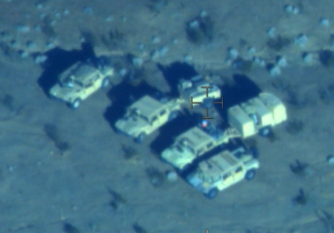
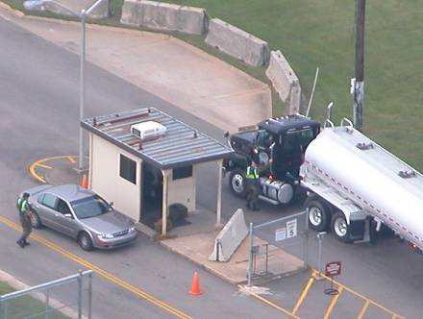
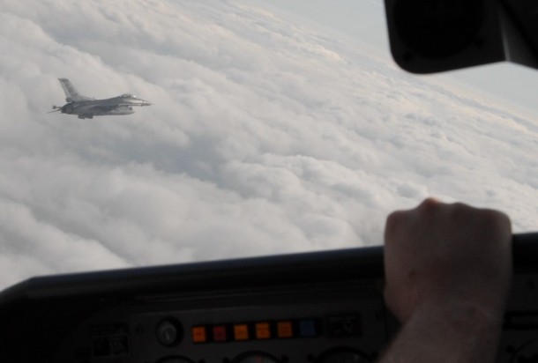
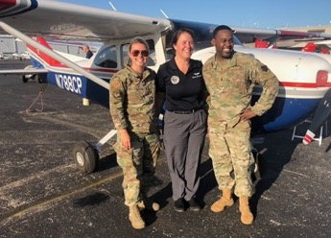
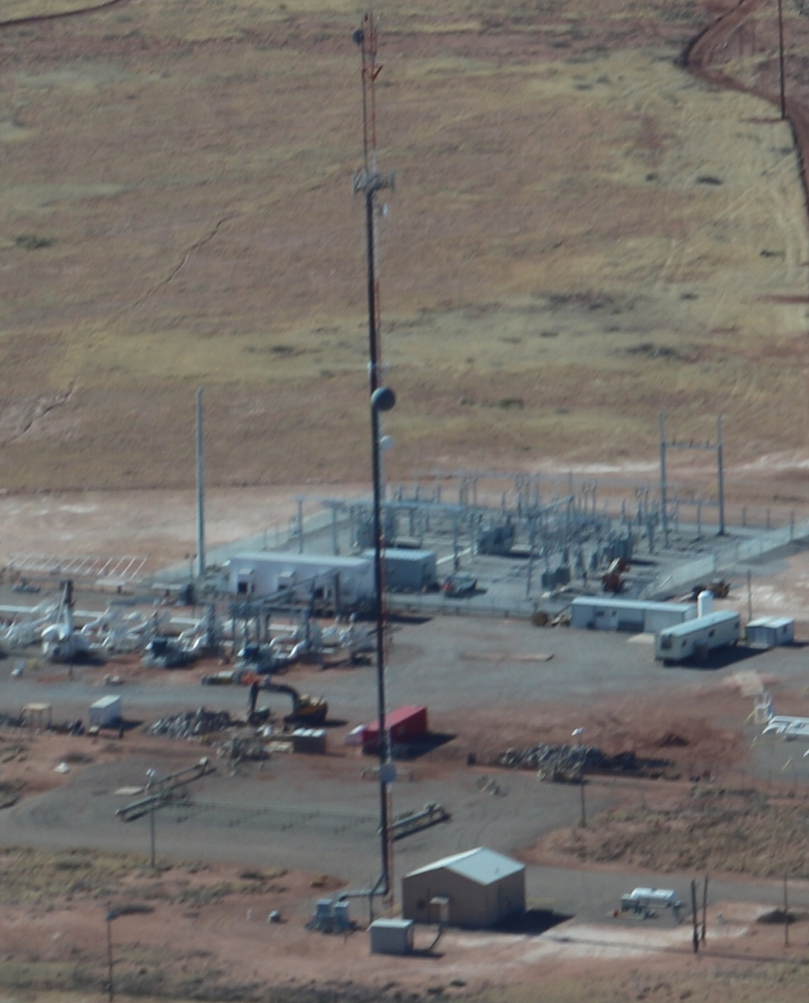
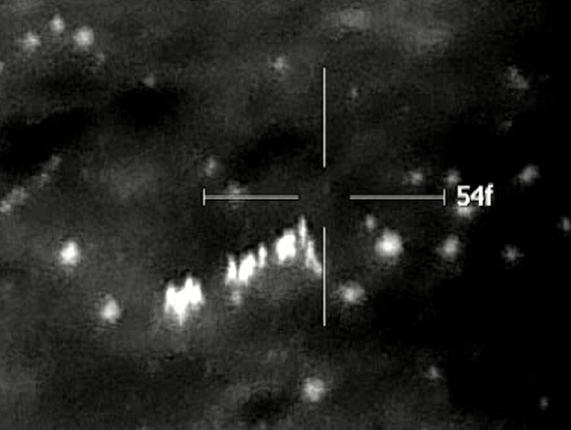
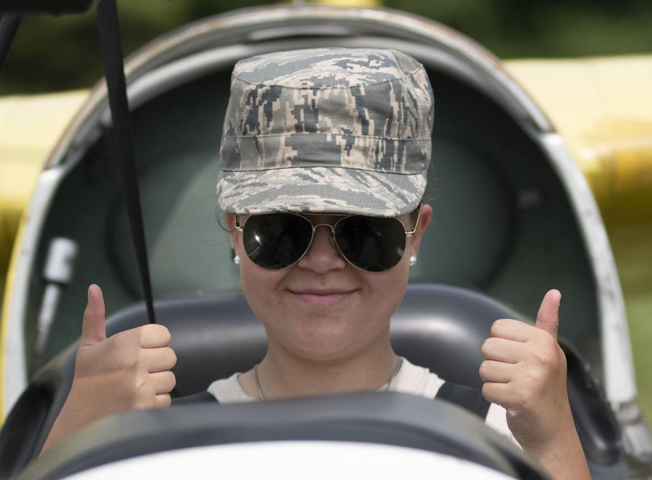
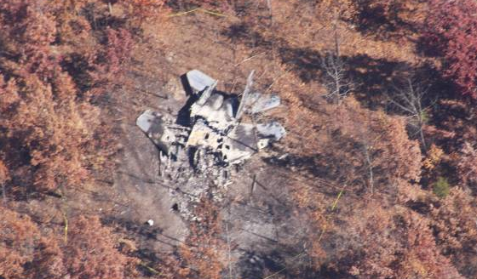

CAP doesn’t just support SAR & HADR
5
Notes:
5

Slide 6
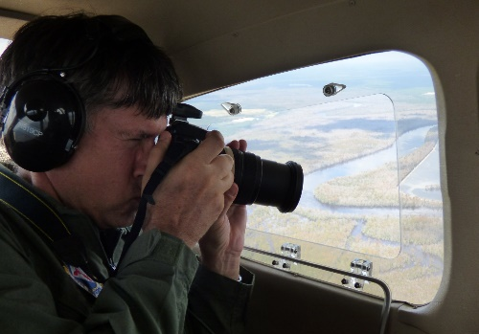


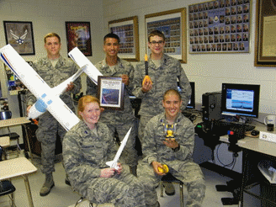
Congressional Charter
SAR & Disaster Relief
Homeland Security
Drug Interdiction
AFROTC Flights
AFJROTC Flights
Emergency
Services
Leadership
Character Development
Aerospace Education
Physical Fitness
Cadet
Programs
CAP Members
AE Members / Teachers
General Public
STEM Activities
Aerospace Education
6

Slide 7
Legal Authority
Title 36
Title 10
CAP / AFAux
Title 36, USC 40301 – Federally Chartered Corporation
Serving our communities while not under federal response.
Title 10, USC 9442 – Volunteer Civilian Auxiliary of the Air Force
Volunteer Civilian Auxiliary when the services of the Civil Air Patrol are used by any department or agency in any branch of the Federal Government.
The Civil Air Patrol shall be deemed to be an instrumentality of the United States with respect to any act or omission of the Civil Air Patrol, including any member of the Civil Air Patrol, in carrying out a mission assigned by the Secretary of the Air Force.
7

Slide 8
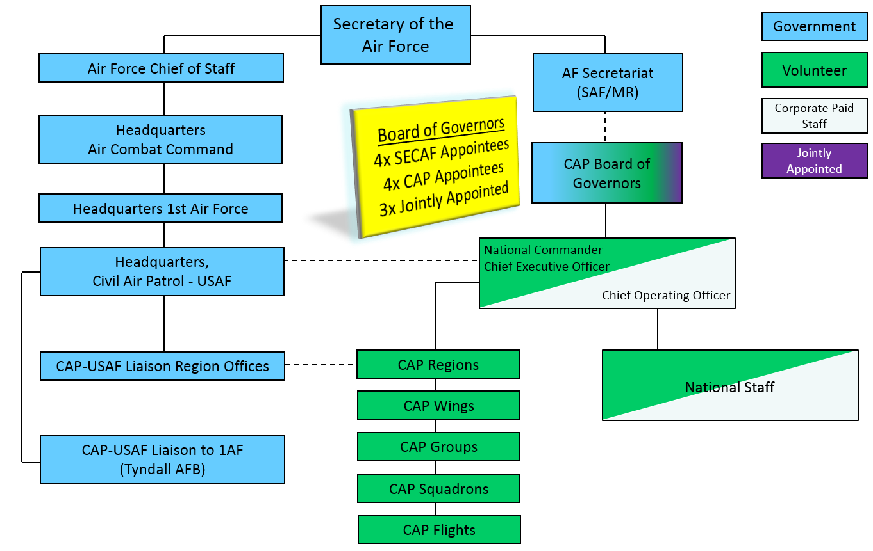
Organizational Chart
8
Notes:
Current organization chart showing both the AF and CAP structure as well as the lines of coordination. Theoretically, the structure starts with the President; however, since CAP is the (temporarily) AF Auxiliary, they can only be tasked by an AF component. Tasking authorities are the Air Component Commander (1AF, 11AF and 13AF) and CAP-USAF. Tasking authority is defined in AFI 10-2701, Organization and Function of the Civil Air Patrol.
For example, during Deepwater Horizon (Gulf oil spill response), Commander USNORTHCOM desired oversight and tasking authority for all participants including CAP. USNORTHCOM is a joint command and cannot task CAP as the AF Auxiliary, therefore AFNORTH maintained tasking authority as the Air Component Commander.
CAP is an all-volunteer organization with the exception of the CAP National Headquarters staff. The gray box in the middle represents CAP NHQ and is a paid staff of approximately 100 members. Additionally, each CAP wing has a paid Wing Administrator, some part-time while most are full-time. In total, there are approximately 150 full-time equivalent paid employees. Their purpose is to perform administrative duties (i.e. FM, safety, publications, HR, etc.) to keep an otherwise volunteer organization operating. This is a customary practice for most volunteer organizations.
Though CAP-USAF re-aligned under 1st Air Force and Air Combat Command, the right side of the slide did not change.

Slide 9
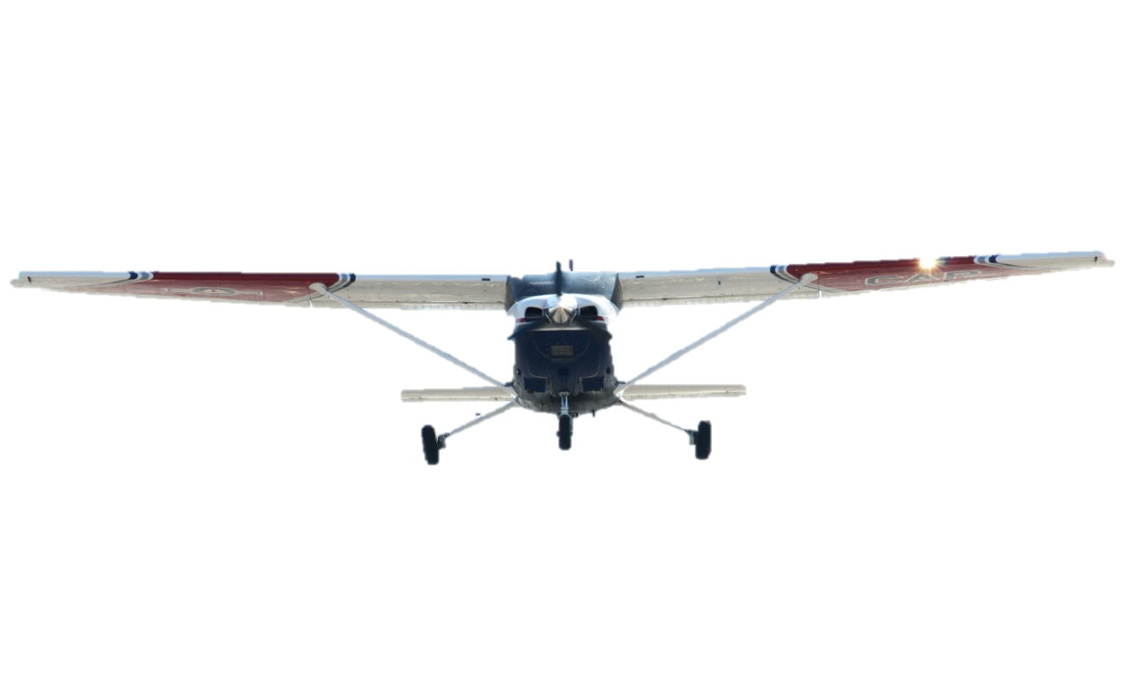

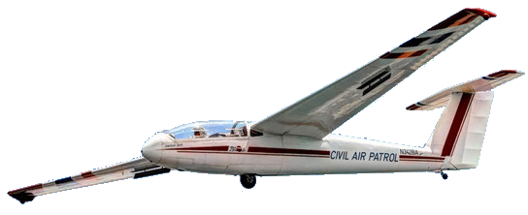
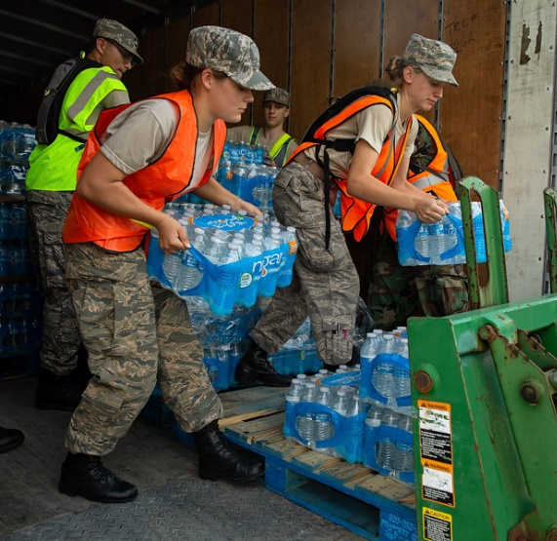
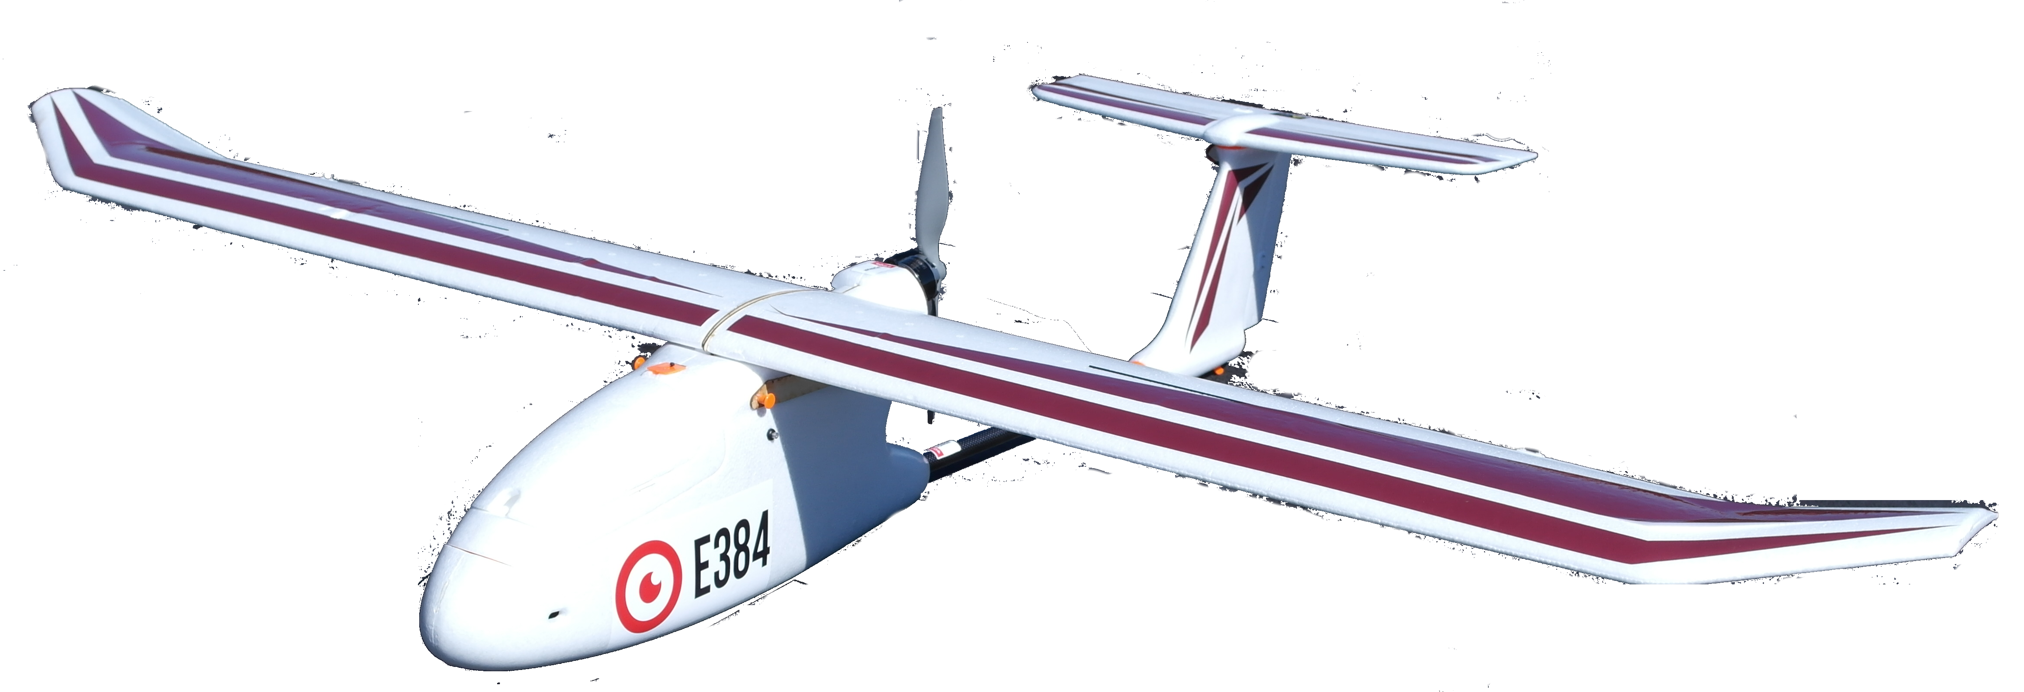
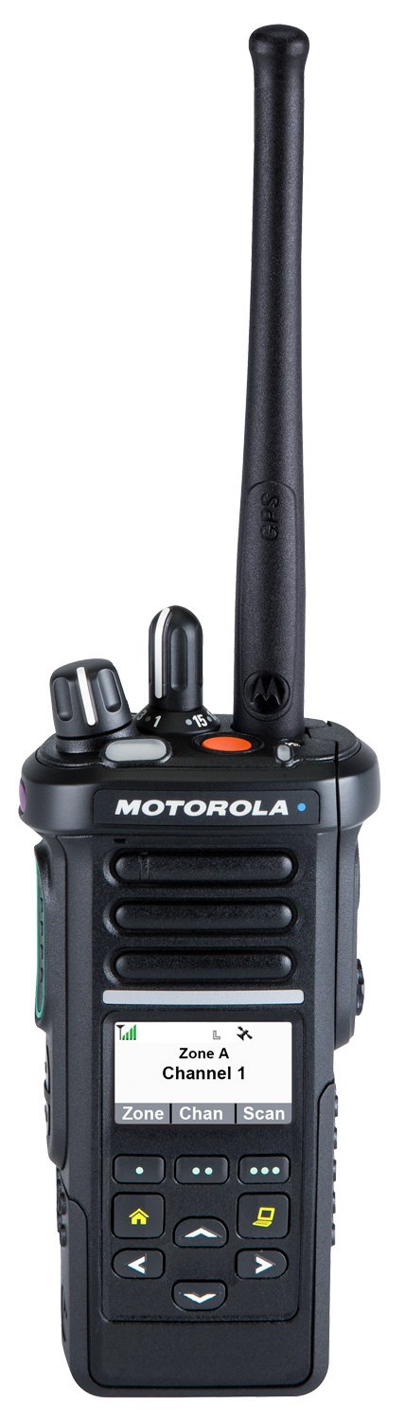
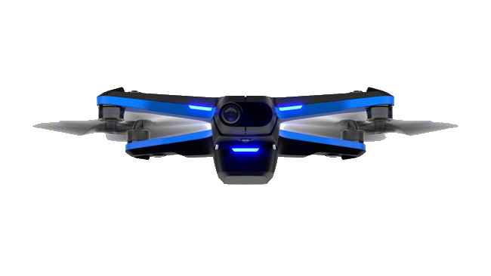
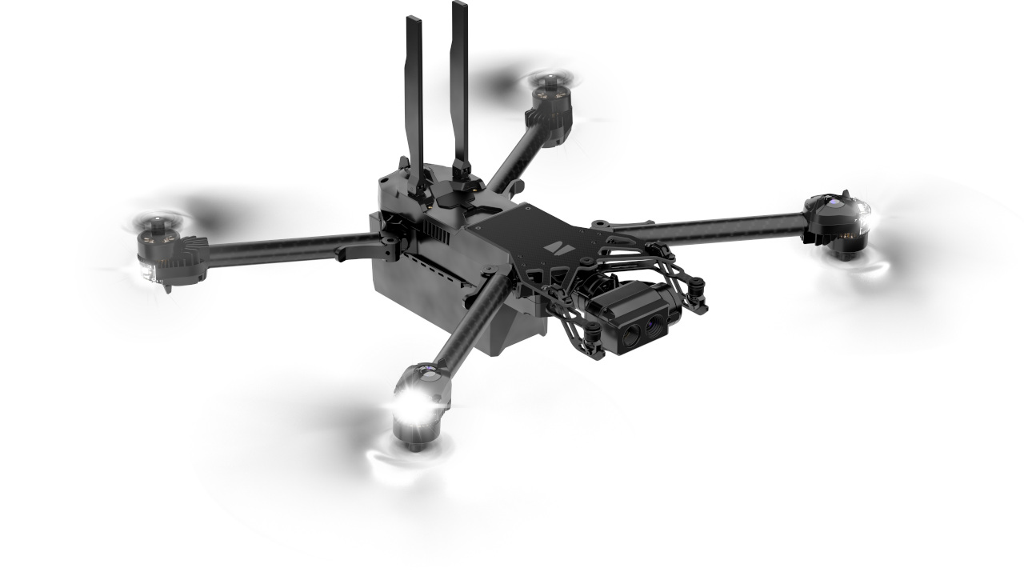
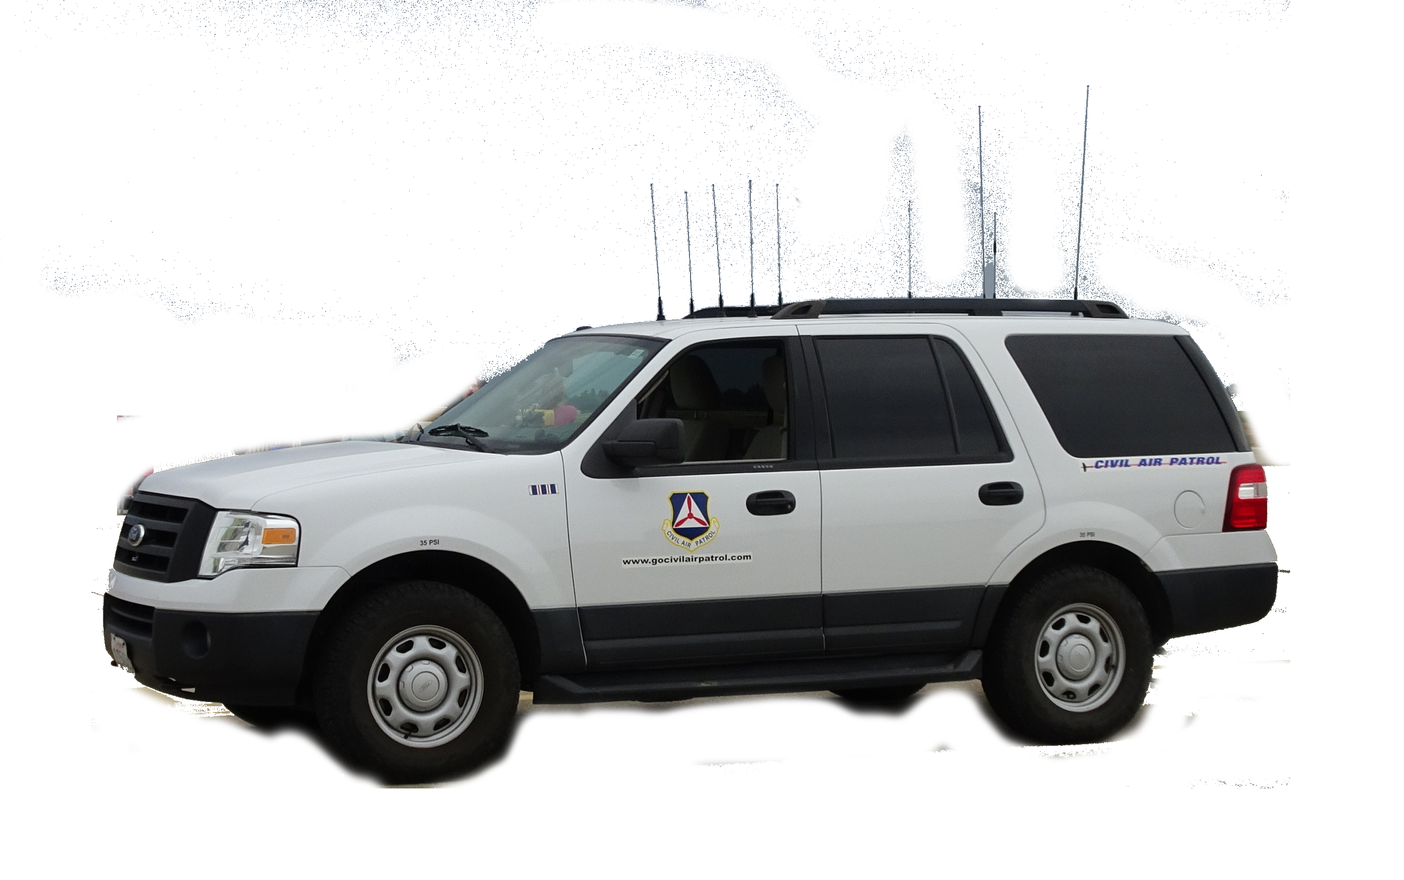
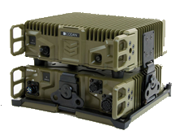
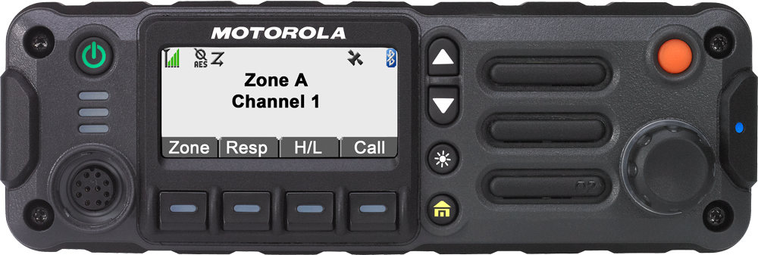
Membership and Resources
2022 Statistics
Membership
Adult Members | 34,273
Cadets | 24,098
Total | 58,371
Units
NHQ, Region, Wings, Units | 1,399
Equipment
Aircraft | 540
Gliders | 45
Hot Air Balloons | 2
Vehicles | 1,045
sUAS | 2,350
VHF LMR Radios – Short/Mid Range | 12,886
VHF Repeaters – Fixed & Tactical | 727
HF Radios – Long Range | 2,060
9
Notes:
Current as of 31 January 2022. Equipment pending retirement or sale or in NHQ storage for eventual retirement, not active use, is not included.

Slide 10
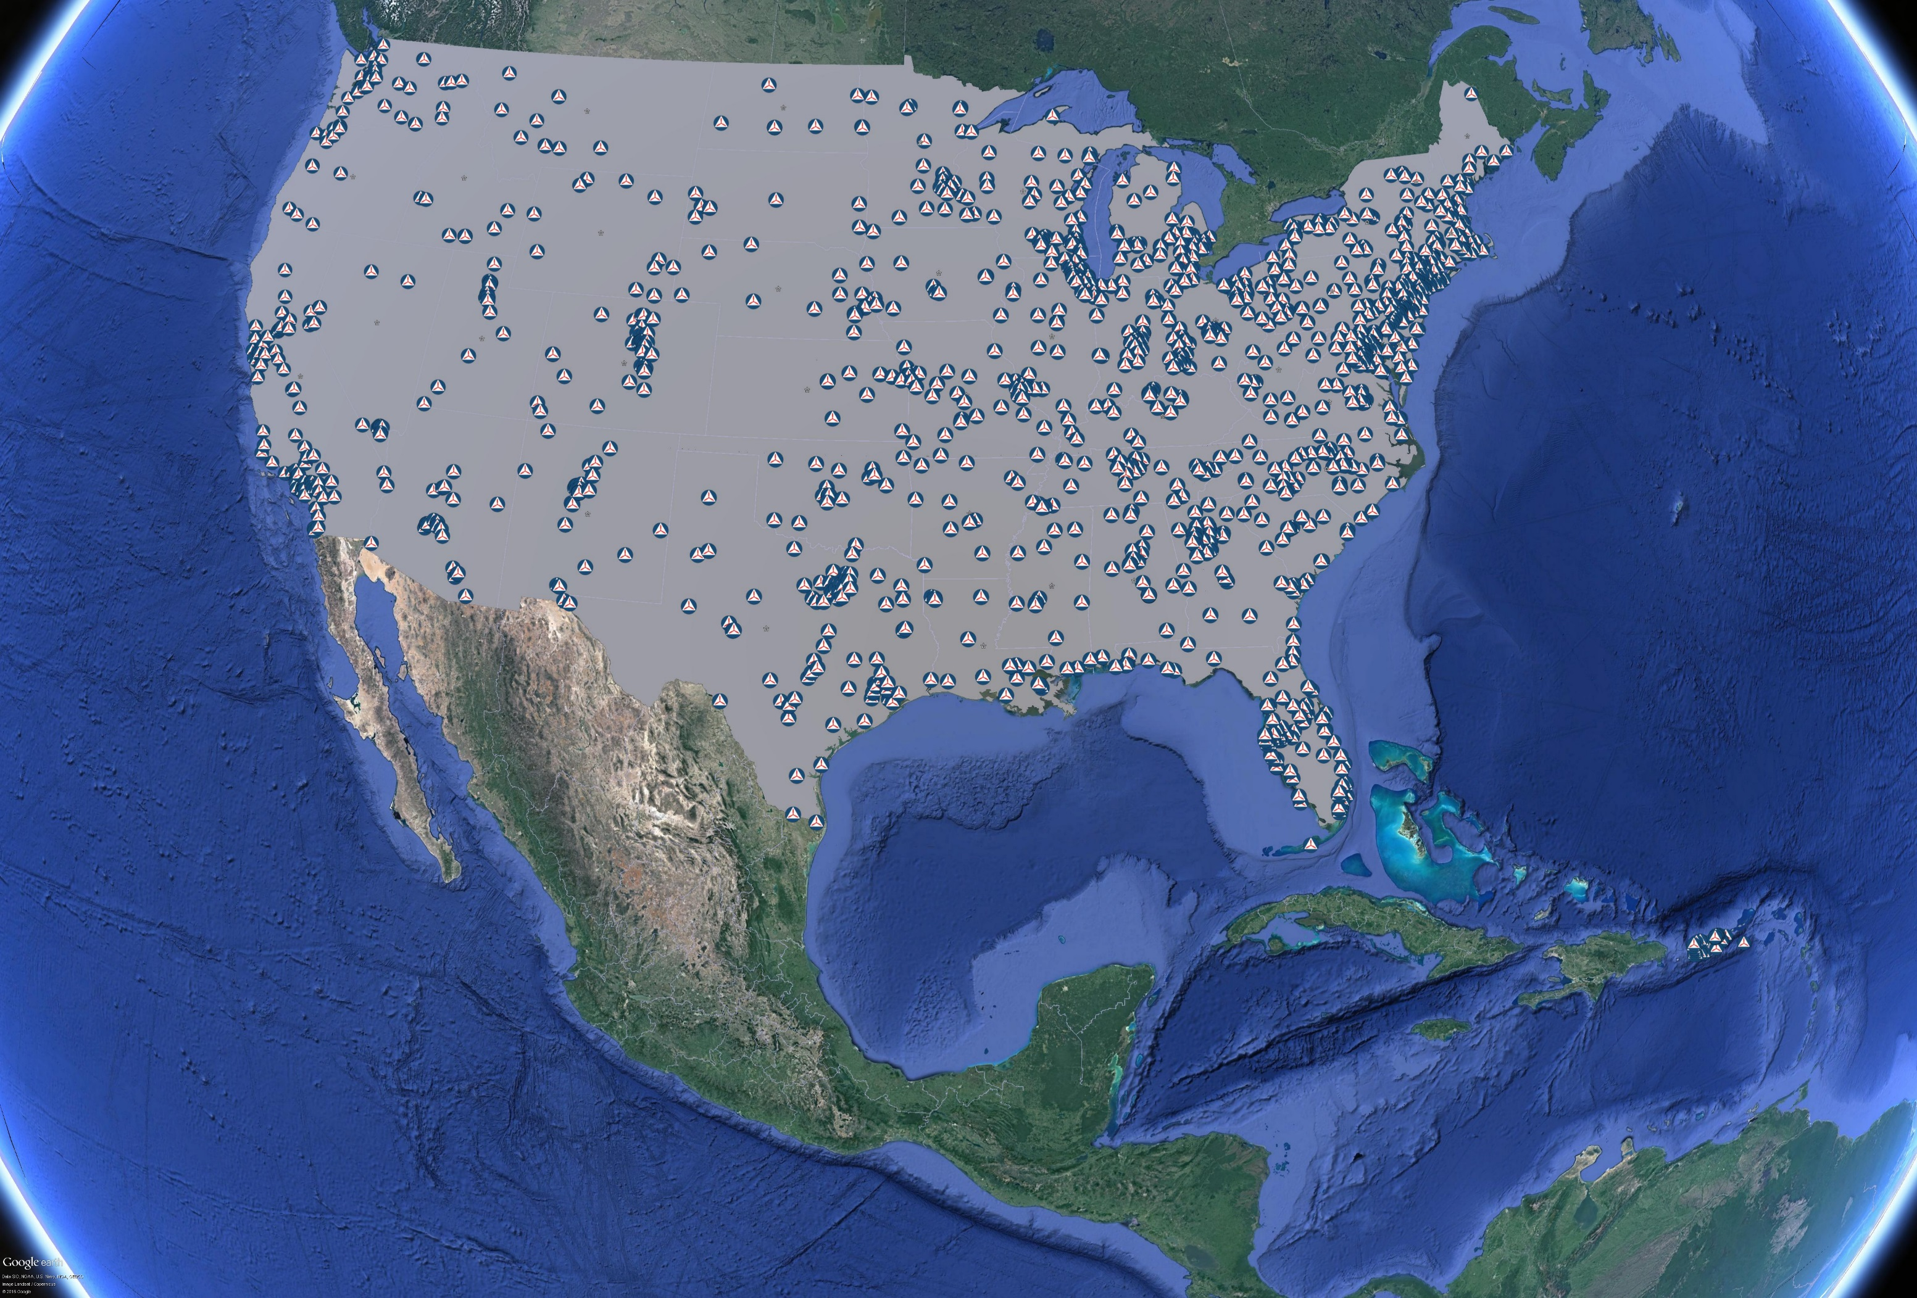
CAP Units
1,399 CAP Units Nationwide
        8 Regions
        52 Wings
        133 Groups
        743 Composite Squadrons
        213 Senior Squadrons
        200 Cadet Squadrons
        50 Flights
10

Slide 11
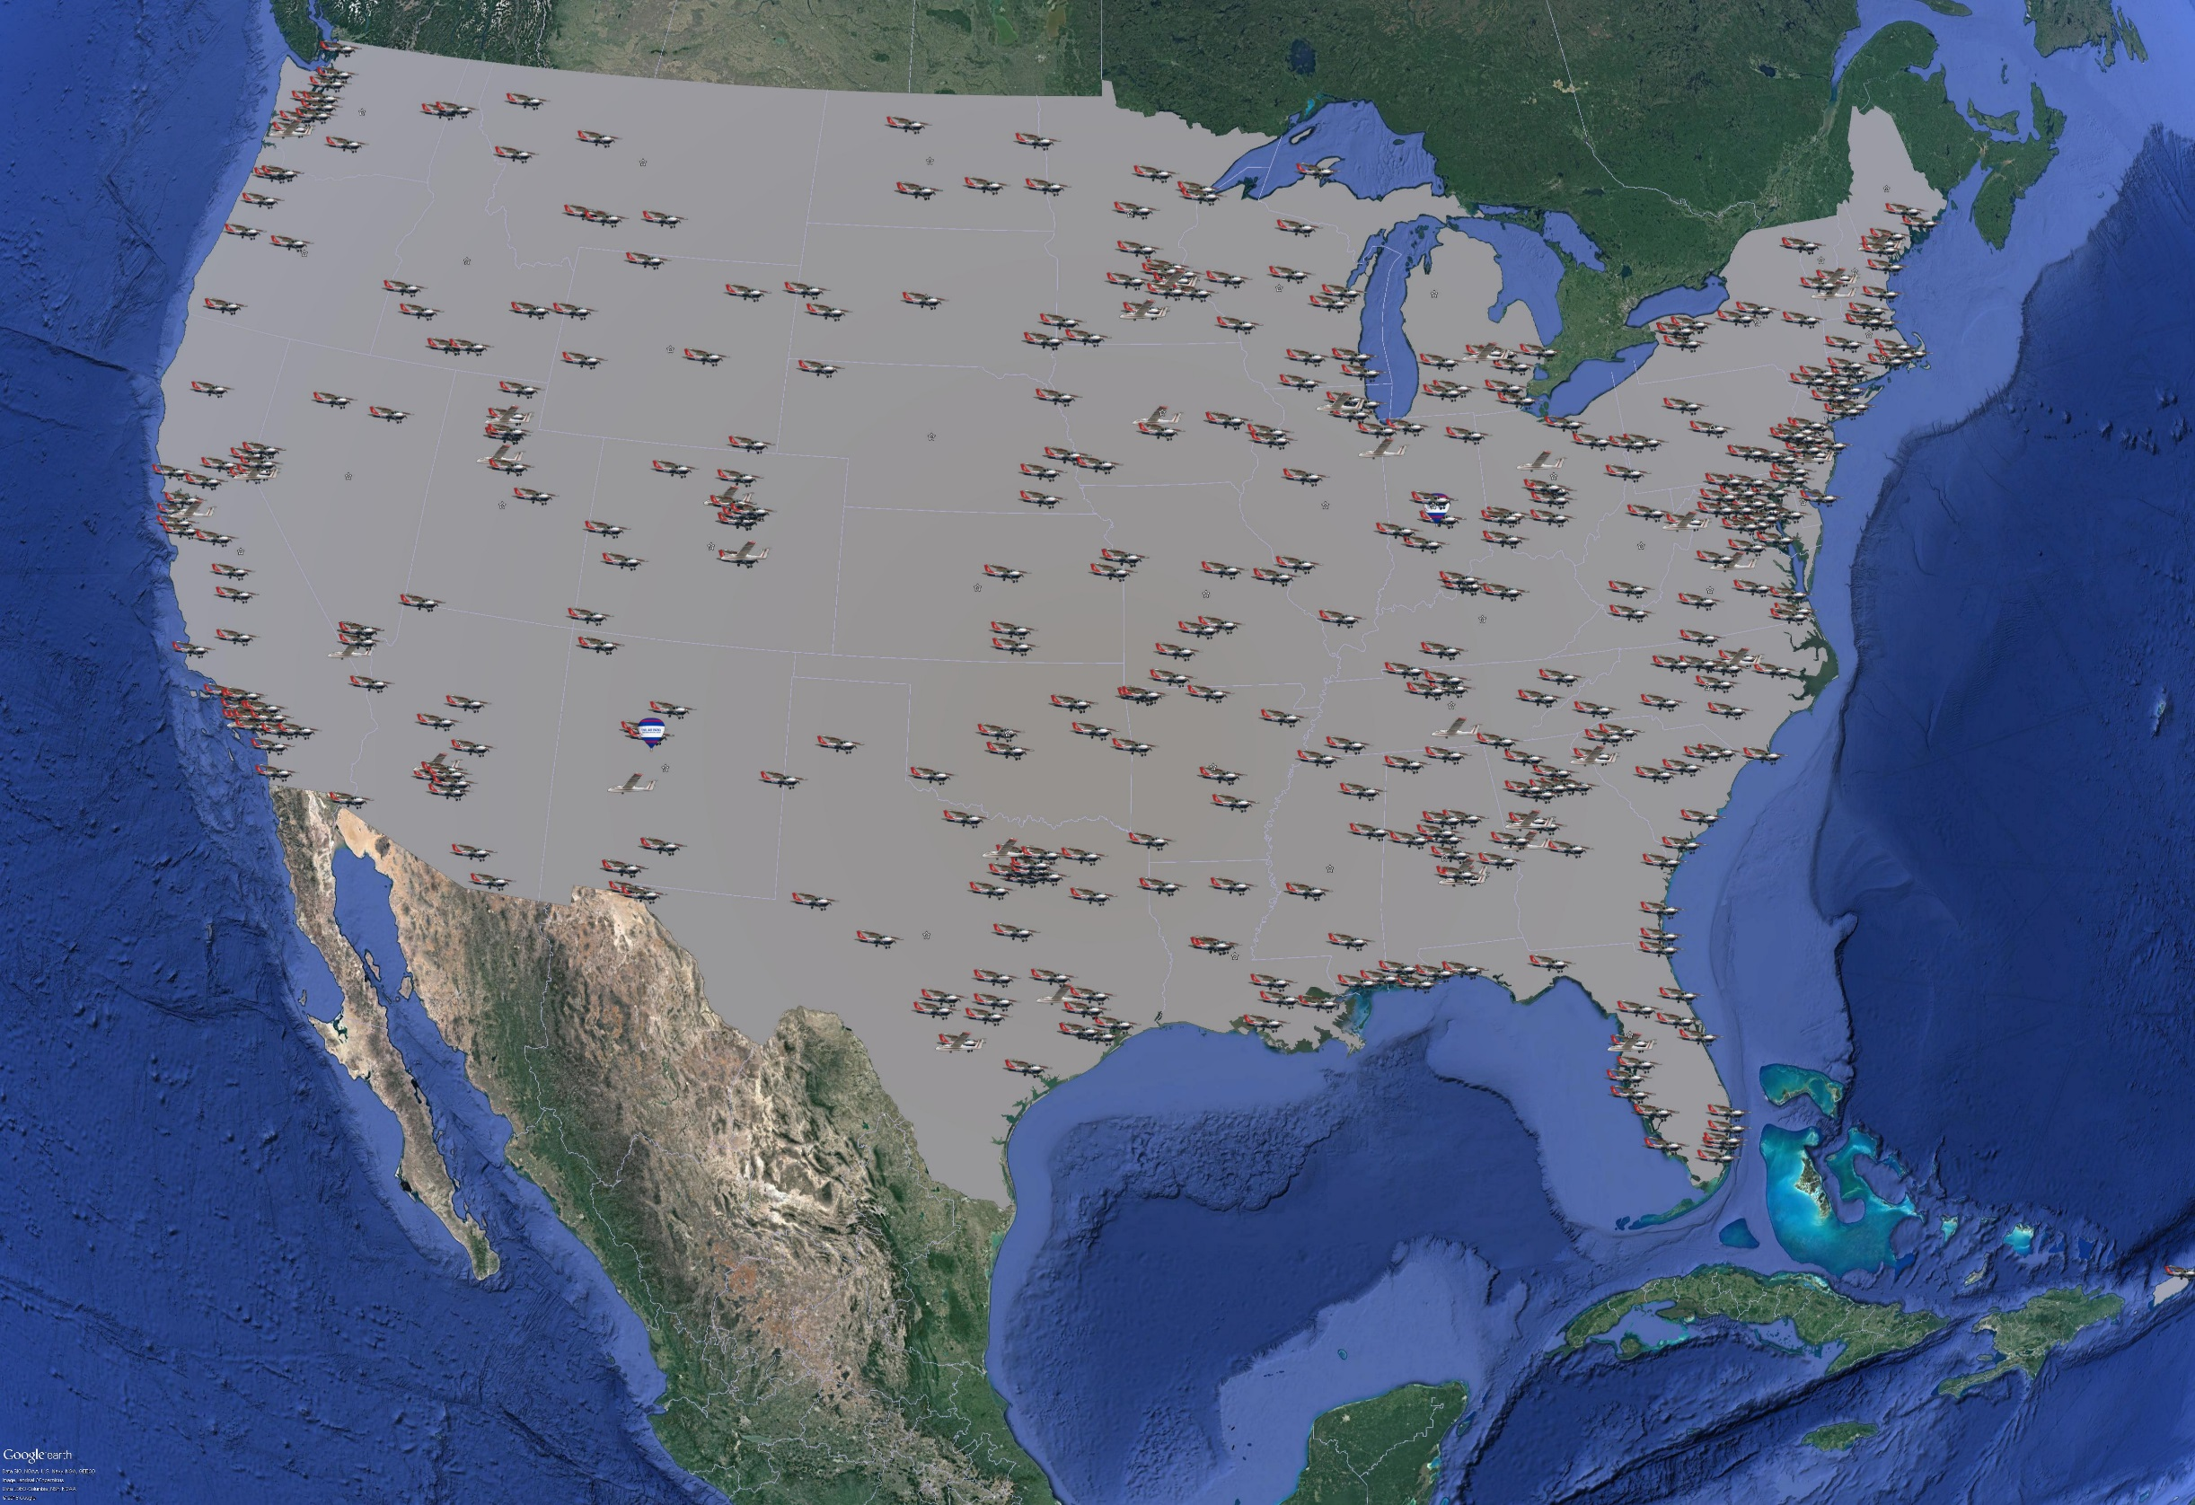
CAP Aircraft
587 Aircraft Owned By CAP
        540 Powered Aircraft
        45 Gliders
        2 Hot Air Balloons
11

Slide 12
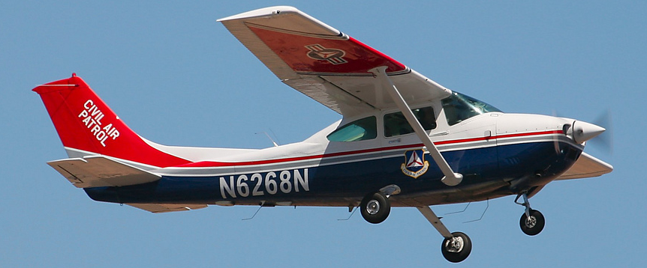
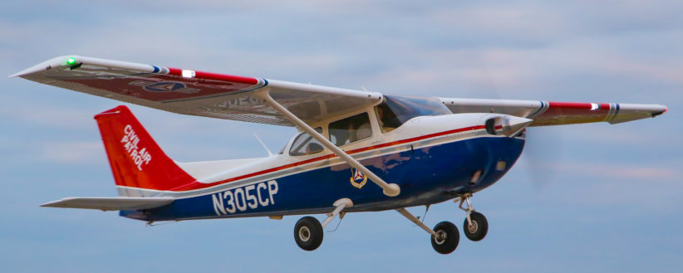
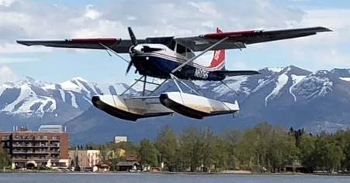
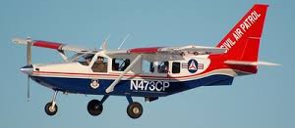
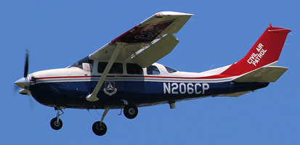
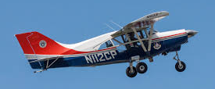
Active Powered Aircraft
Cessna 182 (292)
Cessna 172 (188)
Cessna 185 (3) in AK
Maule MT-7-235 (3)
Gippsland GA-8 (16)
Cessna 206 (38)
12
Operate from 2500’ runway
VHF AM and FM radio
Cruise speed 110-135 knots
Range 520-730 NM

Slide 13
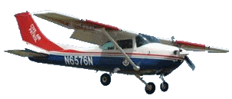
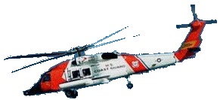

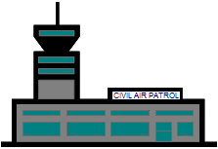
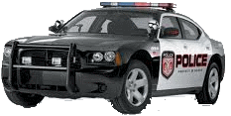
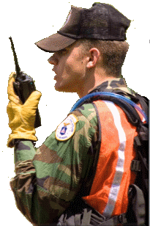
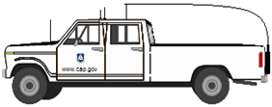
CAP Communications System
CAP Aircraft
Partner Agency Aircraft
Long Range via HF
CAP Fixed Repeaters
Short to Medium Range via VHF
Comm with higher HQ
Incident Command Post
Agile support for SAR, DR, DSCA, HLS ops
Commercial infrastructure independent
Analog, digital and encryption capable
VHF for local (<20 miles)
Fixed repeaters for medium range (<50 miles)
Airborne repeaters for temporary medium
range (<200 miles)
HF for long range (unlimited)
Fully interoperable with all partner agencies
Partner Agency Vehicles
CAP Ground Vehicles
CAP Ground Teams Dismounted
13
Notes:
The CAP communications system provides mission critical secure tactical command and control communications (C3) between aircraft, ground teams and incident command posts performing search and rescue and disaster recovery operations in the field

Slide 14
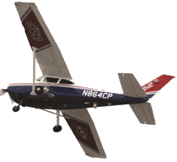






VHF-FM & HF Resources
  572 Fixed VHF-FM Repeaters
  154 Tactical VHF-FM Repeaters
  2,070 VHF-FM Base stations
  5,077 VHF-FM Mobile radios
  5,640 VHF-FM Portable radios
  768 HF-ALE Base Stations
  722 HF Non-ALE Base Stations
  320 HF ALE Mobile Stations
14

Slide 15





Communications Infrastructure
Legend
Fixed VHF-FM Repeaters
Fixed VHF-FM Base Stations
Fixed HF-ALE Base Stations
Fixed HF Non-ALE Base Stations
15

Slide 16


Remote Base Options
CAP Aircraft
Repeater Remote Access
CAP Guard
CAP
Repeaters
Remote Base Station
Incident Commander
Internet
Dismounted Ground Teams
Ground Vehicles
Incident Command Post
16
Notes:
ICPs do not have to be fixed locations within a Wing any longer. ICPs can be “virtual” as was done with the 2017 Hurricane Season, but with greater connectivity to resources in the field remotely. We can’t put all of our eggs in one basket since commercial infrastructure can be limited or even destroyed by some disasters.

Slide 17





COTS Handheld Camera Packages
Carry Aboard Cameras (Nikon Pro Quality) for each powered aircraft
Garmin Virb Elite & Go Pro Hero Wing Mounts
DAART: Domestic Operations Awareness &
Assessment Response Tool
Notes:
79 D200s
234 D90s
264 D7100s
577 Total
There is another 54 D100s that can provide geotagged imagery when paired with a GPS, but most are not so we don’t count them.

Slide 18
DAART
Domestic Operations Awareness & Assessment Response Tool

Slide 19


Waldo Air XCAM Sensors
19

Slide 20


High Resolution Collection

Slide 21

Imagery Can Be Collected Over DoD Installations Pre or Post Event
Tyndall AFB
21

Slide 22

Arkansas Tornado Remote Damage Assessment Using Artificial Intelligence
Notes:
The color scheme in the imagery is:
Unaffected – Green
Affected – Yellow
Minor Damage – Orange
Major Damage – Red
Destroyed – Purple

Slide 23


Sensor Equipped Aircraft
Goal is to field 24 to 30 mid-range FLIR Talon MMS Sensors
4 in final stages, 8 more to be install late this summer and fall
2 Cessna T206Hs for Green Flag and DSCA Support with higher end Wescam MX-15 Hdi Sensors & 2 older 182Qs with analog MX-15s

Slide 24




Inexpensive Small
UAS Applications
DJI Phantom 3 Skydio 2 Pro Skydio X2D Event 38 E384s & E386s Quantix Recon
& 4 Pros

Slide 25

sUAS can also support mishaps like the recent T-38 crash near KMGM
Presented for Academic Purposes Only

Slide 26


sUAS can also support mishaps like the recent T-38 crash near KMGM
Presented for Academic Purposes Only

Slide 27


Slide 28

AERONet for CAP Operational View

Slide 29
Mission Qualified Personnel
  Over 33,600 members are involved in operations
    600+ incident commanders
    2,800+ mission pilots
    6,000+ other aircrew members
    4,000+ ground team members
    800+ personnel have additional law enforcement screening
    19,000+ communication network operators
    140+ chaplains and 120+ chaplain support specialists
29
Notes:
29
Communications network operators includes all personnel with communications training. Most are entry level users. Each CAP Wing and Region has a Director of Communications. There are also 776 personnel that are qualified as CAP Communications Unit Leaders, meeting CAP’s internal mission requirements. There are another 3,011 CAP Mission Radio Operators, again meeting CAP internal mission requirements, but have taken steps beyond entry level users in communications, and most are also CUL Trainees.

Slide 30
Operational Missions
  CAP’s AOR is border-to-border and coast-to-coast within the CONUS, plus Alaska, Hawaii, Puerto Rico, and the U.S. Virgin Islands
  May only support Federal agencies in its capacity as AF Auxiliary
  AF Component Commanders task and approve CAP mission support
  Flies 60-80% of 1 AF/AFNORTH’s daily sorties
  In typical year, CAP flies about 80,000 hours on Air Force Assigned Missions, 15,000 to 20,000 hours in direct customer support beyond CAP’s own missions
30
Notes:
30

Slide 31
Posse Comitatus Act
  Cannot:
    Search individuals/vehicles
    Seize
    Arrest
    Interrogate
    Direct Law Enforcement Activities
31

Slide 32



Cost Effective Force Multiplier
Notes: Chart shows average cost per flying hour
CAP normally receives agency mission funding via a MIPR
32
Notes:
The above rates are based on FY22. The rates can be found online at:
http://comptroller.defense.gov/Portals/45/documents/rates/fy2022/2022_b_c.pdf
We use the Other Federal User rate for comparison since we are normally providing services to DHS or another federal agency.

Slide 33
Defense Support to Civil Authorities CAP Advantage
SECDEF
OSD Executive Secretary
Joint Director of Military Support (JDOMS)
Chairman, Joint Chiefs of Staff
Commander, NORTHCOM
CAP Tasking
State Governor Request for Assistance
Coordination
Air Force
33
Notes:
Special CAP rules
AF Policy, endorsed by OSD allows requests for CAP from State/Local agencies bypass SECDEF approval process.
Why? Because CAP employment does not impact AF combat capability. This Allows CAP to react quicker

Slide 34
Request for Forces
NORTHCOM
Report
Requirement
AFNORTH-1AF (CAOC)
Report
Tasking
DoD
CAP (NOC)
888-211-1812
Tasking
Federal
Agencies
Report
Execution
CAP Wing
State/local
Agencies or NGOs
CAP Remains Under Military Operational Control
34

Slide 35


Bottom Line
  CAP is ready, willing and able to assist
  CAP volunteers are trained professionals who will work to meet your requirements
    Airborne Reconnaissance
    Air Defense Intercept Training
    Communications Support
    Chaplain Services
    Low level route surveys
    AF Thunderbird pre-show surveys
    Disaster Mental Health Response Teams
    Cordon support & crowd control
    Shelter Management
    Wing Inspection Team support
  CAP is a cost-effective force multiplier
35
Notes:
35
Disaster Mental Health Response Teams is what the Air Force calls CISM teams now.

Slide 36
QUESTIONS?

