Slide 1


The Future of the Communications Program
Mr. Malcolm Kyser
HQ CAP/DOK
Civil Air Patrol
CITIZENS SERVING COMMUNITIES

Slide 2
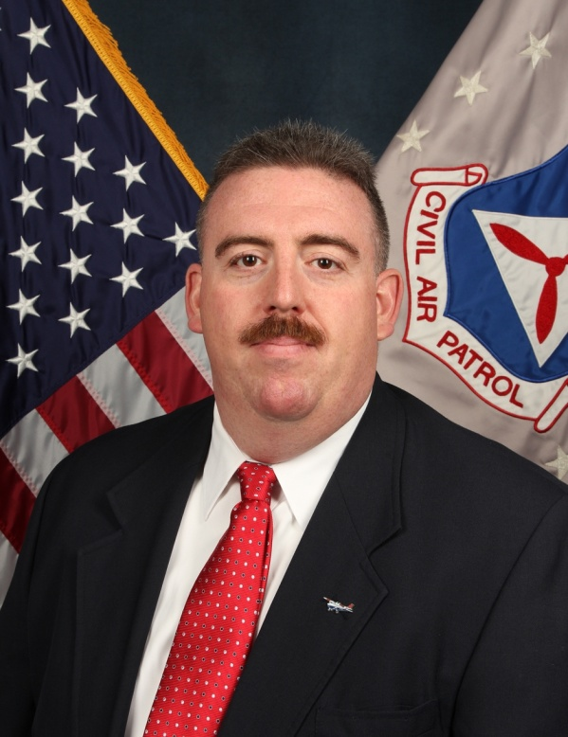
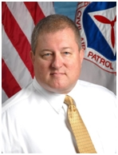
Webinar Presenters
John Desmarais
Director of Operations
National Headquarters
Malcolm Kyser
Chief of Communications
National Headquarters

Slide 3
Webinar Rules of Engagement
Members in the field will be in listen only mode. We have several hundred members signed up, so having everyone with an open microphone is not supportable.
We will try to answer questions throughout the webinar though. Just type your questions, and we will either answer you directly via text or provide a voice answer to your question.
The webinar itself, questions, and chat log are being recorded, so please remain respectful.

Slide 4
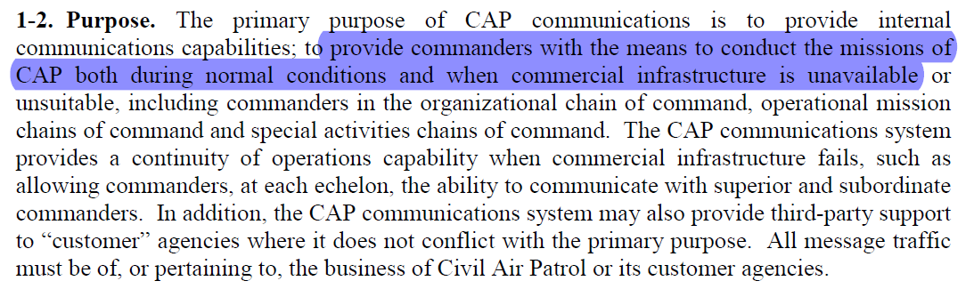
Purpose
CAPR100-1

Slide 5
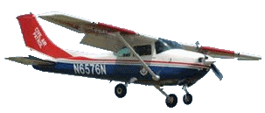
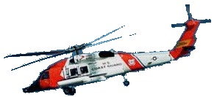
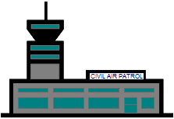
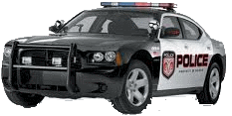
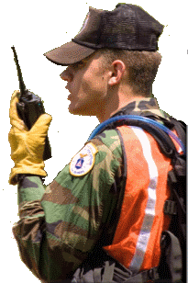
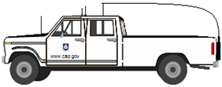
CAP Tactical Communications
CAP Fixed Repeaters
Partner Agency Aircraft
Long Range via HF
Short to Medium Range via VHF
Comm with higher HQ
Incident Command Post
Agile support for SAR, DR, DSCA, HLS ops
Commercial infrastructure independent
Analog, digital and encryption capable
VHF for local (<20 miles)
Fixed repeaters for medium range (<50 miles)
Airborne repeaters for temporary medium
range (<200 miles)
HF for long range (unlimited)
Fully interoperable with all partner agencies
Partner Agency Vehicles
CAP Ground Vehicles
CAP Ground Teams Dismounted
Notes:
The CAP communications system provides mission critical secure tactical command and control communications (C3) between aircraft, ground teams and incident command posts performing search and rescue and disaster recovery operations in the field

Slide 6
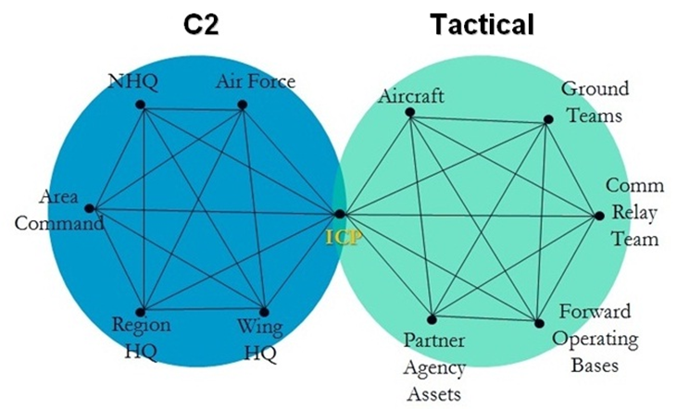
Bigger Picture

Slide 7
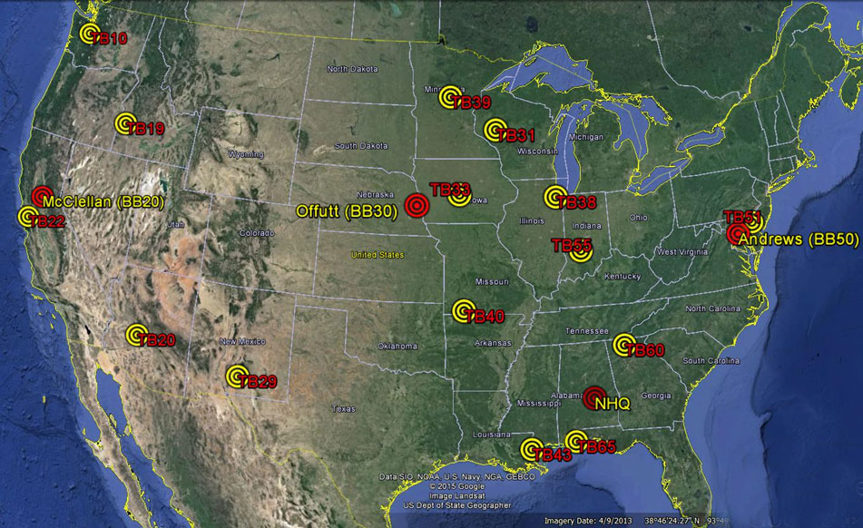
Triblade NCS Team

Slide 8

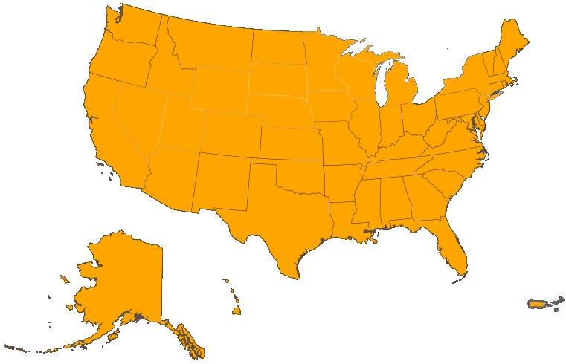

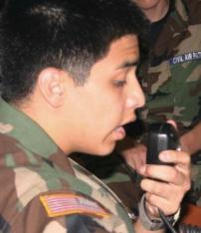
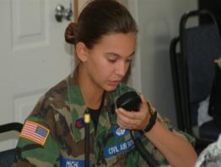
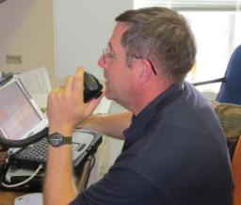
Triblade Net
All wings participating
Average daily # 140+

Slide 9
Triblade Net
CW15 - 170 formal messages, 100% accuracy, average 3 hours
CAP relayed a urgent test message between two USAF bases in < 4 minutes
In an actual mission with traffic to and from a single ICP, traffic could move almost as quickly as email

Slide 10
Triblade Net
US Northern Command / NORAD
1st AF / AFNORTH

Slide 11
The Future

Slide 12
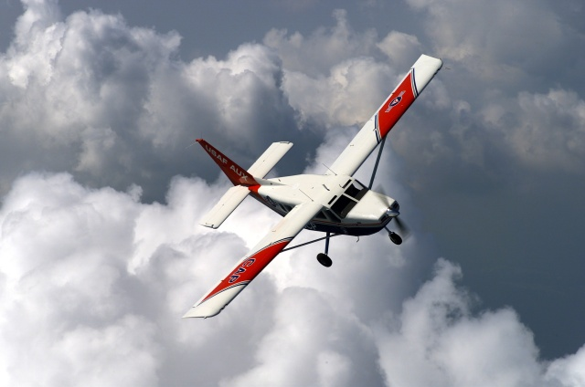
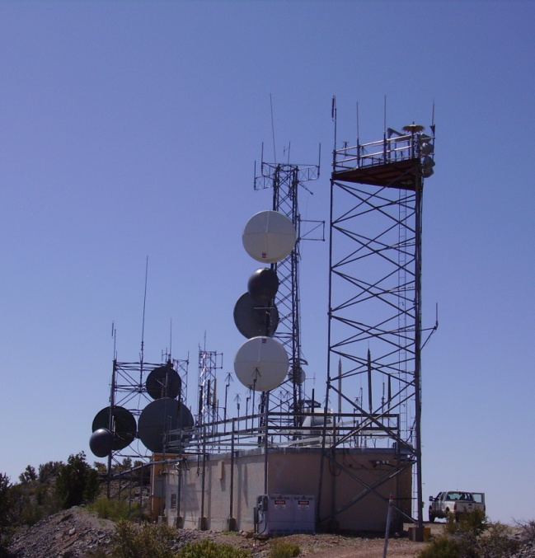
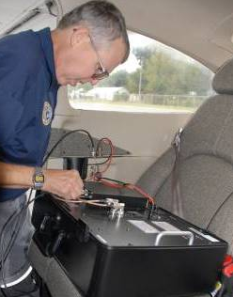
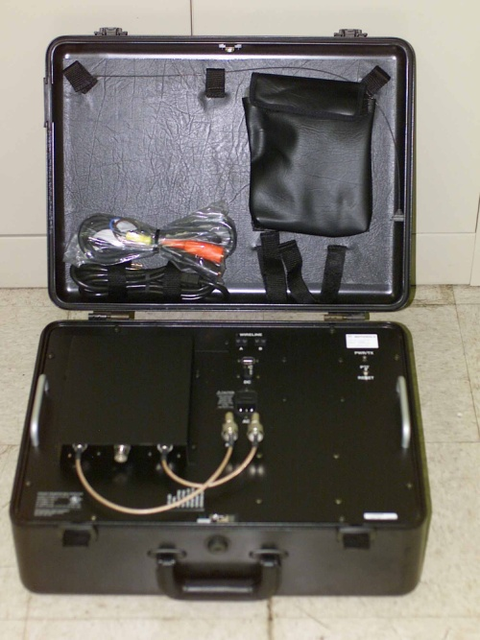
Ops – Comm Integration
One team
Comm-centric Ops Taskings
Comm exercises in WMIRS

Slide 13
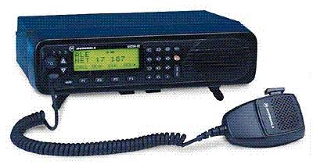
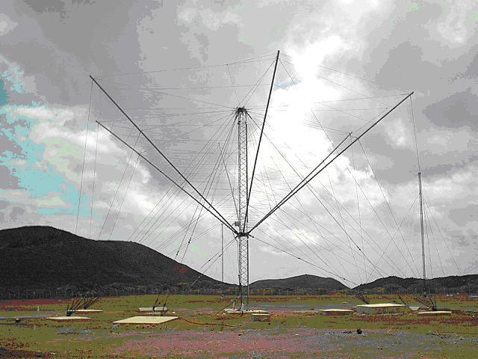
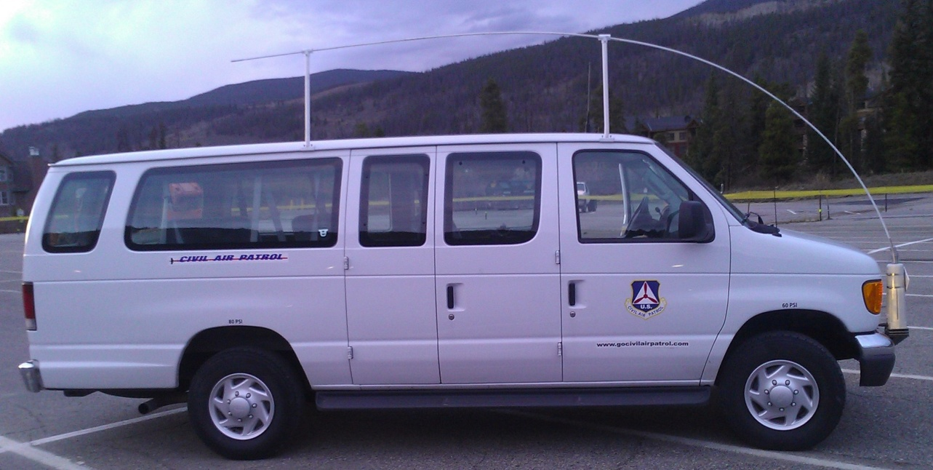
HF Expansion
Wing planning for survivable C2
Improved expertise in use of HF
Expanded HF infrastructure
Expanded HF mobile fleet

Slide 14
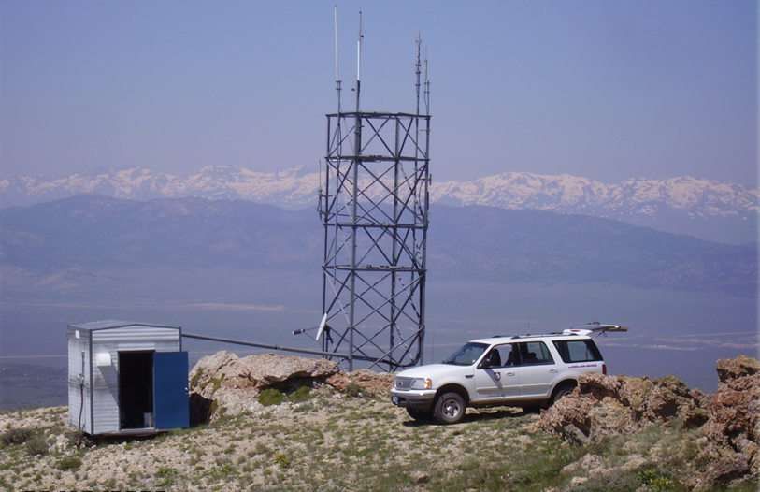
The Future
Distributed comm maintenance
Repeater remote access (via IP and/or HF)
HF email

Slide 15
DOK Staff

Slide 16
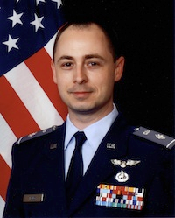
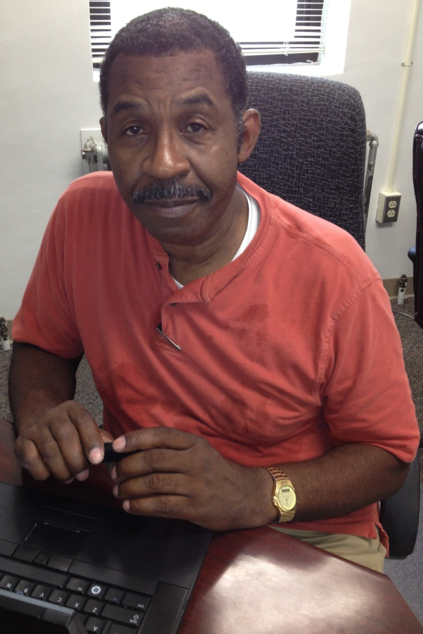
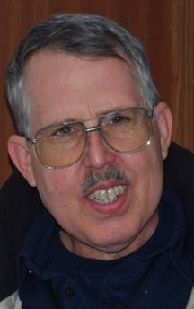
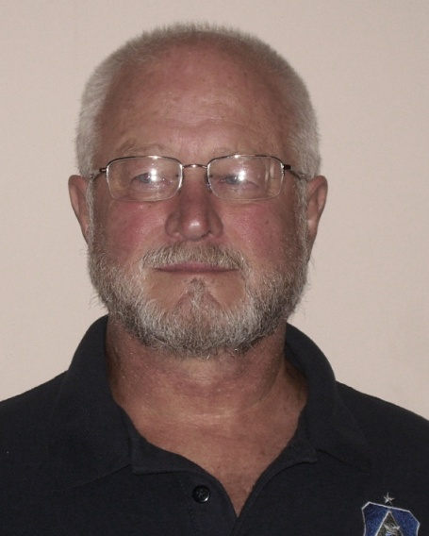
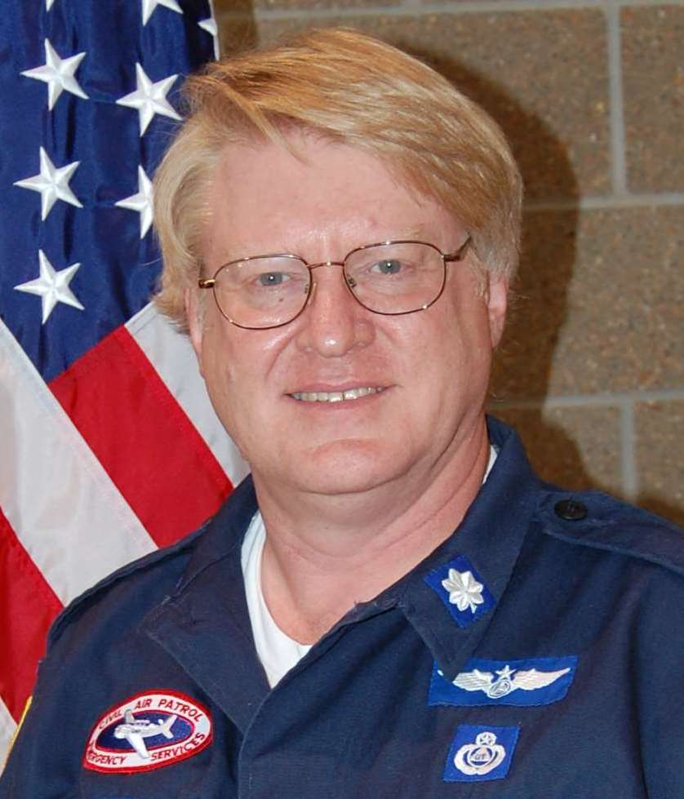
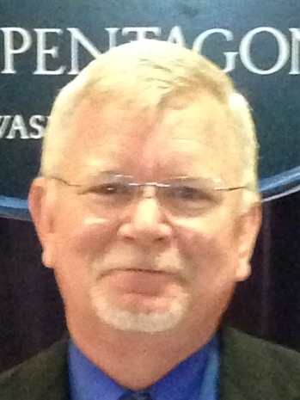
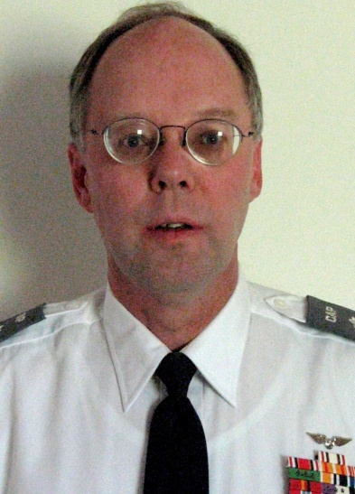
DOK Staff

Slide 17
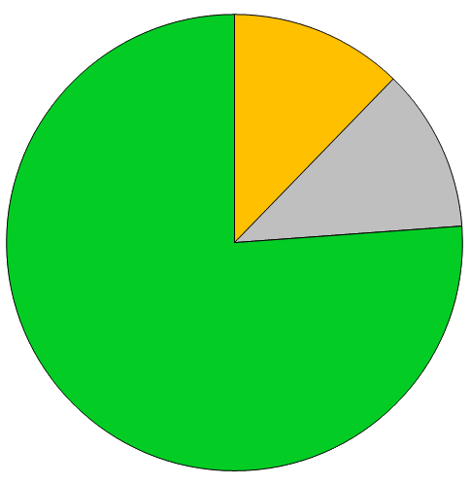
17,000+ Trained Operators
2,100 Comm Specialists
(Tech, Senior, Master ratings)
2,000 working on first advanced rating
13,000 Radio Operators

Slide 18
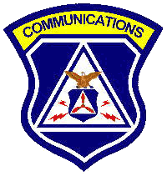
Brand Promise
CAP Communications provides
survivable C² and tactical communications using
high-quality equipment,
trained operators, and
sophisticated network design,
to ensure mission accomplishment for
internal and external customers,
even when commercial
communications and power systems fail

Slide 19
Questions?
Malcolm Kyser
Chief of Communications
National Headquarters
mkyser@capnhq.gov
dok@capnhq.gov
888-211-1812 x 350

Slide 20

Happy Anniversary Year CAP!!!

