Slide 1
Empowering Today’s Cadets
Curt LaFond

Slide 2
KEY QUESTION
How do we increase our capacity
to empower cadets?
Standby for a new model for empowering cadets
to lead changes in their squadrons.

Slide 3
“Major Jones, can we schedule a bivouac?”

Slide 4
“Major Jones, can we schedule a bivouac?”
“Sure. Good luck.”
“Nah. Wing doesn’t like that.”
But here’s my plan
Wrong format
Incomplete, vague
Untenable direction
Too much, too fast
“Maybe someday.”
Step aside, cadet, I’ll take over

Slide 5
“But here’s my plan . . .”
“Way too vague.”
“Too much, too fast.”
“Wrong format.”
Step aside, cadet, I’ll take over

Slide 6
“Here we are, beautiful day!”
“Step aside, cadet, I’ve got this.”

Slide 7
“Time to go home now . . .”
“Did you learn anything?”
“I don’t know.”

Slide 8
The previous hypotheticals represent missed opportunities. While many squadrons know how to deliver high-quality leadership opportunities, we have to admit that it’s conceivable for cadets to experience those roadblocks in units that are just starting-up or rebuilding.

Slide 9
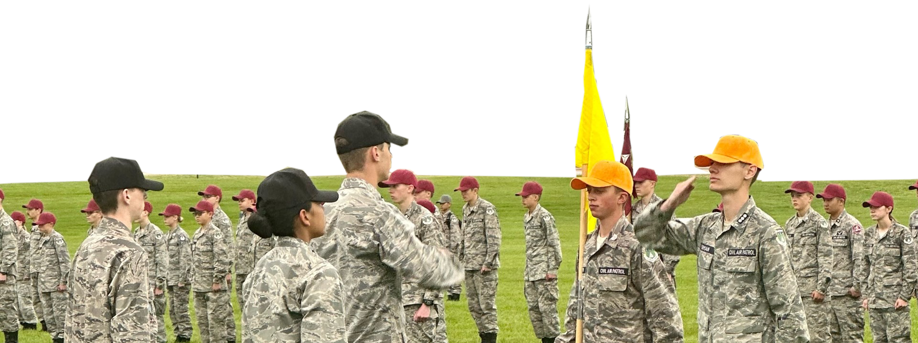
Is the Cadet Program cadet run?

Slide 10
In response to stories like our bivouac example, people often respond, “The cadet program should be cadet run.” Perhaps that statement is less of a claim and more of an expression of frustration.
Regardless, “Is the cadet program cadet run” a red herring that diverts us from the real issues.

Slide 11
Cadet Run
Cadets have total authority
Adults serve as chaperones and safety monitors
Program quality tends to be uneven because of the cadets’ experience
Cadets are abandoned to the limits of their own adolescent wisdom
Adult Run
Like teachers in school, adults have total authority
Program quality might be high due to adult experience
Leadership development is weak
For lack of engagement in CAP’s voluntary environment, cadets might “vote with their feet”
This pairing is a false dichotomy!

Slide 12
CAPP 60-18
GoCivilAirPatrol.com/Library
FIVE KEY TERMS TODAY
Positive Youth Development (PYD)
Youth Voice
Free Choice Learning
Authentic Decision-Making
Youth – Adult Partnership
NEW
RESOURCE
If we can increase understanding of these terms, we’ll begin to realize that cadets can indeed have a high sense of ownership in their program and that adults serve cadets as mentors. This shift in vocabulary can steer the cadet community away from the old false dichotomy of “cadet run or not?”

Slide 14
Interpretation
Cadets want to be “empowered” in the sense of PYD-style ownership of their program.
Our highest-performing adults know how to mentor via PYD, youth voice, free choice learning, and authentic decision making, thereby creating a real youth – adult partnership.
When it comes to our rank-and-file adults – people who might be new or perhaps interact with cadets only in a limited way – that’s where we see missed opportunities.

Slide 15
KEY QUESTION
How do we increase our capacity
to empower cadets?

Slide 16
CAUSAL DIAGRAM
”See the system”
Entries are representative of system factors but are not exhaustive.
CAUSE
EFFECT

Slide 17
FISHBONES or CAUSAL DIAGRAMS
This “fishbone” or causal diagram is not all-encompassing, the final word about the system within which cadet leadership occurs. However, most highly-experienced CP officers are likely to agree it’s at least a fair summary of that system.
One lesson of systems thinking is that we usually cannot identify just one component, fix it, and solve our problems. There’s no silver bullet.
Rather, we need to see the system, struggle to identify the centers of gravity, the places where we think an intervention is worth trying.

Slide 18
DESIGNING THE INTERVENTION
GOAL: INCREASE ”EMPOWERMENT” AMONG WEAKEST SQUADRONS
OBJECTIVES:
Focus on Fundamentals: Show cadets a simple path to leading change
Add Peer Support: Pair cadets up vs. the “sole command” model
Mitigate COVID: no role models from “last year’s” cadre
Embed scaffolding and fading into the process
Provide single set of info to cadets & adults

Slide 19
SIMPLE MODEL FOR CADET CHANGE INITIATIVES
PROPOSE
PLAN
DO
REFLECT
1
4
2
3

Slide 21
HOW YOU CAN HELP
Attacking the right parts of the system?
If Lead2Change attempts stumble, how, why?
How do we roll it out? (National)
How do you roll it out? (Local)
Will the new Glossary help some CP Officers?
Success: Measure against first survey respondents

Slide 22
Can’t happen, won’t happen, here’s why
Youth voice
Free choice learning
I want to host a bivouac.
Slow roll
Go for it, but cadet left to own, falters
Denied for reasons that aren’t showstoppers
Here’s my plan
It’s incomplete or vague
It’s going in an untennable direction
Too much, too fast
Senior: step aside, I’ll take over
We did it, but learned nothing
Authentic decision-making
Youth – adult partnerships
Scaffolds & fading
Reflective practice

