Slide 1
Notes for Senior Staff & Cadet Cadre
This deck is an optional resource for implementing the “emphasis items” I requested in my memo (via CAP/CP) of 8 July 2022.
Feel free to use this deck as-is or adjust it to match your location’s needs.
The “Basic Expectations of Cadets” portion should be covered briefly with the full cadet corps during the Honor Agreement session (Lesson C1). Even more, at the end of the first day, when cadets are in their flights, please take 10 minutes to discuss that list in that small group setting.
Have cadets read the items aloud one at a time and then pause to ask if anyone in the group can elaborate on that point.
What’s that expectation really mean in your own words? Discuss.
Why’s that an expectation? Discuss.
Ever seen something like that behavior happen at some other event in your life? Discuss.
What else is the list missing that our flight feels is important and wants to add?
Semper Vigilans!
EDWARD PHELKA
Major General, CAP
National Commander

Slide 2
HONOR AGREEMENT
LESSON C1
2022 SUMMER ENCAMPMENTS
DISCIPLINARY ENHANCEMENT

Slide 3
Overview
Basic Expectations of Cadets
Honor Agreement
Wingman Program
Access to Senior Staff

Slide 4
Basic Expectations of Cadets
Positive Behavior | Negative Behavior
1. Treat everyone with common courtesy and respect. | 1. Don’t use profanity, racial slurs, or disrespectful language.
2. Be honest and take responsibility for your actions. | 2. Don’t get into fights. Don’t bully, threaten, or haze anyone.
3. Wear your uniform properly. | 3. Don’t take property that is not yours. Don’t break or mishandle equipment lent to you.
4. Obey your officers and follow local rules at cadet events (e.g., off-limits areas, wingman rules, phone use, lights out, etc.). | 4. Don’t touch someone inappropriately. Don’t kiss, hug, or hold hands at CAP activities.
5. Use the chain of command if you have questions, concerns, or ideas to share (with exceptions for #6 below). | 5. Don’t bring tobacco, vapes, alcohol, marijuana (or derivatives) or illegal drugs to CAP activities.
6. Go to any adult leader (Senior) you trust, regardless of the normal chain of command if you need to report bullying, abuse, or violence, or to discuss sensitive topics. | 6. Don’t share, request, or post sexually suggestive text messages or images.
7. Use the Air Force command, “KNOCK IT OFF” at any time to have everyone stop what they are doing if you think someone could soon get hurt. | 7. Don’t bring firearms, air guns, paint guns, or any weapons to CAP (small knives may be allowed in the field).

Slide 5
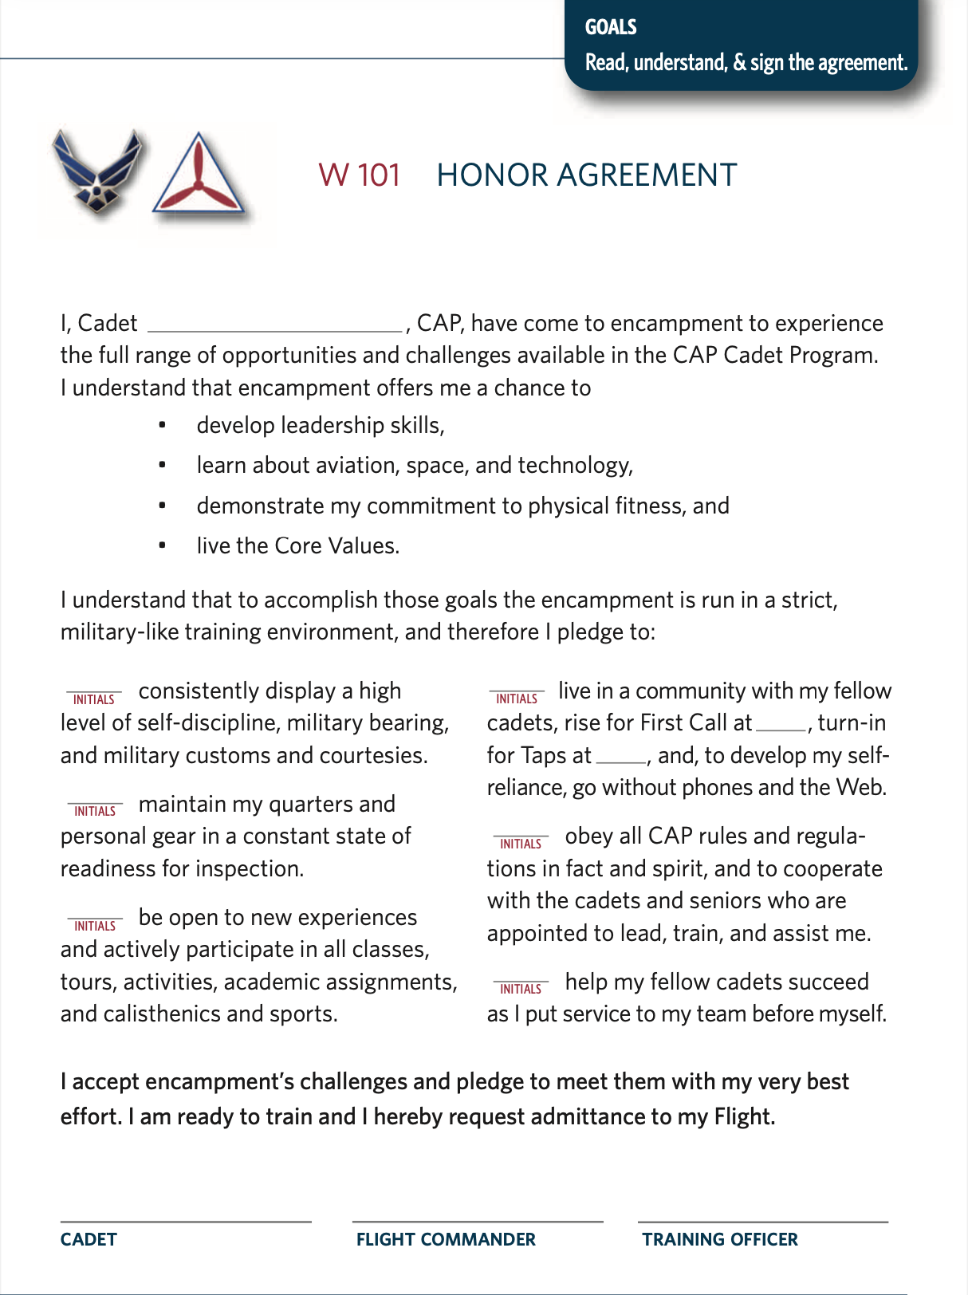
Honor Agreement
See page 7

Slide 7
Wingman Concept
See page 56

Slide 8
Access to Senior Staff
Know that the training officer is the adult leader available to you if you’re struggling with something that you don’t want to discuss with another cadet. You can see your training officer any time that you need to, and if your encampment has a chaplain on staff, you can see that person any time, too.
Bottom line: if you need to speak with an adult, you have that right any time.
See page 3

