Slide 1
WATER SAFETY

Slide 2
Nothing like a relaxing beach trip on a hot day

Slide 3
We Want It to be SAFE!

Slide 4
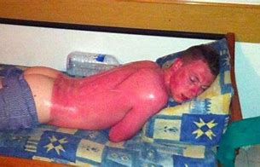
Remember the Sunscreen

Slide 5
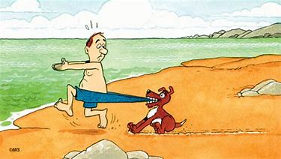
Don’t Swim Alone

Slide 6
Have a Swim Buddy

Slide 7
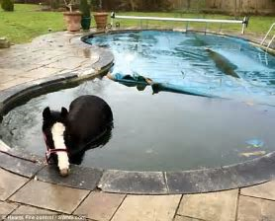
No Horseplay Around the Water

Slide 8
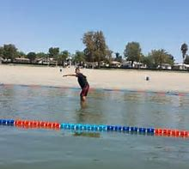
Swim in Designated Areas

Slide 9
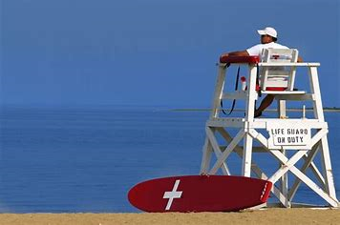
Swim Where a Lifeguard is On Duty

Slide 10
It’s Safer!

Slide 11
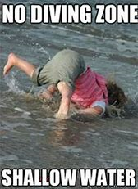

Slide 12
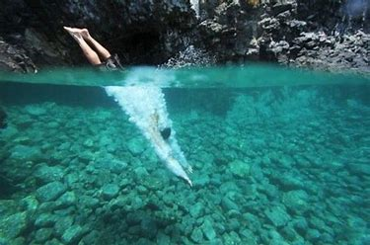
If you don’t KNOW, jump in feet first

Slide 13
Remember

Slide 14
Not for flotation

Slide 15
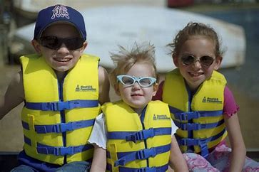
Non-swimmers

Slide 16
Remove Pool Toys

Slide 17
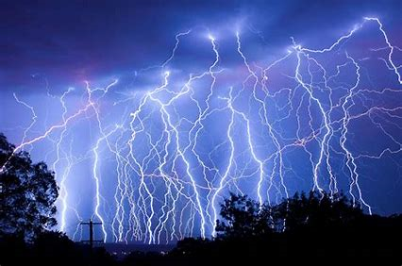
Time to go to the house……….

Slide 18
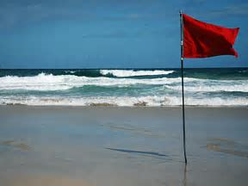
Respect High Surf Warnings

Slide 19
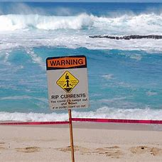
Rip Currents are an Ocean Hazard

Slide 20
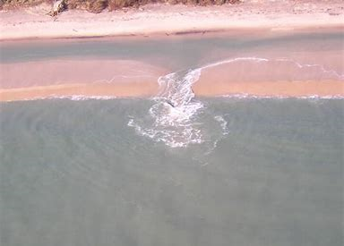

Slide 21
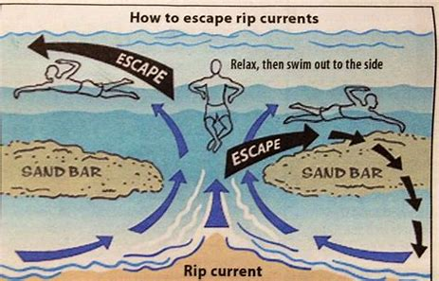

Slide 22
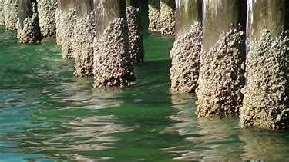
Be Careful Around Pilings and Piers

Slide 23
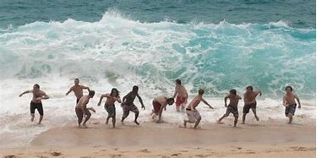
Don’t turn your back on the ocean

