Slide 1
CAPS 73-series Operations Procedures

Slide 2
Sources of Change
Aircrew Professionalism Cross-Functional Team
Glider Program Cross-Functional Team
CAP-USAF AFAM Status Requirements
CAP Publications Proof-of-Concept
Comments and recommendations from the field

Slide 3
Publications Architecture
CAPR 70-1
CAPS 71-series Training
CAPS 72-series Standards
CAPS 73-series Procedures
CAPS 73-series
73-1 Operations Procedures, Airplane
73-2 Operations Procedures, Glider
73-3 Operations Procedures, Balloon
CAP Publications Proof-of-Concept

Slide 4
Why Operations Procedures?
Explicit
Above the water (20%)
Tacit
Below the water (80%)
Belongs to everyone
Person-to-person
Not persistent
Cannot be socialized
Not subject to review
Compatibility, interoperability, safety, repeatability & quality
Make knowledge explicit for review/use by all (IMPROVE)
The “CAP way” for training
Alternative path for risk mitigation, in lieu of
Additional regulations
Additional checklist steps
Additional training requirements

Slide 5
Philosophy
A default CAP standard
Not a substitute for sound judgment or common sense
Deviations are authorized when necessary
Deviation pre-briefed or communicated (time critical)
AS ALWAYS, the pilot in command (PIC) has the ultimate responsibility for the safe operation of the aircraft.
If you have a better standard, let us know: dov@capnhq.gov

Slide 6
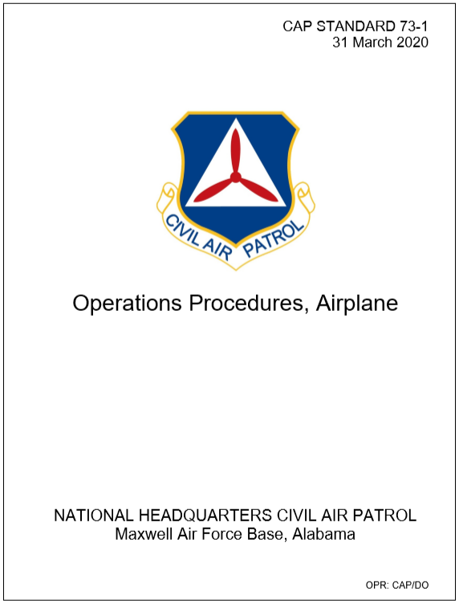
Core Procedures
Mission Planning and Briefing
Briefing and debriefing
Pre-flight risk assessment
Mission Execution
Preflight – role of the AIF
Sterile cockpit
Transfer of aircraft controls
Use of checklists and callouts
Post-flight and debrief
Brief/Post-flight Checklists

Slide 7
Category-specific Items
Airplane
Glider
Calculation of TOLD and W&B
Operations under Basic Med
Departure and arrival briefings
Automatic Flight Control System
Coupled Go-Arounds
Go-Around Decision Making
Short-field procedures
Program Risk Management
Required risk controls
Staffing
Daily risk assessment & awareness
Non-participants
Initial solo-flight
Risk Control Implementation

Slide 8
Questions & Answers
Please go to –
gocivilairpatrol.com > Programs > Emergency Services > Aircraft Operations > Change Communications

