Slide 1
Civil Air Patrol Safety Reporting a Safety Significant Occurrence
Notes:
Welcome to Civil Air Patrol Safety’s “Reporting a Safety Significant Occurrence” course.. This presentation will take you through the basics of initial notification and reporting of a safety significant occurrence (or SSO) and entering information into the CAP Safety Information System (or CAPSIS). This presentation follows the CAPSIS Safety Reporting Guide which can be found on the CAPSafety website in the CAPSIS section at www.gocivilairpatrol.com. If you accessed this presentation from the CAPSIS webpage, you must take the course in AXIS LMS to receive credit.

Slide 2
Objectives
Introduce the terms associated with safety reporting
Member responsibilities in safety reporting
Review the information that reporting members can provide
Notes:
The objectives for this course include:
Introducing the terms associated with safety reporting
Covering member responsibilities in the reporting process
And, reviewing the information that reporting members can provide in CAPSIS

Slide 3
Using the Learning
Know what to report
Follow the reporting process
Enter reporting information
Notes:
Here’s how you should be able to use the learning from this course. You should:
Become knowledgeable about what to report so the right information is reported, and the right people are involved
Become familiar with the reporting process and how to follow that process
Be able to enter important information into CAPSIS
Let’s start by looking briefly at why reporting is an important part of CAP’s safety management system and how it supports our ideal safety culture.

Slide 4
The Importance of Safety Reporting
Vital to ideal safety culture
Supports CAP’s readiness, reliability, and credibility
Awareness of what should be reported
Members and equipment are available and ready
Encouraged to report issues
Reporting immediately helps resolve safety issues more quickly
Positive tendency to report
Add or improve safeguards
Notes:
First, safety reporting is vital to our ideal safety culture. The specific characteristics of an ideal reporting culture in CAP, looks like the following:
Members are aware of safety issues that should be reported
Members are encouraged to report safety issues
Members have a positive tendency to report safety issues
When our reporting culture is healthy…
We ensure we are ready because safety issues get identified early to ensure that members and equipment are available and ready for the mission or activity
We ensure we are reliable because reporting safety concerns as soon as they are observed helps us ensure we can complete the mission or activity by keeping safety top of mind throughout
We ensure we are credible because safety issues are reported, and we use the data to add or improve safeguards that prevent injury, illness, or damage

Slide 5
IMPORTANT!!!
How members are treated when they self-report an occurrence will determine their tendency to do so in the future!!!
Notes:
Members reporting an SSO should never be treated punitively. Doing so damages our ideal reporting culture by discouraging them to report in the future. Always thank members for self-reporting and for supporting CAP and our safety program.
Members reporting SSOs are a critical link in protecting themselves, their fellow members, and the resources we need to be ready, reliable, and credible to serve America’s communities, save lives, and shape futures. Safety reporting is the first step to ensuring we learn how to do those things better every day.
Now, let’s cover some of the terms and definitions you will encounter in safety reporting.

Slide 6
Terms
Safety Significant Occurrence (SSO)
Notes:
Safety Significant Occurrence. Any observed outcome that resulted in or could have resulted in damage to equipment or a facility, injury to a member, and/or a member illness.

Slide 7
Terms
Safety Significant Occurrence (SSO)
Damage
Notes:
Damage. Any physical harm, breakage, marring, or any unintended change to a vehicle, aircraft, facility, or any other piece of real or personal property. This includes any damage to CAP property, regardless of the cause, or damage to private property that may occur during a CAP activity or mission.

Slide 8
Terms
Safety Significant Occurrence (SSO)
Damage
Injury
Notes:
Injury. Evidence of internal or external physical trauma or damage to the body and/or evidence of an aggravated pre-existing injury in the context of a CAP activity or mission.

Slide 9
Terms
Safety Significant Occurrence (SSO)
Damage
Injury
Illness
Notes:
Illness. Evidence of disease or sickness affecting the body or mind and/or evidence of an aggravated pre-existing illness occurring in the context of a CAP activity or mission.

Slide 10
Terms
Safety Significant Occurrence (SSO)
Damage
Injury
Illness
Near Miss
Notes:
Near Miss. An SSO that did not, but could have resulted in damage to equipment, injury to a member, and/or a member illness.

Slide 11
Terms
Reportable Accident or Incident
Notes:
And lastly, Reportable Accident or Incident. 49 CFR Part 830 defines requirements for immediate and later reporting of aircraft accidents and incidents to the National Transportation Safety Board (or NTSB) .14 CFR Part 107.9 defines the requirements for reporting small unmanned aircraft (or sUAS) accidents to the Federal Aviation Administration (or FAA). Refer to these regulations for the most current and up to date requirements. All reportable accidents or incidents must be reported the National Operations Center per CAPR 160-2.
Let’s move on to Member responsibilities in the safety reporting process.

Slide 12
Member Responsibilities
Damage to a vehicle (car, truck, van, trailer)
Damage to a facility (CAP owned or other owned)
Member illness or injury (occurring or aggravated)
Any near miss (potential damage, injury, illness)
Participate in safety reporting
Damage to an aircraft (airplane, glider, sUAS, balloon)
Notes:
CAP’s Safety Management System depends on member’s being encouraged to follow and following the regulations and processes for reporting safety significant occurrences.
Here are the basic things that must be reported when they occur in the context of a CAP activity, mission, or other event. Keep in mind that these SSOs must be reported, even if the source of the damage, injury, or illness is not known:
First, report all damage to aircraft, excluding minor damage from bird strikes or wildlife strikes
Report all damage to vehicles, except normal wear and tear,
Report all damage to facilities that CAP uses for our missions, activities, and other events, or is impacted by them, whether or not we own that facility.
Report all injuries, regardless of their severity and any illness that manifested or was aggravated by a CAP mission, activity, or other event.
Finally, report any near miss per the definition covered earlier. You can find additional information about near miss reporting requirements in CAPR 160-2.

Slide 13
Initial Reporting Requirements Members
Report SSOs you are involved in or witnessed to the activity director, encampment commander, or incident commander
In the absence of the above, report SSOs to your unit/wing commander
Notes:
Before any reporting in CAPSIS, members must report SSOs they were involved in, witnessed, or discovered to an activity director, encampment commander, or incident commander, as applicable. In the absence of these, members must report the SSO to their unit commander or wing commander, if the unit commander cannot be reached.

Slide 14
Collect and provide this information to commanders and the NOC
Date/Approximate Local Time and Time Zone in which the event occurred.
Who
List of CAP members and CAPIDs involved in the mishap, including persons affected, witnesses, pilot, and all individuals onboard an aircraft, or driver and all passengers in a vehicle.
When
What
What equipment, if any, was involved, including vehicle ID, aircraft tail number, and which wing is responsible for the equipment?
Why
Confirm whether operation was a CAP Air Force Assigned Mission or Corporate Mission (Mission number and/or mission symbol), if applicable. Also, provide the specific name of the CSA, NCSA, NFA, or Encampment
Where
Where did the mishap occur? Airport identifier or cardinal direction and distance from nearest airport, intersection/highway and town/city.
How
A quick narrative in sentence format of what happened. Please include any known damage or injuries, if applicable.
Notes:
When initially reporting a possible death, serious injury or illness, or reportable accident or incident, follow this list of guidelines:
Who was involved?
What equipment was involved?
Where did it happen?
When did it happen?
Why was it happening?
How did it happen?

Slide 15
And…
Media
Local or national media attention (if known)
Mission
A brief synopsis of any significant mission impact to the CAP Region/Wing or operational mission
Notes:
And…
Any media attention?
Or Any mission impact?

Slide 16
Initial Reporting Requirements Activity Directors, Encampment Commanders, & Incident Commanders
Notify emergency contact (per CAPF 161)
Notify member’s unit/wing commander
Ensure activity or mission safety officers are notified so they can make entries into CAPSIS
16
Notes:
Once a member reports an SSO, activity directors, encampment commanders, or incident commanders, as applicable, must ensure member emergency contacts are notified per CAPF 161 and then notify each member’s involved unit commander or wing commander, if the unit commander cannot be reached. Be sure to bring the activity or mission safety officer into the process to begin the process of making entries into CAPSIS.

Slide 17
Initial Reporting Requirements Unit, Wing, and Region Commanders
Follow Region Supplement to CAPR 160-2 to ensure wing and region commanders and directors of safety receive initial notification of SSO
Request the information collected (who, what, when, where, why, how, media, mission)
Ensure safety officers make initial entry in CAPSIS
17
Notes:
Regions are required to submit and receive approval for a supplement to CAPR 160-2 that outlines the means and members (by role) who must be notified of an SSO. Be sure to provide them with the information collected earlier (the who, what, when, where, why, how, media, and mission impacts). This ensures that commanders are not caught off guard and can perform their required actions. Safety officers can then make initial entries into CAPSIS or assist the reporting member in the CAPSIS entry process.

Slide 18
National Operations Center (888)-211-1812
All SSOs involving death, serious injury/illness, or a reportable accident or incident must be reported to the NOC by the region commander
18
Notes:
In instances where SSOs result in death, serious injury or illness, or a reportable accident or incident, the region commander must notify CAP’s National Operations Center (or NOC) at the number on this slide. The NOC then provides additional notifications to NHQ personnel who may have other responsibilities for notifications or interacting with government agencies or the media.

Slide 19
CAP Chief of Safety (CAP/SE) reports accident and incidents
Members must cooperate with NTSB, FAA, etc.
Provide CAP/SE contact info to NTSB, FAA, other agents
Notes:
In accordance with CAPR 160-2, if an SSO involves a possible reportable accident or incident, CAP/SE, or their designee, has sole responsibility for reporting CAP aircraft accidents and incidents to the NTSB, FAA, or other government entity, as applicable.
Members involved in an SSO while participating in a CAP mission or activity must not self-report any accident or incident to a government entity without coordinating with CAP/SE.
Members should fully cooperate with NTSB and FAA representatives if they are contacted and must provide those representatives with contact information for CAP/SE as the official CAP point of contact.
CAP members must not speak to the media on behalf of CAP or speculate as to the nature or cause of an accident or incident and must refer all media inquiries to CAP/SE or CAP Marketing and Communications

Slide 20
CAPSIS Reporting
As soon as possible after initial reporting but within 48 hours of the SSO
Notes:
After required initial notifications are made, it’s now time to enter the occurrence into CAPSIS. This entry should be made and submitted as quickly as possible but not more 48 hours after the SSO or from the date and time the SSO was discovered.

Slide 21
Who should enter an SSO in CAPSIS?
Safety Officers
Notes:
While any member can enter an occurrence in CAPSIS, safety officers, including activity safety officers, mission safety officers, unit and wing safety officers should ideally make the initial entry. Doing so ensures that the entry is made in a timely manner and contains all relevant information that will support the safety review process. Here’s a good rule of thumb…before entering any information in CAPSIS, reach out to your safety officer.
Let’s now cover the steps for entering an occurrence in CAPSIS.

Slide 22
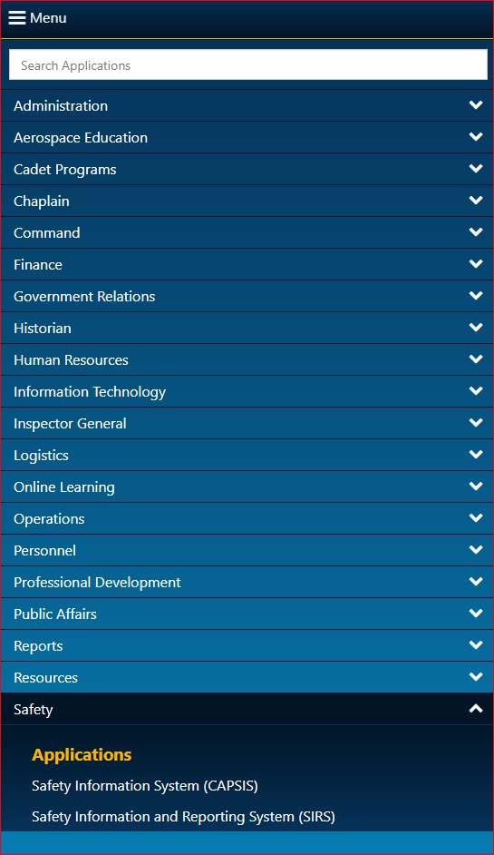
Where can I get access to CAPSIS?
Notes:
The CAPSIS application can be accessed from the eServices menu at the bottom under “Safety”. Don’t forget to save CAPSIS as a favorite so you can access it from the eServices homepage.

Slide 23
What should be entered?
Notes:
What should be entered?
Any observed or potential safety hazard should be entered. The Safety Reporting Process in CAPSIS will lead you through the following steps for what information to provide for initial reporting. Fill in as many of the fields as possible which will help the assigned review officer finalize the initial report.
The General tab contains the SSO account, date/time, and location fields. This section also asks the question, “Was this a near miss?” if there was no actual damage, injury, or illness involved but where something was observed that could have resulted in a negative safety outcome.

Slide 24
Notes:
If you are using this report to meet Specialty Track requirements or for training purposes, select the “This entry is used for Specialty track or for Training” button. By selecting the referenced button, the system will not count this as an official report and can be deleted by the safety officer once completed.

Slide 25
Notes:
The Account field is a free-text field that briefly describes What happened? Keep this brief and do not include proper names or other identifying information about an individual.

Slide 26
Notes:
Next, select the Date and local time of the SSO. In some cases, a reporting member may observe an outcome such as damage to a vehicle or an aircraft but not be able to determine the date it occurred. In this instance, select the UNKNOWN box.

Slide 27
Notes:
The Location field is where you can input the state, city, and/or airport. Once a state is selected, you may begin typing the city or three-letter airport code and a list of options will be available for selection. For similar reasons as previously noted in the date/time field, if the location is not known, UNKNOWN may be selected.

Slide 28
IMPORTANT!!!!!!
Notes:
REMEMBER this Important Tip: After entering all known information in the General tab, be sure to click “Save SSO” before moving to the Activity tab.

Slide 29
Notes:
Next, let’s cover the fields in the Activity tab.
These fields include the Activity type – which may also lead to additional drop-down or text entry fields – and the responsible wing and unit. Note that the region information is also included in all wing/unit selections.

Slide 30
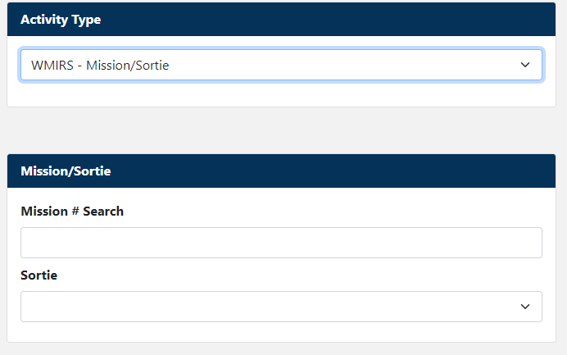
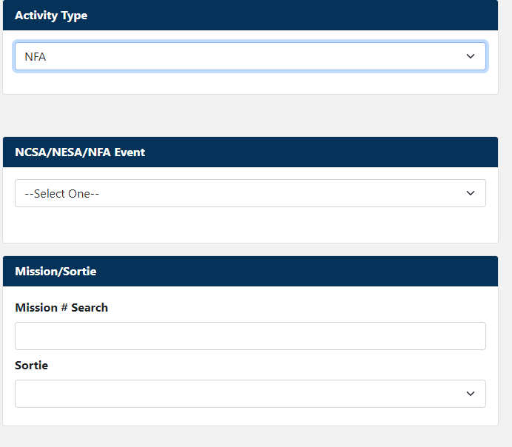
Notes:
When selecting an activity in which the SSO occurred, the system may ask for additional information in the form of selectable options or text entries. Depending on which activity is selected, you may also select an associated sub-activity – such as sports or physical fitness. Only use the OTHER option if the activity of sub-activity is not listed. Other fields may auto fill based on selections from this list.

Slide 31
Notes:
The responsible wing/unit may auto-fill based on previous selections. If this field is auto filled, verify it is accurate. If not, select the wing/unit that had responsibility for the activity. Note that NHQ and REGION options will also be available in this field.

Slide 32
IMPORTANT!!!!!!!
Notes:
REMEMBER this Important Tip: After entering all known information in the Activity tab, be sure to click “Save SSO” before moving on to the Individuals tab.

Slide 33
Notes:
Let’s now cover the fields under the Individuals tab. This is where you enter the CAP IDs or names of individuals involved in an SSO or of those who can provide relevant witness information about it.

Slide 34
Notes:
In the Individual field, enter the CAP ID of the individuals involved in or witnessing the SSO, add them to the report, and answer the injury and illness questions for each. If the individual was a non-member, select “No” to the CAP member question and enter the individual’s name. Contact information for non-members should be placed in the attachments tab which we will describe later. The information added in this section is auto-saved.

Slide 35
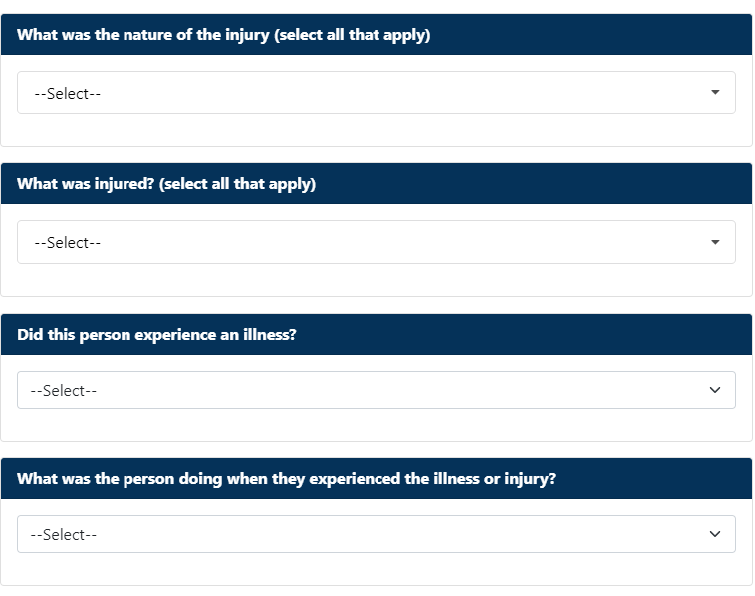
Notes:
Once you have added an individual, the system will ask you a series of questions.
For Injury or Illnesses. If the individual was injured or became ill, select “Yes”, and select additional information about the injury or illness, if known.
If you select “Yes”, you must select a severity option from the next dropdown. The option labeled “No medical treatment or first aid only” may be selected if the individual didn’t receive any treatment or only received first aid.
Before going on, select an answer to the question, “What was the person doing when they experienced the illness or injury?”

Slide 36
Notes:
Answering “Yes” to the injury or illness questions about an individual will automatically trigger an email notification to CAP members for entering a statement about the SSO. If the individual was neither injured nor became ill and was not directly involved in the SSO (such as a driver, pilot, instructor pilot, etc.), you can select “Yes” to the witness question. If the individual is a CAP member, they will receive an email notification for entering a witness statement. Remember, if a non-CAP member is involved in or witnessed an SSO, their contact information should be included in the attachments tab covered later.
The Follow Up field can be used to select any known updates about an individual who was injured or became ill. For example, if an individual was transported to a medical facility and later either received medical treatment or if the final result was first aid only in accordance with CAP regulation 160-2.
If “None” or “First Aid” is selected, the region commander or the region director of safety have the option to close the occurrence or to require a review.

Slide 37
Notes:
Once you have answered the relevant questions about an individual, they will be listed in the “Individuals involved in an SSO” field which will also depict some additional symbols that pertain to them. In this case, John Doe is depicted as having been injured. You can add as many individuals as you need to using the same process just described.

Slide 38
Notes:
The Resources tab contains information about damaged aircraft, vehicles, equipment, or facilities, as applicable. If nothing was damaged, you may leave this information blank. You may list as many resources as you need to in this tab.

Slide 39
Notes:
In the resource field, you can select aircraft, vehicle, equipment, or facility. You will be asked a series of questions about the resource and individuals involved. The questions will vary depending on the resource selected. We cover the list of possible questions in the slides that follow.

Slide 40
Notes:
Note that not all of the following questions will be associated with each resource and the specific wording of the question may vary.
Who owns the resource? Is the resource CAP-owned, member-owned, or other-owned
Who was onboard? In this field, you will be able to select from the individuals listed previously and select the role they were serving in at the time. If you need to go back and add an individual, you may do so and then return to this tab to associated them with the resource.
What specific resource was involved? Based on the selected resource type, you can select from a list of information about the resource. If this field is auto filled, verify it is accurate.
When did the damage occur? This question may include the phase of flight or the driving situation during which the damage occurred.
What was damaged? You can select from a list of components that were damaged in the SSO.
Registration. Select or enter the registration, if known. If this field is auto filled, verify it is accurate.
Type. This field is specific to aircraft and should be auto filled based on previously entered information. Verify it is accurate.

Slide 41
Notes:
Lastly, we briefly cover the Attachments tab. Here, you can upload any records, documents, or pictures associated with the SSO. Don’t forget to include any non-member contact information in this tab.

Slide 42
Thank you!
Notes:
This concludes the “Reporting a Safety Significant Occurrence” course. You may now close this presentation. Be sure to take the knowledge check quiz.

